Slide 2
LEUKOCORIA

Slide 3
DIFFERENTIAL DIAGNOSIS

Slide 4
LEUKOCORIA
Congenital Cataract
Retinoblastoma
Retinopathy of Prematurity
Persistent Hyperplastic Primary Vitreous
Retrolental Fibroplasia
Toxocariasis
Toxoplasmosis
Incontinentia pigmenti
Retinal Detachment
Cytomegalovirus Retinitis

Slide 5
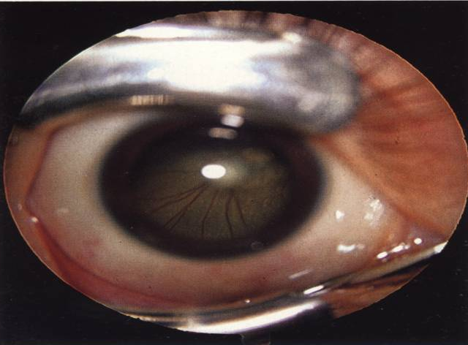
RETINAL DETACHMENT WITH A MITTENDORF SPOT

Slide 6
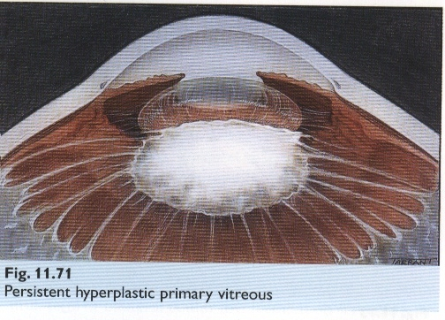
PERSISTENT HYPERPLASTIC PRIMARY VITREOUS

Slide 7
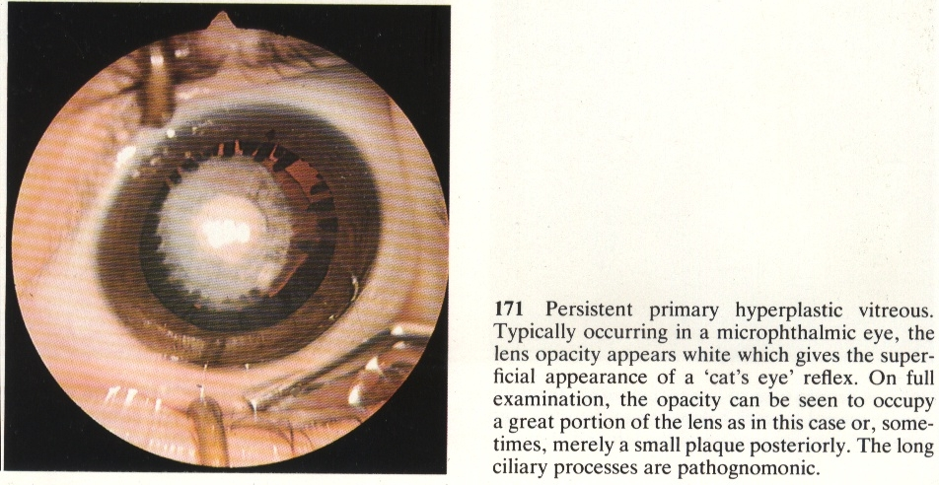
TOXOPLASMOSIS

Slide 8
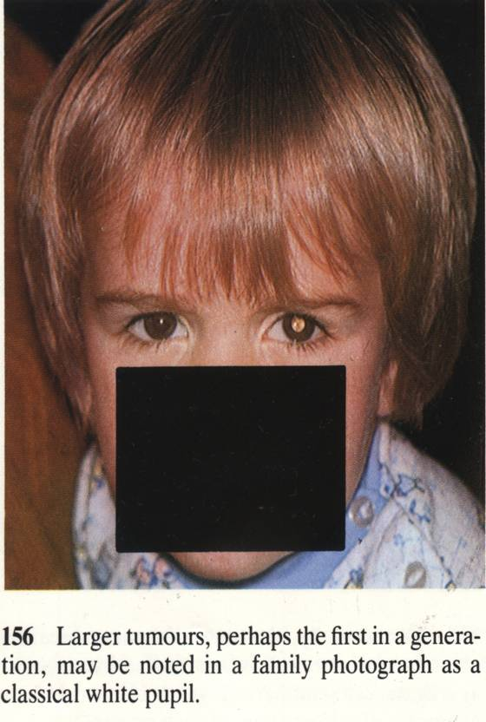
RETROLENTAL FIBROPLASIA

Slide 9
CONGENITAL CATARACT
An opacity in the crystalline lens, present at the time of birth or appears with in first three months of life

Slide 10
TYPES OF CATARACT
CONGENITAL 80-90%
TRAUMATIC 10-20%

Slide 11
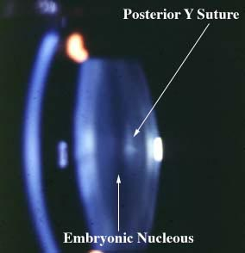
SURGICAL ANATOMY
9-10mm
4-5mm
Clear Healthy Young Crystalline Lens

Slide 12
INCIDENCE
Constitutes 20% of treatable blindness in the world
Occurs in 1 in 250 live births
Maybe unilateral or bilateral

Slide 13
AETIOLOGY
IDIOPATHIC 35%
HEREDITARY 25%
INTRA-UTERINE CAUSES 20%
    MATERNAL INFECTIONS
    MALNUTRITION
    PREMATURITY
    DRUG INDUCED

Slide 14
AETIOLOGY
INBORN ERRORS OF METABOLISM 10%
    GALACTOSEMIA
    MANNOSIDOSIS
    FABRY’S DISEASE
ASSOCIATED WITH OCULAR ANOMALIES 05%
    MICROPHTHALMIA
    ANIRIDIA
    COLOBOMA

Slide 15
AETIOLOGY
CHROMOSOMAL ABNORMALITIES 03%
    DOWN’S SYNDROME
    TURNER SYNDROME
    TRISOMY 13 & 18
BIRTH TRAUMA 02%

Slide 16
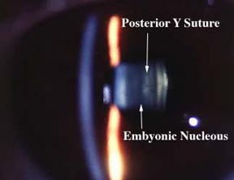
STRUCTURE OF AN INFANT LENS
Embryonic Nucleus
Foetal Nucleus
Infantile Nucleus
Cortex
Capsule

Slide 17
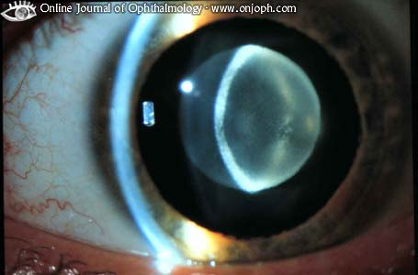
EMBRYONAL NUCLEAR CATARACT

Slide 18
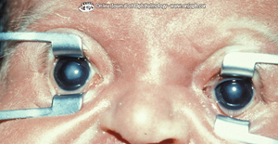
NUCLEAR CATARACT

Slide 19
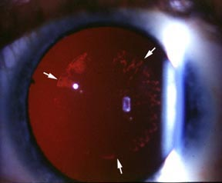
CORTICAL CATARACT

Slide 20
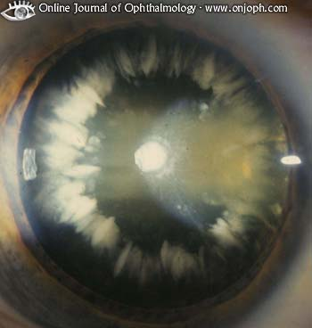
CORONARY CATARACT

Slide 21
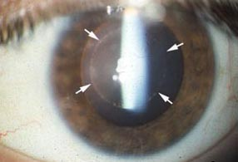
LAMELLAR (ZONULAR) CATARACT

Slide 22
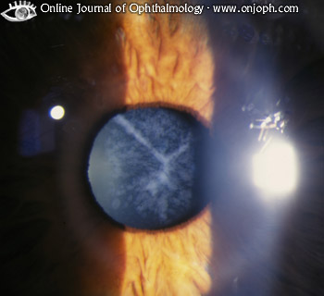
SUTURAL (STELLATE) CATARACT

Slide 23
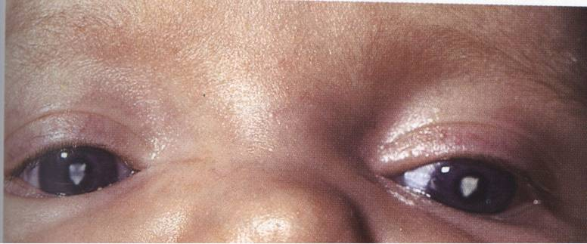
ANTERIOR CAPSULAR CATARACT

Slide 24
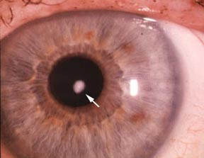
ANTERIOR POLAR CATARACT

Slide 25
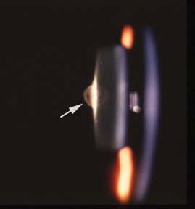
POSTERIOR POLAR CATARACT
Aqueous
lens
cornea

Slide 26
CLINICAL FEATURES
White pupillary reflex
Poor Visual Acuity
Nystagmus

Slide 27
CLINICAL EVALUATION
Purpose: To know:
  Cataract density
  Type of cataract
  Condition of retina and optic nerve
  Any associated ocular anomaly
Steps:
1. Torch examination
2. Examination under Anesthesia
      Ophthalmoscopy direct / indirect

Slide 28
PAEDIATRIC CONSULTATION
  Dysmorphic features or suspicion of associated systemic diseases

Slide 29
LABORATORY INVESTIGATIONS
TORCH screening
Blood Complete picture
Blood Glucose levels
Urine:
    Routine examination
    Reducing substances

Slide 30
VISUAL FUNCTION EVALUATION
Visual Acuity
  Follows light or not
  Colour targets
  Reaction to occlusion
Pupillary Reflexes
Fixation Reflex
Visual Evoked Responses (VER)

Slide 31
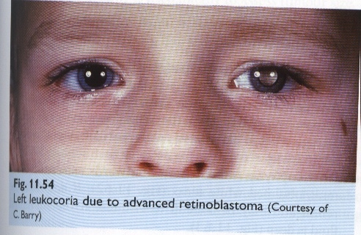
RETINOBLASTOMA

Slide 32
MANAGEMENT
SURGERY is the only solution whenever indicated
INDICATIONS OF SURGERY
  Very Dense Cataract
  Moderately Dense Cataract
  Mild Cataract (Central)

Slide 33
SURGICAL TECHNIQUES
BEFORE 18 MONTHS
  Lensectomy with Anterior Vitrectomy
  Simple Lens Aspiration
AFTER 18 MONTHS
  Extracapsular Cataract Extraction with Posterior Chamber IOL
  Phacoemulsification with Posterior Chamber IOL
  Secondary IOL

Slide 34
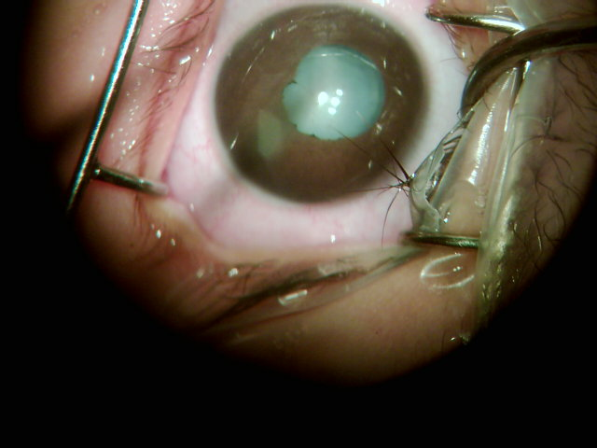
LID SPECULUM INSERTED

Slide 35
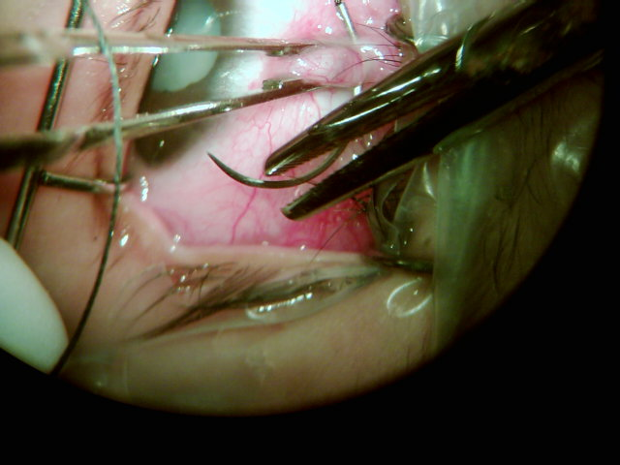
BRIDLE SUTURE

Slide 36
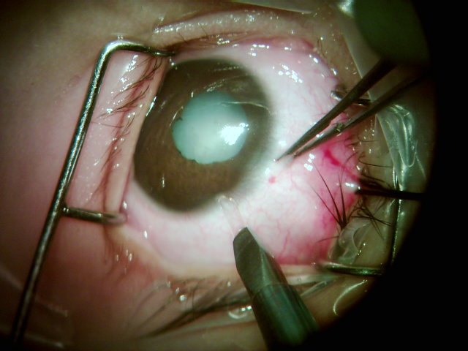
INCISION

Slide 37
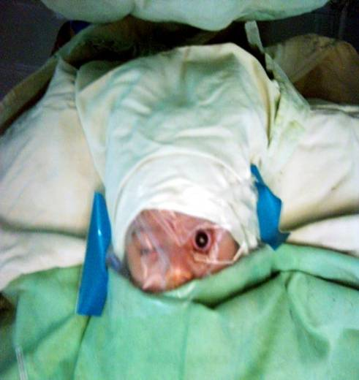
METICULOUS DRAPPING

Slide 38
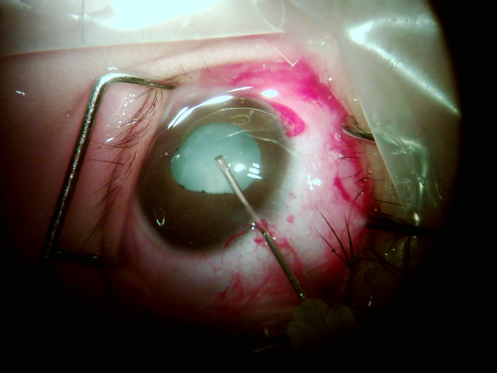
ANTERIOR CAPSULOTOMY

Slide 39
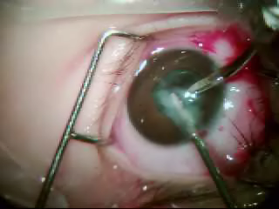
LENS ASPIRATION

Slide 40
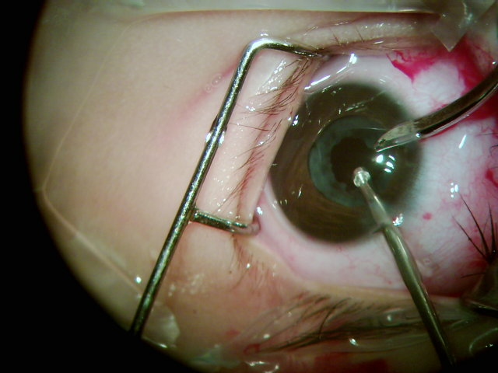
ANTERIOR VITRECTOMY

Slide 41
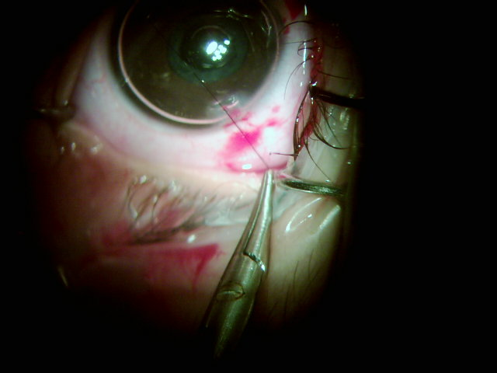
WOUND CLOSURE

Slide 42
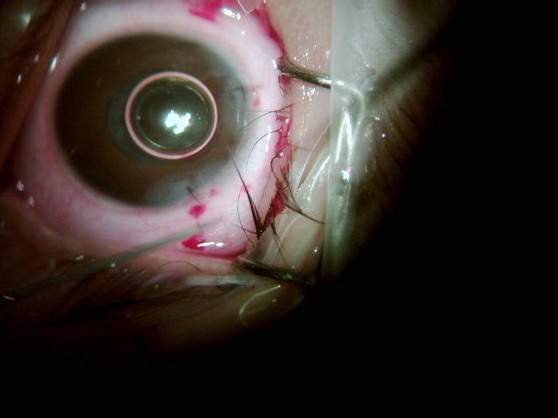
STITCHES APPLIED

Slide 43
MANAGEMENT OF APHAKIA
SPECTACLES (Bilateral Aphakia)
CONTACT LENSES (Before 2 years / Unilateral aphakia)
INTRAOCULAR LENS IMPLANTATION (18 months onwards)

Slide 44
PROGNOSIS
Encouraging results in bilateral cases (before 03 months)
Not very encouraging results in unilateral cases unless the cataract is removed very early, with in first few weeks of life

Slide 45
PROGNOSIS
Visual morbidity may result from deprivation amblyopia, refractive amblyopia, glaucoma (10% post surgical removal), squint, secondary cataract and retinal detachment
Mental retardation, deafness, kidney disease, heart disease, and metabolic disorders may be part of the presentation

Slide 46
THANK YOU

