Slide 2
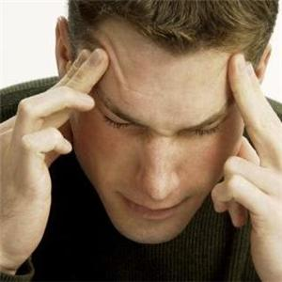
FACIAL PAIN AND HEADACHE

Slide 3
INTRODUCTION
Patients with facial pain are frequently referred to ENT
Most have initial diagnosis of sinusitis
In reality few have sinogenic pain

Slide 4
SINONASAL INNERVATION
Sinonasal mucosa innervated by ophthalmic and maxillary division of trigeminal nerve
Minor contribution by greater superficial petrosal branch of facial nerve
Ostiomeatal complex > turbinates > septum > sinus mucosa (order of sensitivity to pain)

Slide 5
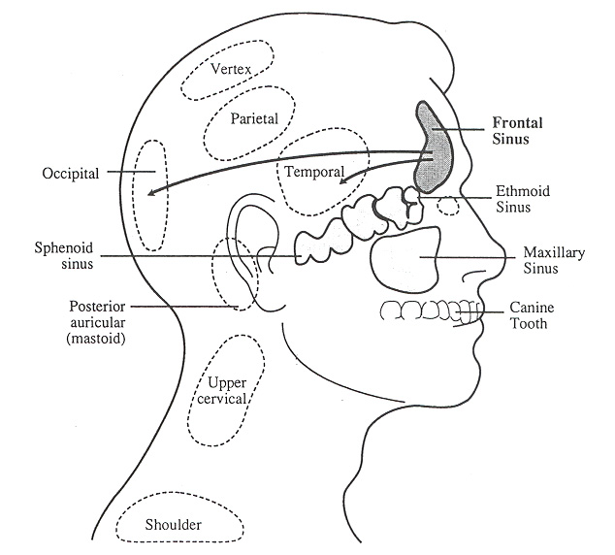
FRONTAL SINUS
Ophthalmic branch of trigeminal nerve
Pain referred to forehead and anterior cranial fossa

Slide 6
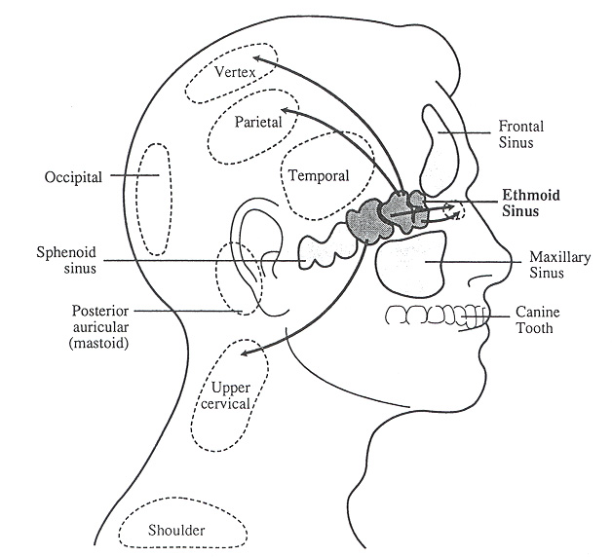
ANTERIOR ETHMOIDAL SINUS
Innervated by ophtalmic division of trigeminal via anterior ethmoidal nerve (an offshoot of nasociliary nerve)

Slide 7
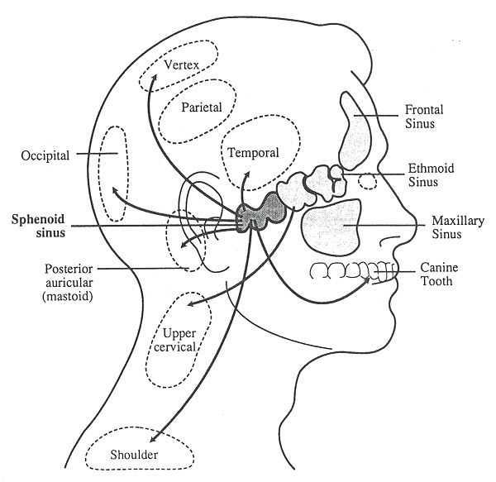
POSTERIOR ETHMOIDAL AND SPHENOID SINUS
Maxillary division of trigeminal nerve through posterior ethmoidal nerve
Ophthalmic division of trigeminal nerve
Greater superficial petrosal nerve

Slide 8
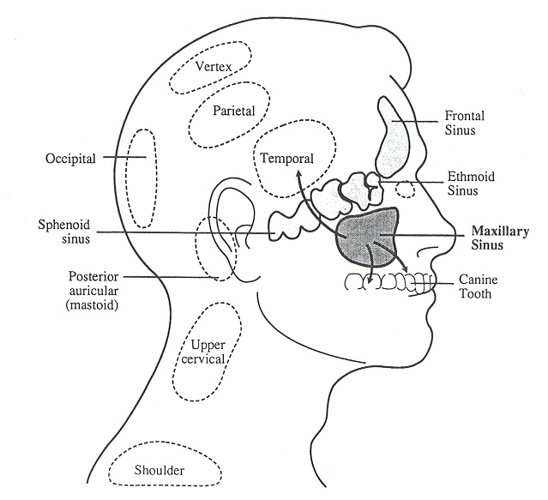
MAXILLARY SINUS
Maxillary division of trigeminal nerve
Posterior superior alveolar nerve
Infraorbital
Anterior superior alveolar

Slide 9
Pain afferents
Majority of painful stimuli from face are transmitted via afferents in the trigeminal nerve
Rest through 7, 8,9 and 10th nerves
Facial pain from deep structures dull due to unmyelinated afferent nerves
From superficial structures, it is sharp due to myelinated fibers

Slide 10
CLASSIFICATION
Rhinological pain
Sinusitis
Post trauma or surgery
Dental pain
Painful teeth
Phantom tooth pain
TM joint dysfunction
Myofascial pain

Slide 11
CLASSIFICATION
Vascular pain
Migraine
Cluster headache
Paroxysmal hemicrania
Temporal arteritis
Sluder’s neuralgia
Neuralgias
Trigeminal neuralgia
Glossopharyngeal neuralgia
Postherpetic neuralgia

Slide 12
CLASSIFICATION
Misc
Pain caused by tumours
Tension type headache
Midfacial segmental pain
Atypical facial pain

Slide 13
HISTORY
Where is the pain and does it radiate?
Is the pain continuous or intermittent?
Character of the pain?
Precipitating factors?
Relieving factors?
Effect on daily life?

Slide 14
PAST MEDICAL HISTORY
Head injuries, infections, surgeries?
Psychiatric illness?
Alcohol, tobacco use?
Medications?
Oral contraceptives
Antihypertensive
Herbal medications

Slide 15
EXAMINATION
General physical examination
Complete head and neck examination
TMJ & muscles of mastication
Trigger points
Neurological examination

Slide 16
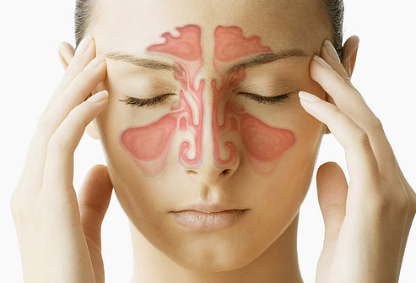
SINUSITIS
In acute sinusitis there is nasal obstruction, rhinorrhoea, facial pain in association with URTI
Chronic sinusitis often painless except during acute exacerbations
Pain often unilateral and dull and increases in intensity on bending forward

Slide 17
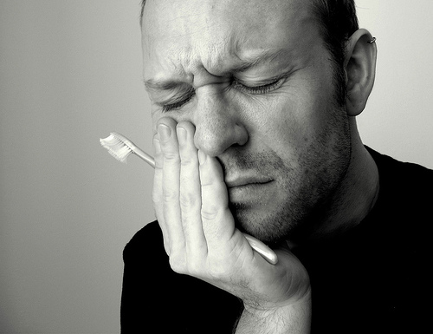
PAINFUL TEETH
Offending tooth is painful to percussion
Can radiate to surrounding structures and opposite jaw

Slide 18
TMJ DYSFUNCTION
May be localized to the joint or extend over the periauricular area extending to the temporoparietal and cervical regions
May present with deep otalgia
Chewing exacerbates pain
TMJ and surrounding muscles may be tender on direct palpation

Slide 19
MYOFASCIAL PAIN
Five times more common in post menopausal women and strong association with stress
Poorly defined aching in the neck, jaw and ear
Tender points in the sternocleidomastoid and trapezius muscles

Slide 20
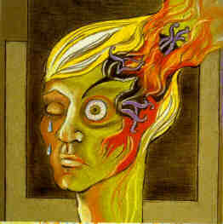
MIGRAINE
Aura precedes onset of headache
Visual disturbances
Unusual tastes and aromas
Throbbing unilateral pain
Can last upto 72 hours
Trigger factors
Various foods
Sleep disturbance
Withdrawal of stress
(Saturday morning headaches)

Slide 21
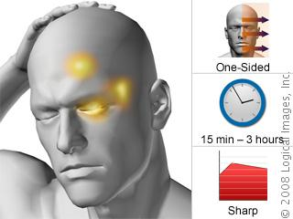
CLUSTER HEADACHE
Typically affects men 30-50 yrs old
Pain is commonly frontal, temporal,extends over the cheeck or even into the teeth
There may be lacrimation, rhinorrhoea and nasal obstruction
Distressing throbbing pain that wakes patient up
Feel like banging their head against a wall
Lasts for 15 mins to 3 hours

Slide 22
SLUDER’S NEURALGIA
Vascular origin
A collective group of neuralgic, motor,sensory and gustatory symptoms and signs including facial pain
Caused by inflammation of sphenopalatine ganglion and mucosal contact with the lateral nasal wall causing facial pain

Slide 23
Trigeminal neuralgia
Paroxysms of severe lancinating pain induced by a specific trigger point
In more than one third pain arises in both the maxillary and mandibular divisions
One fifth is confined to the maxillary division
In small number ophthalmic division affected

Slide 24
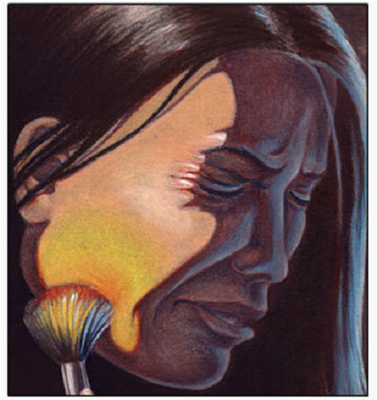
TRIGEMINAL NEURALGIA
Typical trigger points are lips and nasolabial folds
May also be triggered by touching the gingivae
Flush over the face
Remissions are common

Slide 25
TENSION TYPE HEADACHE
Feeling of thightness, pressure or constriction which varies in intensity, frequency and duration
May be at vertex,eyes or temple and often an occipital component
Usually present on waking
Does not worsen with routine physical activity
Rarely interferes with patient getting to sleep

Slide 26
MIDFACIAL SEGMENT PAIN
Similar to tension type headache except that symmetrical facial pain involves the midface and retro-orbital region
Hyperaesthesia of the skin and soft tissues in the area affected
Pain lasts for hours on daily basis
Pain reduces in stress free environment (weekends)

Slide 27
ATYPICAL FACIAL PAIN
Diagnosis of exclusion
History often vague and inconsistent
Pain moves from one part of face to other between different consultations
Feeling of “Mucus moving” in the sinuses
Patients have completely fixed ideas about their condition
History of depression and significant psychological disturbance

Slide 28
SUMMARY
History taking key to accurate diagnosis
Sinusitis is a rare cause of chronic facial pain and most patients with facial pain do not warrant surgery
Sinogenic pain is intermittent and associated with rhinological symptoms
Sinus mucosal thickening on a CT scan does not indicate that pain is sinogenic

Slide 29
SUMMARY
Vascular pain such as migraine and cluster headaches can cause rhinorrhoea and nasal congestion
Many patients with chronic facial pain benefit from the appropriate ‘neurological’ medication

Slide 30
THANK YOU

Slide 31
Questions??

