Slide 1
GRADUAL PAINLESS DETERIORATION OF VISION
MAJ SADIA HUMAYUN
CLASSIFIED EYE SPECIALIST
AFIO

Slide 4
VISUAL LOSS
SUDDEN
TRANSIENT
PERMANENT
GRADUAL DETERIORATION
UNILATERAL/BILATERAL

Slide 5
Painless Gradual loss of vision
1- Refractive error
2- Cataract
3- Glaucoma
4- Age related macular degeneration ( AMD )
5- Diabetic retinopathy
6- Optic nerve compression
7- Drug toxicity
8- Hereditary retinal dystrophies

Slide 6
REFRACTIVE ERRORS
1- Myopia
2- Hypermetropia
3- Astigmatism
4- Presbyopia

Slide 7
MYOPIA

Slide 8
HYPERMETROPIA

Slide 9
ASTIGMATISM

Slide 10
PRESBYOPIA

Slide 11
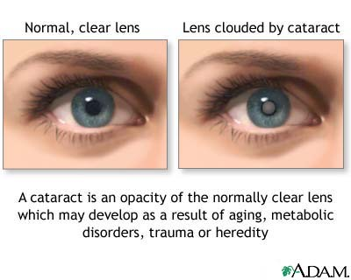
CATARACT
The most common cause of treatable loss of vision .

Slide 12
ACQUIRED CATARACT
AGE RELATED CATARACT
PRESENILE CATARACT
TRAUMATIC CATARACT
SECONDARY CATARACT
DRUG INDUCED CATARACT

Slide 13
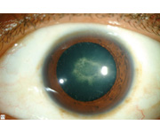
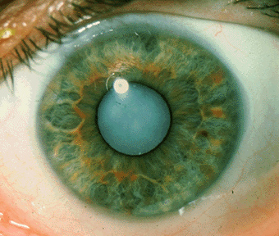

Slide 14
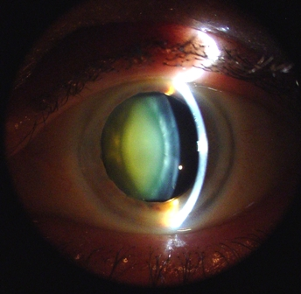
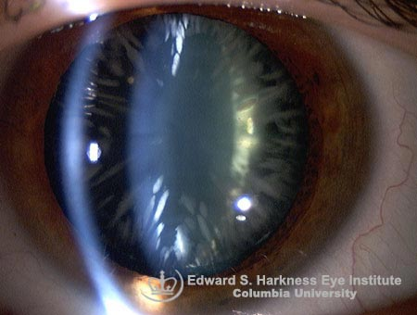

Slide 15
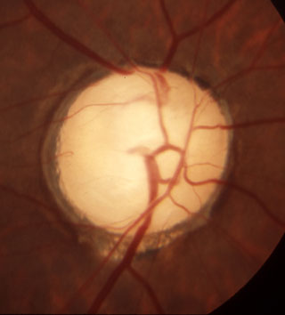
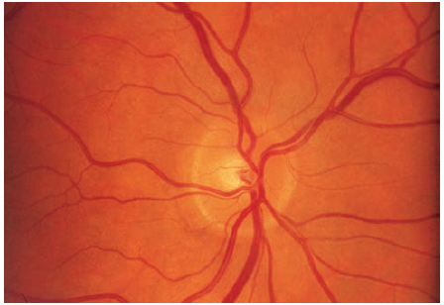
GLAUCOMA
The 2nd common cause of blindness in adults (40 years).
Elevated intraocular pressure (20-30 mmHg).
Gradual visual field loss.
Optic nerve changes.
Haloes around the light

Slide 16
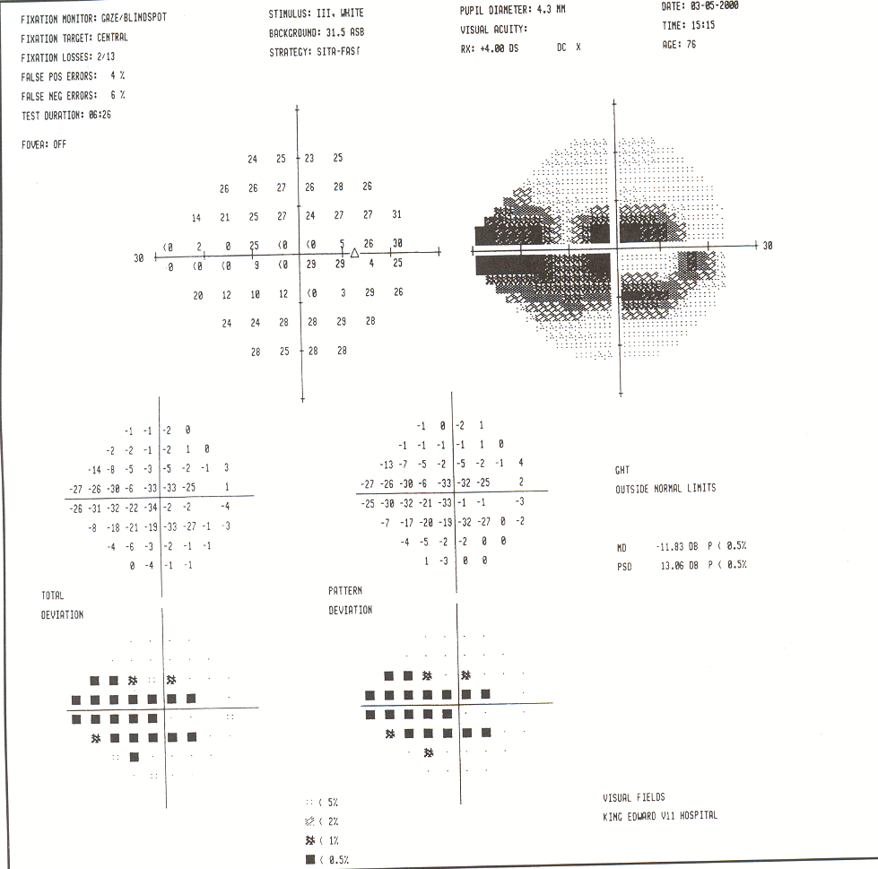
GLAUCOMA
Congenital Glaucoma
Primary Glaucoma
1- Open angle
2- Closed angle
Secondary Glaucoma

Slide 17
Age Related Macular Degeneration (ARMD)
Progressive degeneration of the macula in elderly people
The most frequent cause of blindness beyond 55 years old.
Types :
1- non neovascular ( dry )
2- neovascular ( wet )

Slide 18
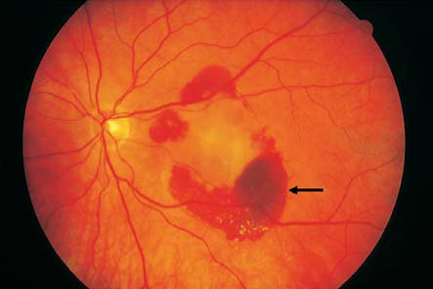

Slide 19
DIABETIC RETINOPATHY
It is a microangiopathy, involving the precapillary arterioles,
capillaries and post capillary venules.

Slide 20
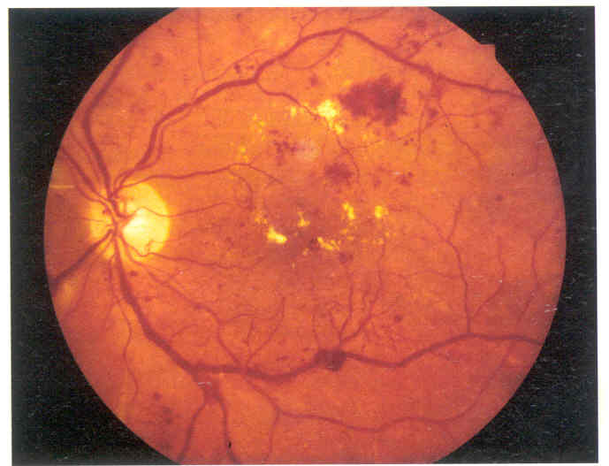
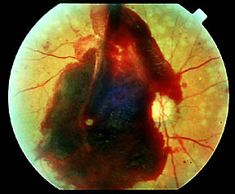
TYPES OF DIABETIC RETINOPATHY
Background Diabetic Retinopathy Pre-proliferartive Diabetic Retinopathy
Proliferartive Diabetic Retinopathy Advanced diabetic eye disease

Slide 21
OPTIC NERVE COMPRESSION
Orbital tumors
Pituitary adenoma
Optic Nerve Sheath Meningioma
Sarcoidosis
Thyroid Ophthalmopathy

Slide 22
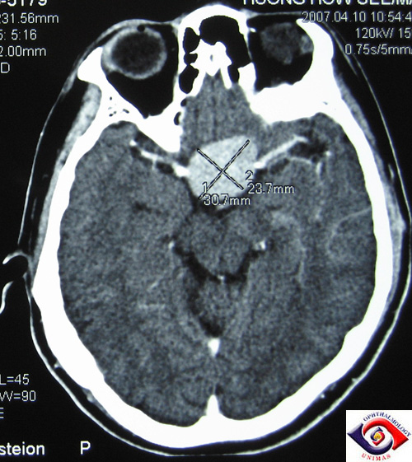
OPTIC NERVE COMPRESSION

Slide 23
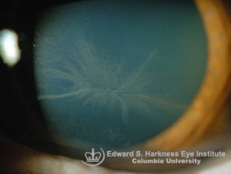
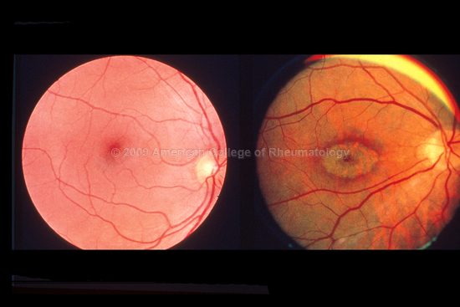
DRUG TOXICITY
1- ALCOHOL-TOBACO AMBLYOPIA.
2- CHLOROQUINE.
3- HYDROXYCHLORQINE.
4- AMIODARONE.
5- STEROIDS.
6- CHLORPROMAZINE
7- ETHAMBUTOL

Slide 24
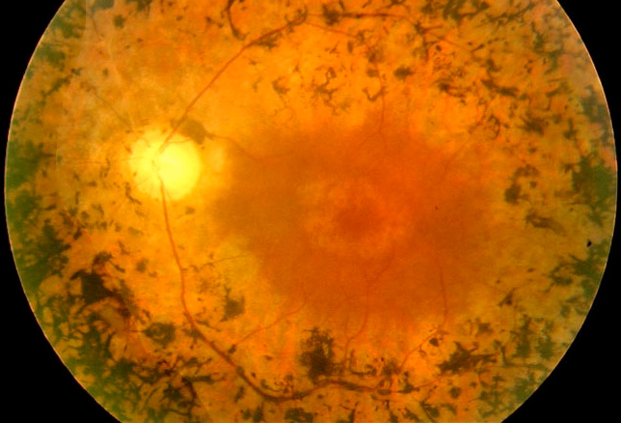
HEREDITARY RETINAL DYSTROPHY
Retinitis pigmentosa :
- Degeneration of rod cells and retinal atrophy
Night blindness
Arteriolar attenuation
Disc pallor
Bone spicule pigmentation
- No satisfactory treatment .

Slide 25
THANK YOU

