Slide 1
DISASTERS

Slide 2
What are Natural Disasters?
Volcanic eruption
Earthquake
Cyclone or Hurricane
Avalanche
Flood
Drought
Forest fire or Bushfire

Slide 3
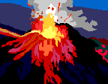
Volcanoes
A volcanic eruption is the spurting out of gases and hot lava from an opening in the Earth’s crust.
Pressure from deep inside the Earth forces ash, gas and molten rock to the surface.

Slide 4
Earthquake
An earthquake is a violent shaking of the ground. Sometimes it is so strong that the ground splits apart.
When parts of the earth, called plates, move against each other giant shock waves move upwards towards the surface causing the earthquake.

Slide 5
Cyclone, Hurricane, Tornado or Typhoon
A Cyclone is a fierce storm with storm winds that spin around it in a giant circle. During a cyclone trees can be uprooted, buildings can be destroyed and cars can be overturned.

Slide 6
Avalanche
An Avalanche is a movement of snow, ice and rock down a mountainside. Avalanches happen very suddenly and can move as fast as a racing car up to 124mph.
Avalanches can be caused by –
snow melting quickly
snow freezing, melting then freezing again
someone skiing
a loud noise or an earth tremor

Slide 7
Flood
A flood is caused by an overflow of water which covers the land that is usually dry.
Floods are caused by heavy rain or by snow melting and the rivers burst their banks and overflow.
Costal floods are caused by high tides, a rise in sea level, storm waves or tsunami (earthquakes under the sea).

Slide 8
Drought
A drought is the lack of rain for a long time.
In 1968 a drought began in Africa. Children born during this year were five years old before rain fell again.

Slide 9
Forest Fire or Bushfire
Fires can burn out of control in areas of forest or bush land. Fires are caused by lightning, sparks of electricity or careless people. Wind may blow a bushfire to areas where people live.

Slide 10
definitions
An overwhelming ecological disruption occurring on a scale sufficient to require outside assistance …
PAHO 1980
Disasters are exceptional events which suddenly kill or injure large numbers of people…
Red Cross/Red Crescent

Slide 11
Definitions
Any occurrence that causes damage, ecological disruption, loss of human life or deterioration of health or health services on a scale that warrants extraordinary response from outside the affected community or area
Source: WHO strategy and approaches to humanitarian action,1995
Man made calamity (accident or intentional)
A catastrophic event that overwhelms a community’s response capabilities

Slide 12
Definitions
CRED defines a disaster as “a situation or event which overwhelms local capacity, necessitating a request to a national or international level for external assistance; an unforeseen and often sudden event that causes great damage, destruction and human suffering”

Slide 13
WHO CRITERIA
10 or more people killed.
100 people reported affected.
declaration of a state of emergency.
call for international assistance.
WHO Centre for Research on the Epidemiology of Disasters
(UCL ,Brussels, Belgium)

Slide 14
Mortality Rate Emergency Indicators
Crude Mortality Rate (CMR): “single most important indicator of serious stress in affected populations.”
CMR = deaths/10,000/day: emergency phase
<1 = Under control
>1 = Serious condition
>2 = Out of control
>4 = Major catastrophe

Slide 15
How to calculate CMR?
Crude Mortality Rate =
Total number of deaths in a given time period x 10,000
----------------------------------------------------------------------------------
Estimated total population x Number of days in the time period
Example: 52 deaths in 2 weeks in an affected population of 40,000 people.
52 deaths x 10,000
--------------------------------------- = 0.93 deaths/10,000/day
40,000 people x 14 days

Slide 16
Types of disasters
Natural (Acts of God) |  | Man made
Sudden Impact | Gradual onset | Hostile | Accidental
Earthquake Volcanic Eruption Cyclones Flash Floods | Floods Snow Storm Famine Droughts | World war I&II Terrorism 9/11 Sabotage | Air crashes Train accidents Fires, Smog Nuclear accidents Bombings Accidents

Slide 17
Types of disaster
Meterological e.g., storms, drought
Topological e.g., floods, avalanches, landslides
Telluric & Tectonic e.g., earthquakes,volcanic eruptions
Accidents
Atomic explosion
Bio-terrorism

Slide 18
Floods

Slide 19
Air Crash

Slide 20
Tornados

Slide 21
Drought

Slide 22
Sandstorm

Slide 23
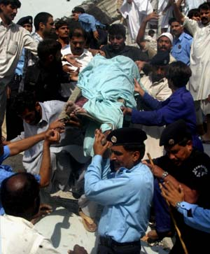
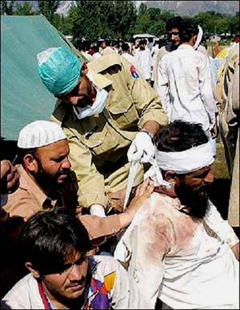
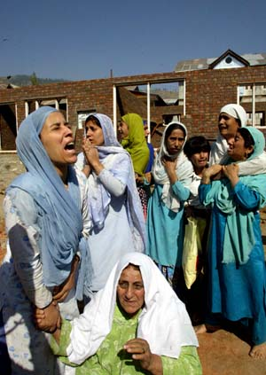
INTRODUCTION
Chaos cannot be prevented during the initial period of a major disaster, but it has to be the aim of every disaster operation plan to keep this time as short as possible

Slide 24
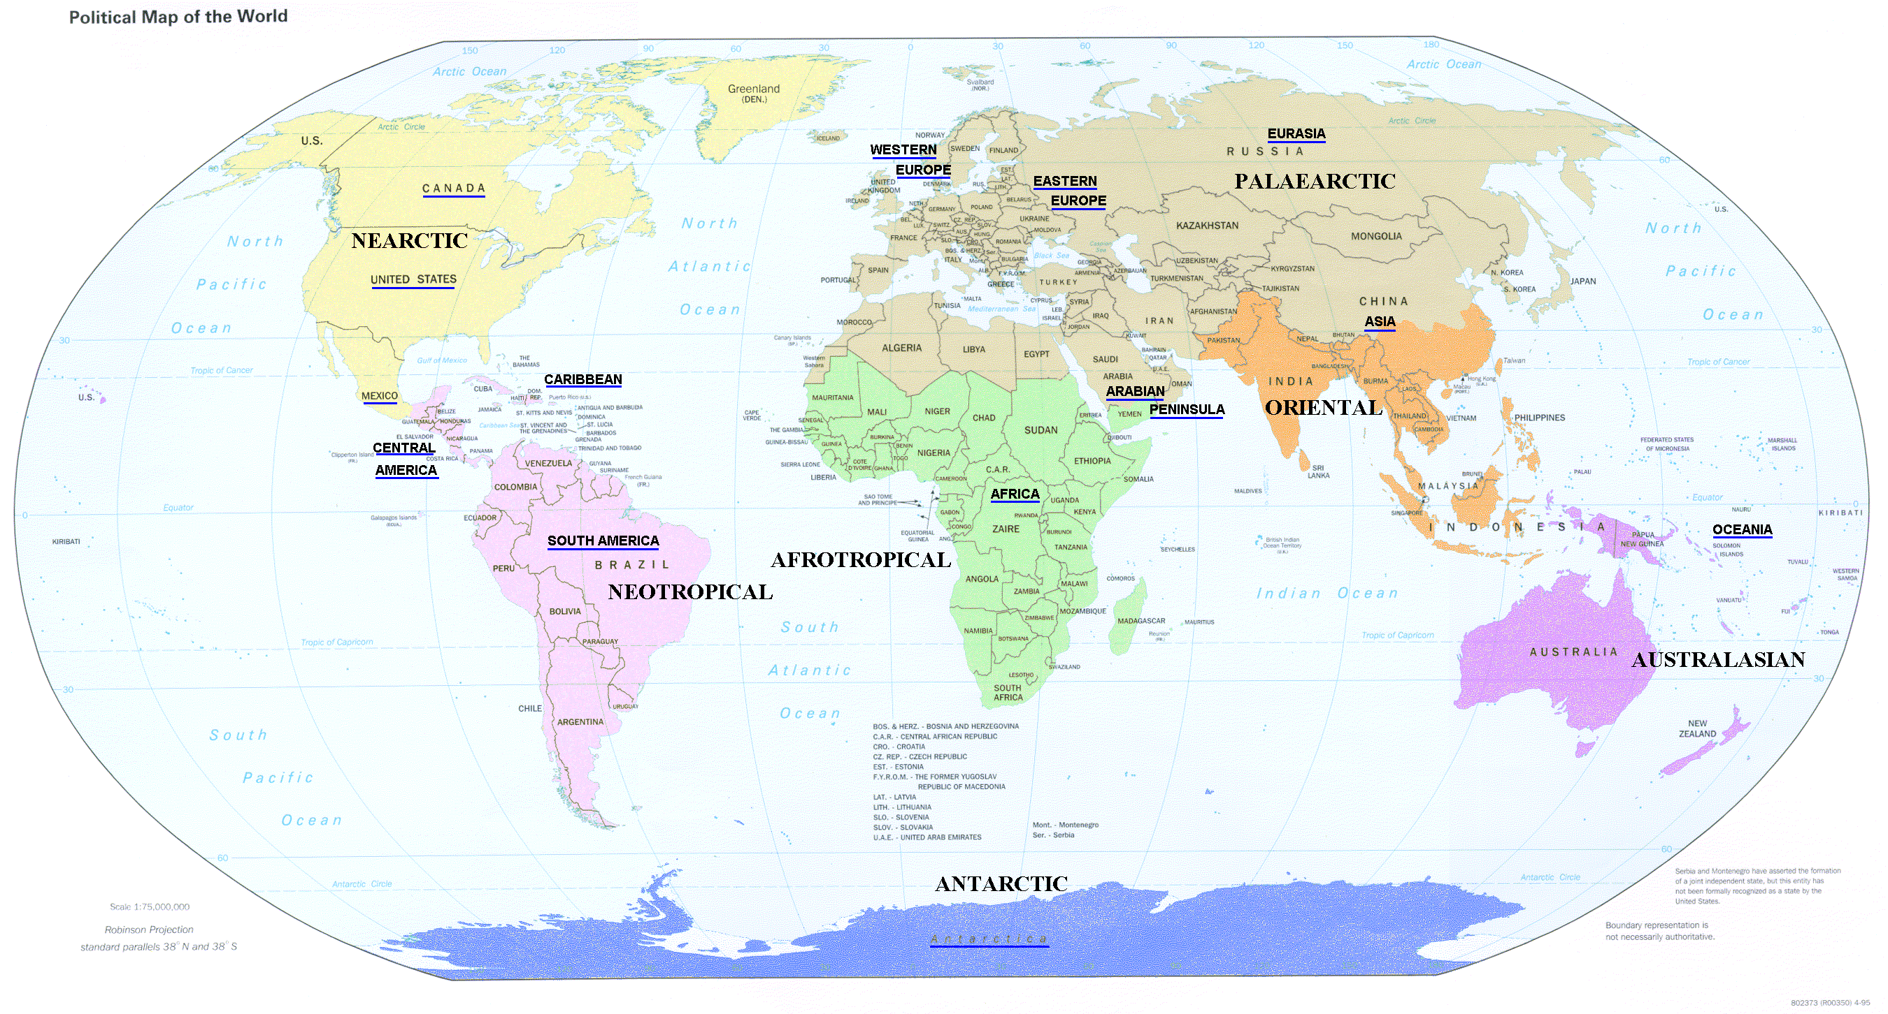
Frequency
1
ASIA
10
EUROPE
15
10
LATIN AMERICA
AFRICA
10
1
Climatological disasters more frequent
AUSTRALIA
For each major Natural Disaster in Europe & Australia there are 10 in Latin America /Africa & 15 in Asia

Slide 25
Top Ten Natural Disasters Worldwide by number of deaths - 2005
Disaster | Country | Deaths
Earthquake, Oct | Pakistan
Hurricane Stan, Oct | Guatemala | 1513
Hurricane Katrina Aug | United States | 1322
Earthquake, Oct | India | 1309
Flood, Jul | India | 1200
Earthquake, Mar | Indonesia | 915
Flood, Jun | China, P Rep | 771
Earthquake, Feb | Iran, Islam Rep | 612
Measles Epidemic, Apr | Nigeria | 561
Flood, Feb | Pakistan | 520
73338
Source = www.net-data/disasters

Slide 26
Top 10 Natural Disasters in Pakistan
By Number of Deaths
DISASTER | DATE | DEATHS
Earthquake NWFP & AK | 8 Oct 05 | 73,338
Earthquake Quetta | 31 May 1935 | 30,000
Earthquake Northern Area | 15 Dec 1965 | 10,000
Earthquake Kohistan | 28 Dec 1974 | 4,700
Earthquake | 27 Nov 1945 | 4,000
Flood | 1950 | 2,900
Flood | 28 Jul 2010 | 1961
Flood | 8 Sep 1992 | 1334
Flood | 2 Mar 1998 | 1,000
Flood | Jun 1977 | 848
Source = www.pakistan.gov.pk

Slide 27
Top 10 Natural Disasters in Pakistan
By Number of Affectees
DISASTER | DATE | TOTAL AFFECTED
Flood | 28 Jul 2010 | 20,202,327
Flood | 8 Sep 1992 | 12,324,024
Flood | 9 Feb 2005 | 7,000,450
Flood | 30 Jul 1992 | 6,184,418
Flood | 2 Aug 1976 | 5,566,000
Flood | Aug 1973 | 4,800,000
Earthquake | 8 Oct 2005 | 2,869,142
Flood | Jul 1978 | 2,246,000
Drought | Mar 2000 | 2,200,000
Flood | 19 Aug 1996 | 1,300,000
Source = www.pakistan.gov.pk

Slide 28
EFFECTS OF DISASTERS

Slide 29
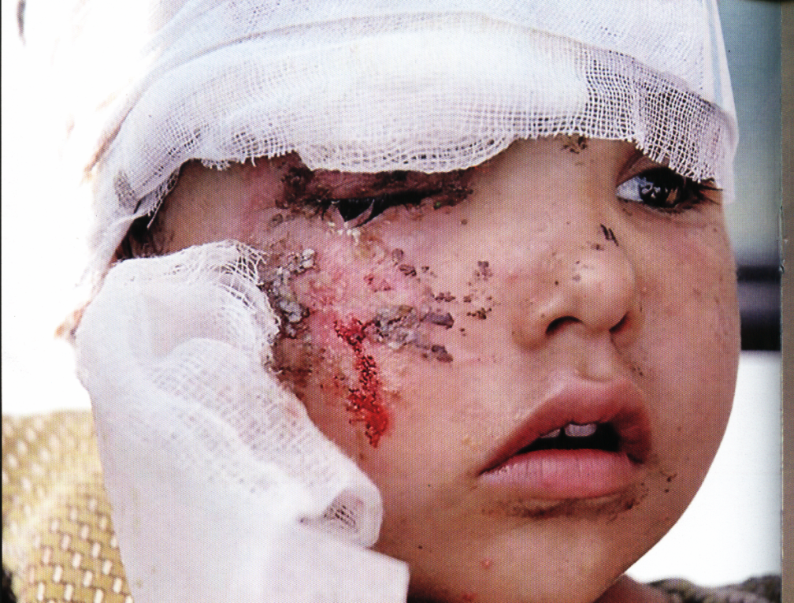
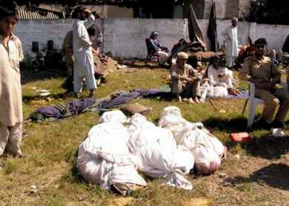
Health Effects
Injuries & Deaths

Slide 30
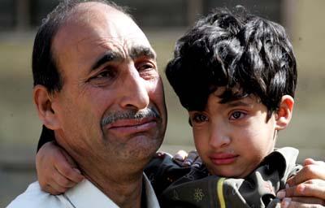
Health Effects
Emotional Stress and Psychological Reactions

Slide 31
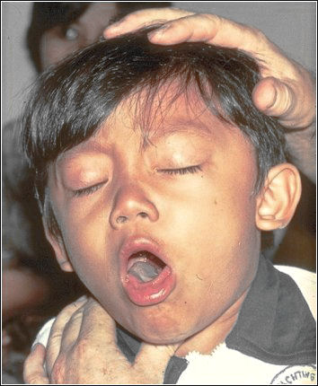
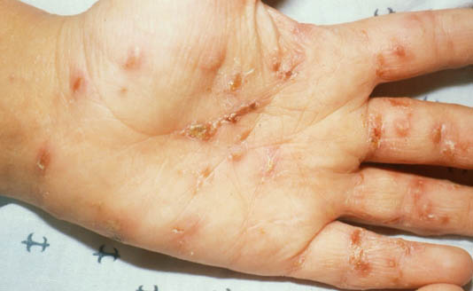
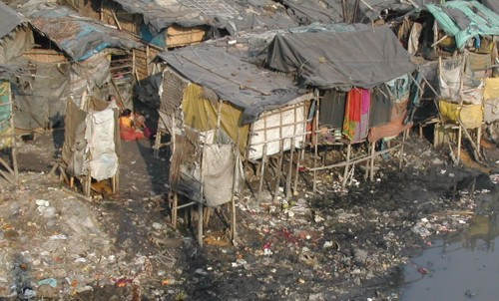
Health Effects
Vector borne
Person to person
contact
Respiratory route
Food and water borne
Epidemics

Slide 32
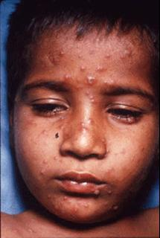
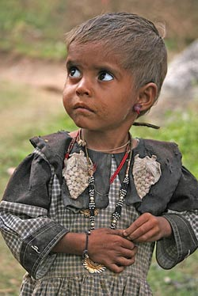
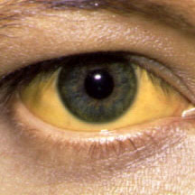
Health Effects
Increase in indigenous diseases

Slide 33
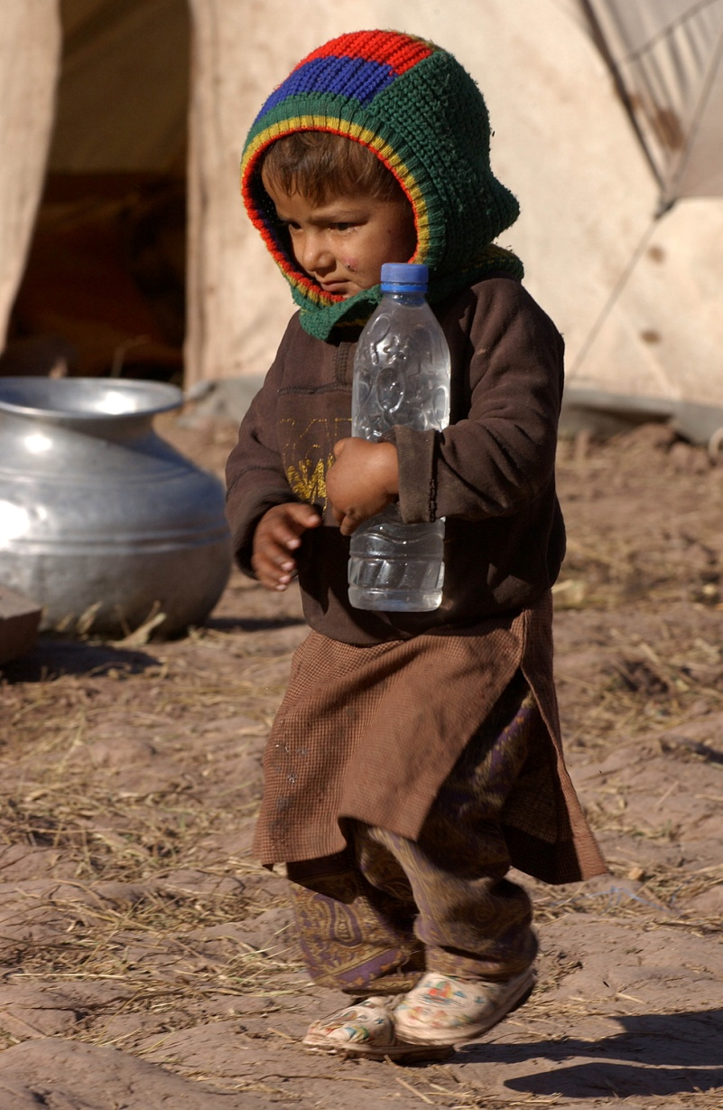
Other Effects
Food Shortage

Slide 34
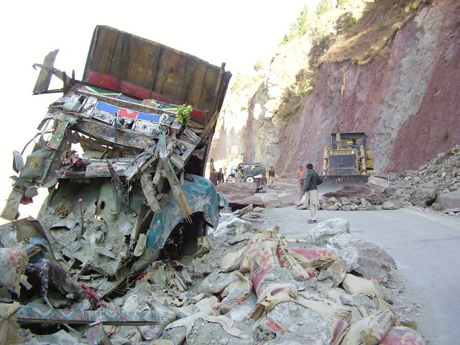
Other Effects
Disruption of Services / Infrastructure Damage

Slide 35
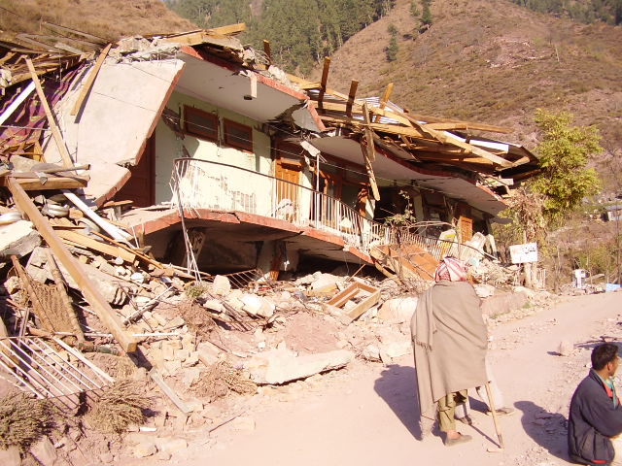
Other Effects
Property Damage

Slide 36
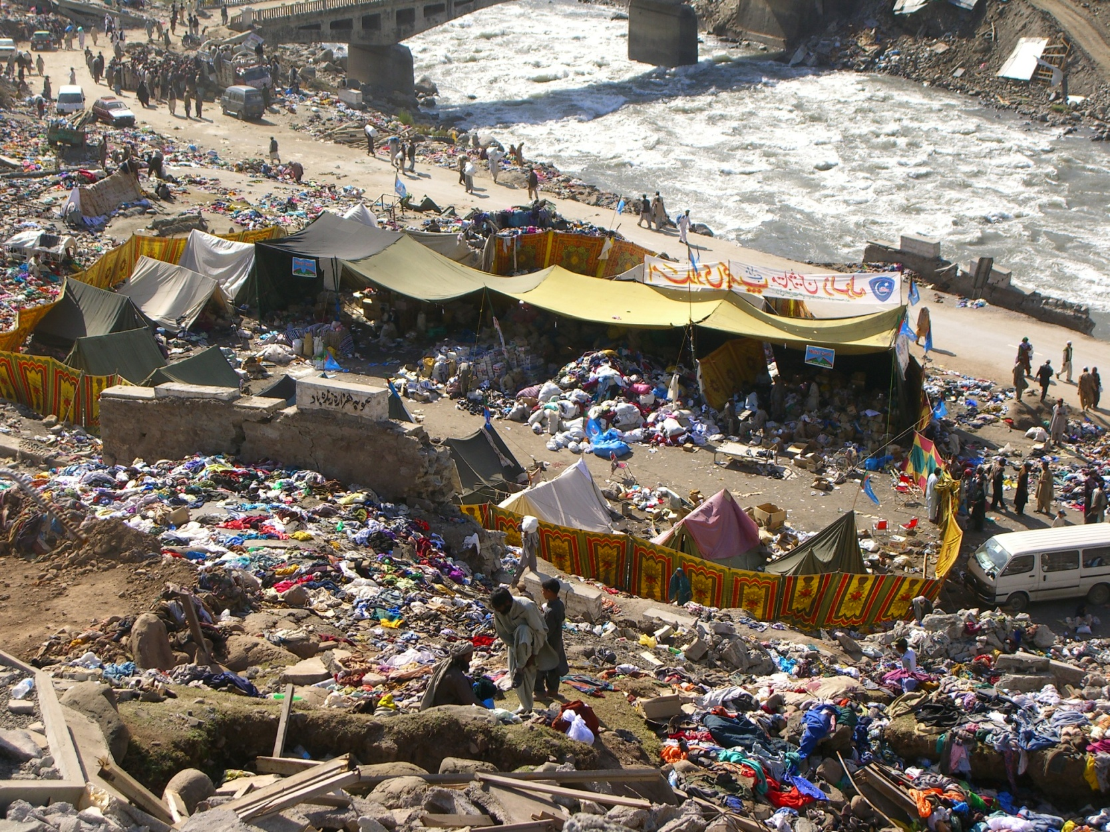
Other Effects
Environmental Damage

Slide 37
Cascading Causes and Emergencies
DEFORESTATION
HEAVY RAINFALL
LACK OF
PREPAREDNESS
FLOOD
POOR
RESPONSE
DAMAGE TO
CROPS
CONTAMINATED
WATER SUPPLY
DAMAGE TO
HEALTH SYSTEM
INJURY
INC DISEASE RATE
OVERLOAD OF
HEALTH SYSTEM
FOOD SHORTAGE
INCREASED
DEATH RATE

Slide 38
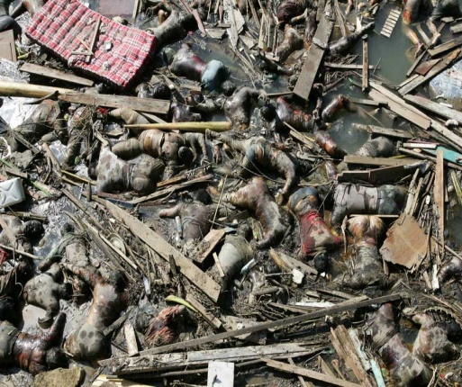
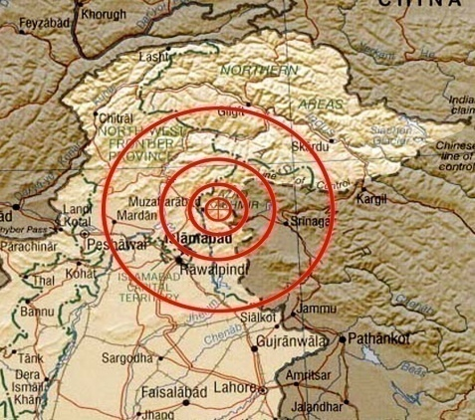
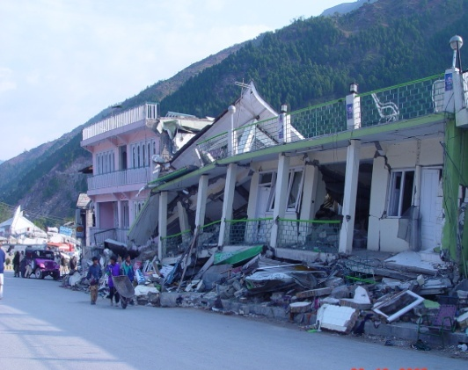
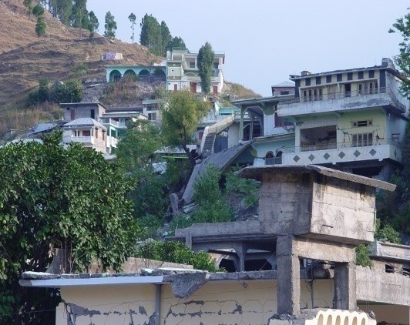
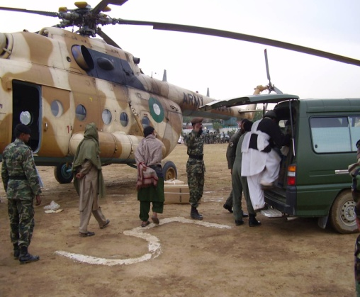
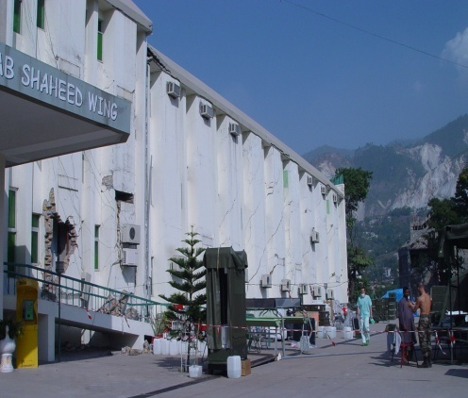
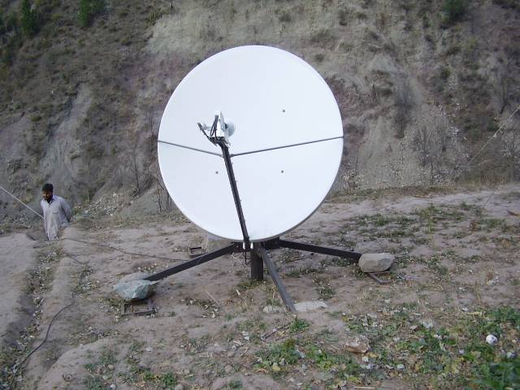
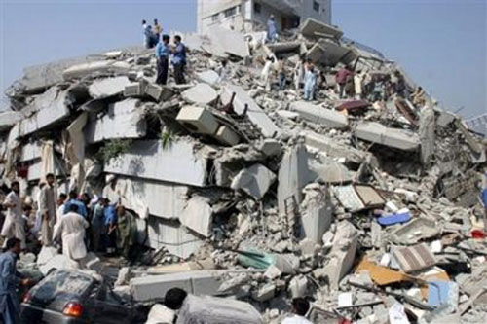
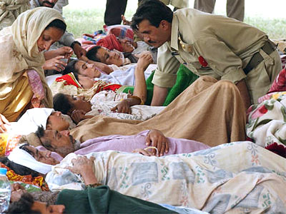
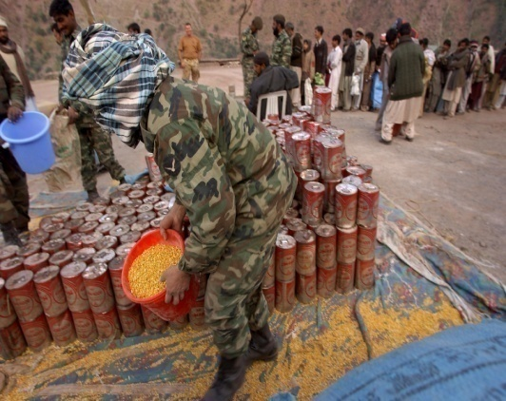
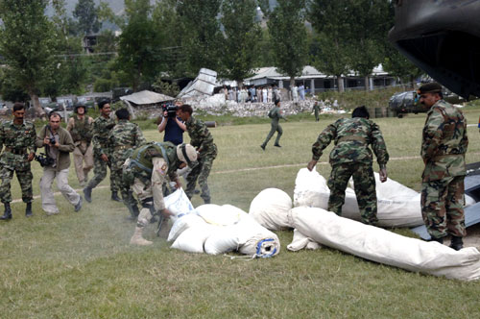
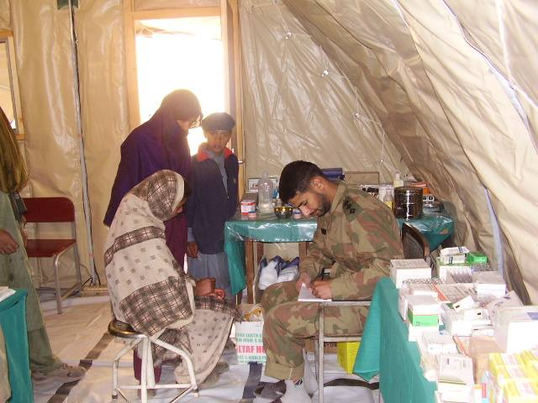
Parameters to Measure
Magnitude of Disaster
CONDITION OF
PUBLIC BUILDINGS
GEOGRAPHIC
EXTENT
PRIVATE AND PUBLIC
PROPERTY DAMAGE
NUMBER DEAD
NUMBER
SEVERELY INJURED
COMMUNICATION
INFRASTRUCTURE
CONDITION OF
COMMUNITY SERVICES
CONDITION OF
HEALTH FACILITIES
RELIEF ACTIVITIES
ALREADY IN PROGRESS
ESTIMATES OF
HEALTH FACILITIES
SPREAD OF
COMMUNICABLE
DISEASES
EXTENT OF
FOOD SUPPLY

Slide 39
Phases of Disaster Management
Disaster impact
Preparedness
Response
R
E
C
O
V
E
R
Y
Rehabilitation
Reconstruction
Mitigation

Slide 40
Triage Do the most good for the most patients
Emergent (Immediate) or Priority One (RED)
Urgent (Delayed) or Priority Two (YELLOW)
Non-urgent (Minimal) or Priority Three (GREEN)
Dead (BLACK)

Slide 41
Emergent or Immediate
Examples
•Unstable chest/abdomen wounds
•Vascular wounds with limb ischemia
•Incomplete amputations
•Open fractures of long bones

Slide 42
Urgent or Delayed
Examples
Stable abdominal wounds
Soft tissue wounds
Vascular injuries with adequate collaterals
Genitourinary tract disruption
Fractures requiring operative intervention
Maxillofacial without airway compromise

Slide 43
Urgent or Delayed

Slide 44
Non-urgent or Minimal
Walking wounded/ walking “well”
Directed away from Triage area to minimal care area for first aid and non-specialty care
May be a source of manpower

Slide 45
Dead/Moribund
Survival unlikely even with optimal care
Should be separated from view of other casualties
Should not be abandoned
Comfort measures with minimal staff

Slide 46
Preparedness Planning how to respond for an emergency or disaster and working to increase resources available to respond effectively
Multisectoral Activity
communications
health
social welfare
police & security
search & rescue
transport
media

Slide 47
Preparedness (a stitch in time saves nine)
Tasks
evaluate risk
adopt standards/regulations
organize communication, warning sys, coordination
& response mechanism
ensure financial resources
develop public education programmes
coordinate with media
organize disaster simulation exercises

Slide 48
Mitigation Activities which actually eliminate or reduce the chance of occurrence or the effects of a disaster
Measures designed to either prevent hazards e.g.,
protection of vulnerable population and structures
Improving structural quality of houses, schools, and other public buildings.
Safety of water supply & sewerage system

Slide 49
Minimum Water Requirements
Minimum maintenance = 15 liters/person/day
Feeding centers = 30 liters/inpatient/day
Health centers and hospitals = 40–60 liters/inpatient/day
1 tap stand/250 people not >100m from users
A large quantity of reasonably safe water is preferable to a small amount of pure water

Slide 50
Minimum Food Requirements
Minimum maintenance = 2,100Kcals/person/day
Carbohydrates = 70%
Proteins = 20%
Fats = 10%

Slide 51
Minimum Shelter/Space Requirements
Minimum shelter space = 3.5 m2/person
Minimum total site area = 45 m2/person for temporary planned or self settled camps

Slide 52
Minimum Sanitation Requirements
At least 1 toilet for every 20 persons
Maximum of 1 minute walk from dwelling to toilet (≥6m and ≤50m)

Slide 53
Disposal of Excreta
Facility | Standard
Latrines, family Trench latrines, shallow (for a few days) Trench latrines, (for a few months) | Not more than four families per latrine without organized, paid maintenance. Latrines should be located at least 6 m from dwellings, 10 m from feeding and health centers, and at least 30 m (and preferably farther) from wells or other drinking-water sources, but no more than 50 m from user. 30 cm wide by 1 m to 1.5 m deep by 3.5 m long per 100 peoples. 70 cm to 100 cm wide by 2 m to 2.75 m deep by 3.75 m long per 100 people

Slide 54
Why we are not prepared?
Traditional approach fail
Need training
Need equipment
Need Rs Rs Rs
Fear of unknown
It can’t happen here
Not interested
Inherent lethargy

Slide 55
D-I-S-A-S-T-E-R
A mnemonic which can help rescuers remember critical information about disaster response and triage.

Slide 56
D-I-S-A-S-T-E-R
D etection
I ncident command
S afety and security
A ssess hazards
S upport
T riage and treatment
E vacuation
R eallocation and redeployment

