Slide 1
SPLEEN AND THYMUS
BRIG IQBAL MUHAMMAD KHAN
MBBS, MCPS, FCPS
ASSOC PROF OF PATHOLOGY
HEAD OF HISTOPATH DEPT
ARMY MEDICAL COLLEGE

Slide 2
SPLEEN
Normal measurements
Structure
Circulation
Functions

Slide 4
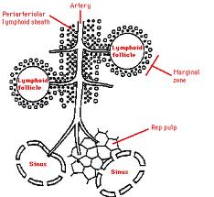

Slide 5
STRUCTURE OF SPLEEN
Normal weight 150 g
Invested by a thin connective tissue capsule
Cut surface show extensive red pulp dotted with white pulp
White pulp is composed of a central artery surrounded by a rim of T-lymphocytes, which at places expands to form lymphoid nodules, capable of developing germinal centres.
Red pulp is traversed by thin walled vascular sinusoids, separated by cords “Cords of Billroth”

Slide 6
STRUCTURE continue……
The sinusoids are lined by discontinuous endothelium
The cords contain macrophages forming a labyrinth acting as filter
Circulation
Open
closed

Slide 7
FUNCTIONS OF SPLEEN
Phagocytosis of RBCs and Particulate matters
Antibody production
Haemotopoisis
Sequestration of formed blood elements
SLENECTOMY result in increased susceptibility to sepsis to capsulated bacteria like pneumococcus, meningococcus and H. influenzae

Slide 8
CAUSES OF SPLENOMEGALY
INFECTIONS
Parasitic : Malaria, Leishmaniasis, trypanosomiasis, schistosomiasis, echinococcosis, toxoplasmosis.
Bacterial : typhoid fever, T.B, brucellosis
Viral : Infectious mononucleosis, cytomegalovirus
Fungal : Histoplasmosis

Slide 9
CAUSES OF SPLENOMEGALY
LYMPHOHEMATOGENOUS DISORDERS
Hodgkin’s disease, non Hodgkin’s lymphoma,
leukaemia, multiple myeloma, myeloproliferative disorders, haemolytic anaemias, thrombocytopenic purpura
STORAGE DISORDERS
Gaucher’s disease, Niemann – Pick disease, Mucopolysaccharidoses

Slide 10
CAUSES OF SPLENOMEGALY
CONGESTIVE STATES
Cirrhosis of liver, portal or splenic vein
thrombosis, Cardiac failure
IMMUNOLOGIC – inflammatory conditions
Rheumatoid arthritis, SLE
MISCELLANEOUS
Amyloidosis, primary and secondary neoplasms, cysts

Slide 11
MORPHOLOGY IN NONSPECIFIC ACUTE SPLENITIS
Mild to moderate splenomegaly (200-400 grams)
Acute congestion of red pulp, which may enlarge and encroach upon lymphoid follicles
Infiltrate of neutrophils, eosinophils and plasma cells in white and red pulps
Follicles may necrose
Abscesses may form

Slide 12
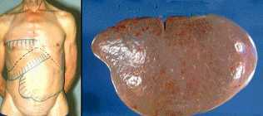
S P L E N O M E G A L Y CLINICAL PRESENTATION
Pressure on stomach
Dragging sensation
HYPERSPLENISM
Splenomegaly
Reduction in one or more of the cellular elements i.e anaemia, leukopenia, thrombocytopenia or combination. Correction by splenectomy

Slide 13
CONGESTIVE SPLENOMEGALY
CAUSES
Portal hypertension – cirrhosis of liver
Splenic vein hypertension
Spontaneous portal vein thrombosis
Pyelophlebitis
Systemic or central venous congestion (CCF)
Pressure on splenic vein – due to carcinoma stomach/pancreas

Slide 14
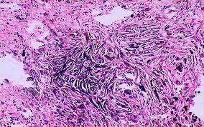
CONGESTIVE SPLENOMEGALY
MORPHOLOGY
Weight may reach 1000 gram to 5000 grams.
Capsule thickened
Congestion, fibrosis, collagen deposition
Excessive destruction by macrophages (hypersplenism)
Foci of recent or old haemorrhages
Organization of focal haemorrhages
Gandy – Gamna nodules (foci of fibrosis containing iron and calcium salts deposits on C.T/elastic fibers)

Slide 15
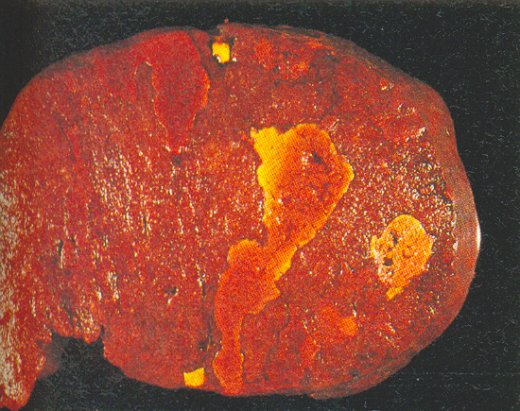
SPLENIC INFARCTS
Due to occlusion of major splenic artery or its branch
Systemic emboli – small or large infarcts
Bland or septic infarcts
Pale and wedge - shaped

Slide 16
MISCELLANEOUS CONDITIONS
Congenital anomalies
Complete absence, hypoplasia, accessory
spleens (spleniculi);
omentum, mesenteries, gastrosplenic ligament or tail of pancreas
Rupture
Traumatic
Non-traumatic
(Malaria, Inf. mononucleosis, Typhoid,
Leukemia)

Slide 17
NEOPLASM
Primary neoplasms are exceedingly rare, benign tumours like haemangiomas, lymphangiomas, fibromas, chondromas etc
Secondary involvement by lymphoid and myeloid tumours is common

Slide 19
THYMUS
Plays key role in cell mediated immunity
Derived from 3rd & 4th pharyngeal pouch.
At birth wt. 10 to 35 gm
At puberty wt. 20 to 50 gm
Elderly 5 to 15 gm

Slide 20
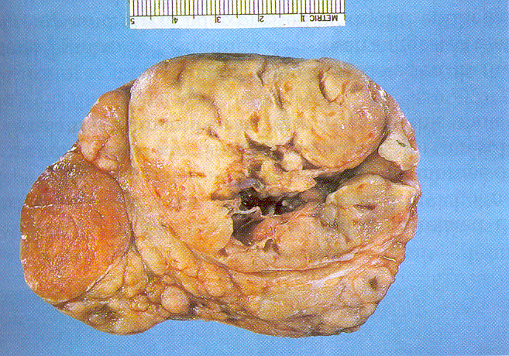
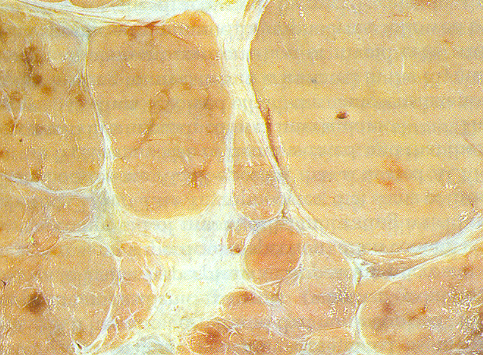
THYMUS
Well encapsulated, two fused lobes
Many lobules: cortex & medulla of each lobule
T- lymphocytes and thymic epithelial cells.
Hassall corpuscles
Other cells: macrophages, dendritic cells, neutrophils, eosinophils, B lymphocytes, scattered myoid (muscle – like) cells.
Role in cell - mediated immunity

Slide 22
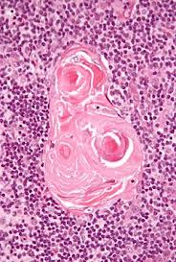
HASSAL CARPUSCLE

Slide 23
THYMUS – DEVELOPMENTAL DISORDERS
THYMIC HYPOPLASIA OR APLASIA
Seen in DiGeorge syndrome
Accompanied by hypoparathyroidism
Absence or lack of cell - mediated immunity
Also accompanied by heart or blood vessels defects.

Slide 24
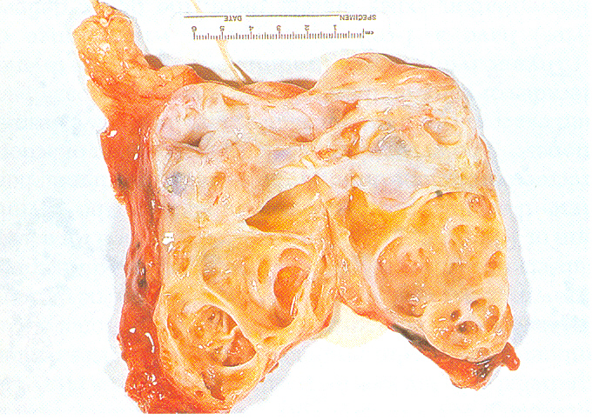
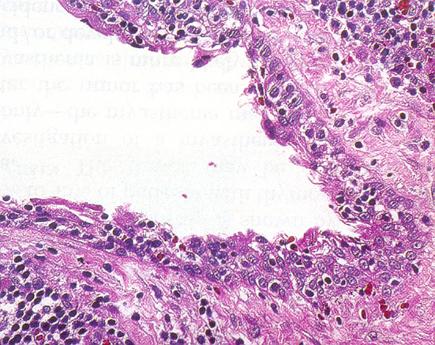
THYMUS - DEVELOPMENTAL DISORDERS
THYMIC CYSTS

Slide 25
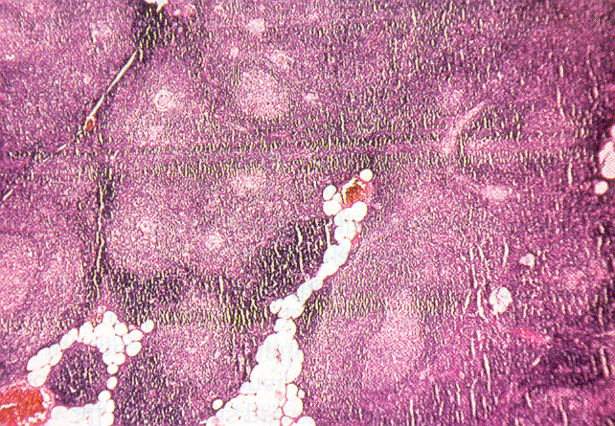
THYMIC HYPERPLASIA
Appearance of lymphoid follicles within thymus
Follicular hyperplasia associated with chronic inflammation & immunologic states e.g Myasthenia Gravis (65-75%), Graves disease, SLE, Scleroderma and Rheumatoid arthritis

Slide 26
THYMOMAS
DEFINITION
“Tumours of thymic epithelial cells.”
CATEGORIES
Benign : cytologically & biologically
Malignant:
Type I : invasive thymoma
Type II : thymic carcinoma
AGE, SEX, LOCATION
Adults, equal sex distribution
Common location anterosuperior mediastinum
rarely involve neck, thyroid, pulmonary hilus or elsewhere.

Slide 27
THYMOMA - GROSS
Lobulated, firm, gray white encapsulated masses
Size upto 15-20 cm
Mostly solid but at times cyst formation due to necrosis
Calcification common
Infiltrative tumours penetrate the capsule and reaches perithymic tissue

Slide 28
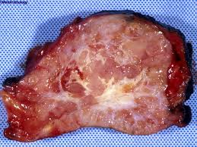
THYMOMA - GROSS

Slide 29
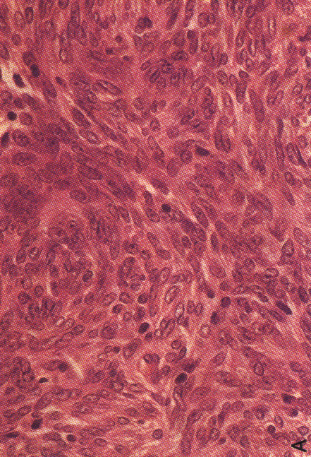
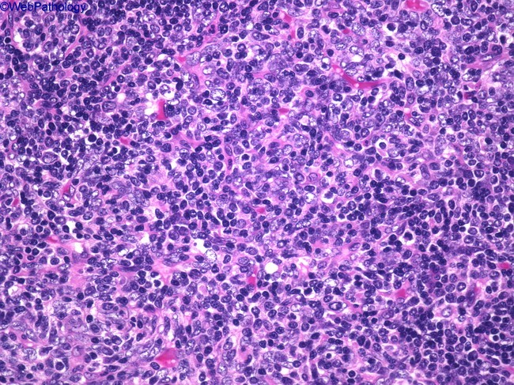
MORPHOLOGY - THYMOMAS
BENIGN THYMOMAS
Medullary type
Spindle cells with sparse thymocytes
Mixed type
Mixed polygonal cortical epithelial cells and dense infiltrate of thymocytes.

Slide 30
MORPHOLOGY – THYMOMAS
MALIGNANT THYMOMA - TYPE - I
20 – 25% of all thymomas
Cytologically benign tumour
Biologically aggressive,
Capable of metastasis
Penetration of capsule and local invasion
Composed of epithelial cells & thymocytes

Slide 31
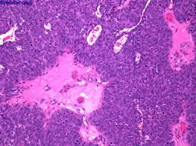
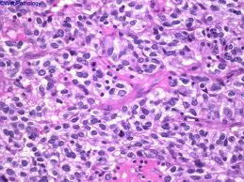
MORPHOLOGY – THYMOMAS (Contd)
MALIGNANT THYMOMA TYPE -II
5% of thymomas designated as thymic carcinoma
Cytologically malignant.
Majority well or poorly differentiated squamous cells carcinoma
Other pattern lymphoepithelioma

Slide 32
CLINCIAL COURSE - THYMOMAS
Discovered incidentally
30-45% associated with myasthenia gravis
Para-neoplastic syndromes
Pure red cell aplasia
Acquired hypogammaglobulinemia
Graves disease
Pernicious anaemia
Cushing syndrome
Dermatomyositis - polymyositis

