Slide 2
SEQUENCE
SEPTAL HEMATOMA/ ABSCESS
SEPTAL PERFORATION
BOIL NOSE

Slide 3
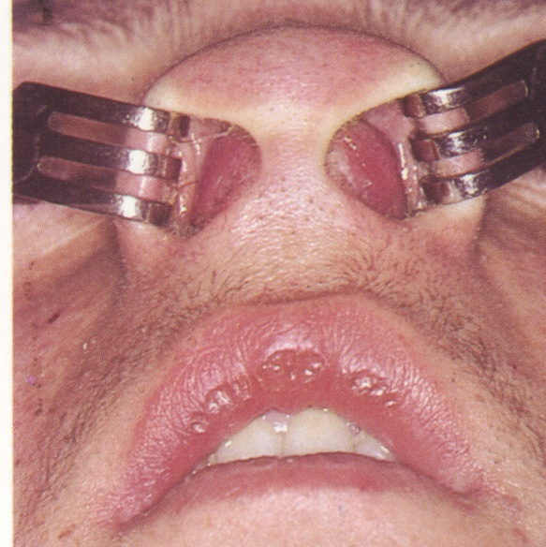
SEPTAL HEMATOMA/ ABSCESS

Slide 4
SEPTAL HEMATOMA
Collection of blood under the perichondrium or periosteum of the nasal septum
ETIOLOGY
Nasal Trauma
Septal surgery
Spontaneous

Slide 5
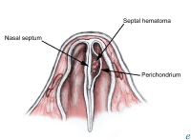
PATHOPHYSIOLOGY
Nasal Trauma
Perichondrium firmly adherent
Submucosal blood vessels torn as buckling forces pull perichondrium from cartilage
Blood collects between the perichondrium and the septal cartilage
Hematoma becomes infected within 3 days

Slide 6
SYMPTOMS
Bilateral Nasal obstruction (95%)
Pain (50%)
Rhinorrhea (25%)
Fever (25%)
Symptoms appear within the first 24-72 hours

Slide 7
SIGNS
Bluish/reddish, smooth, rounded swelling on one or both sides of nasal septum
Soft, fluctuant

Slide 8
TREATMENT
Incision & drainage
Needle aspiration if abscess suspected
Nasal Packing
Broad spectrum antibiotics
Analgesics

Slide 9
COMPLICATIONS
Thickened septum
Septal abscess
Septal necrosis
Supra tip saddling

Slide 10
SEPTAL ABSCESS
Sec infection of Hematoma
Sec to Nasal Boil
Fever with chills
Skin over nose becomes red
Submandibular lymph nodes

Slide 11
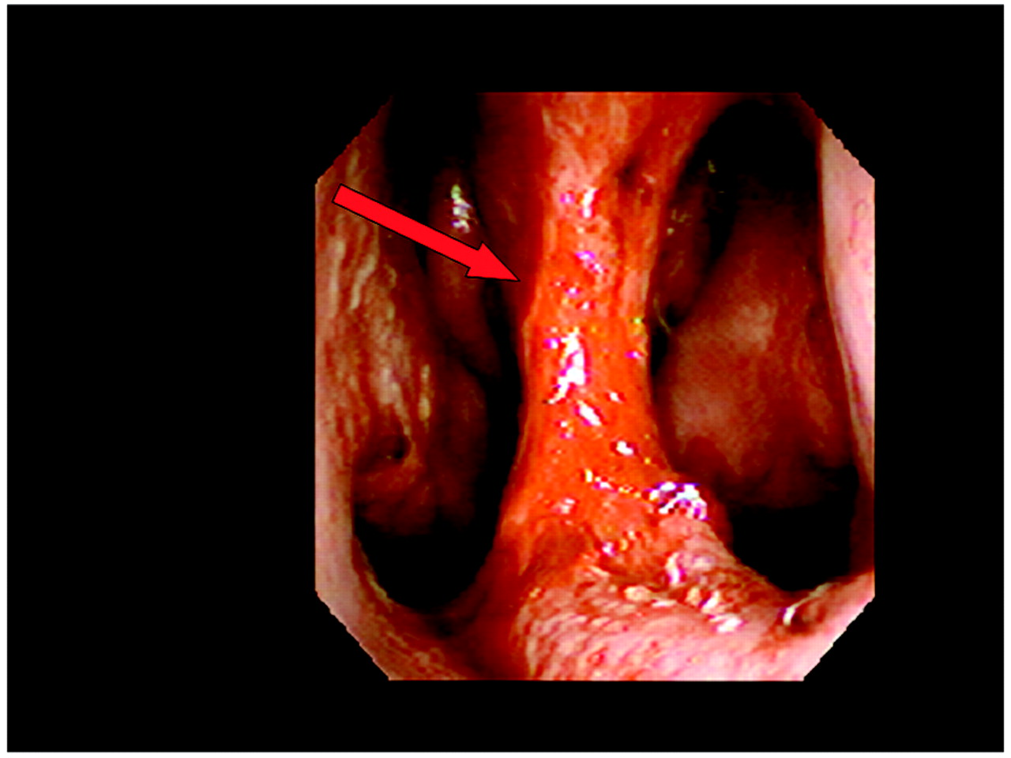
SEPTAL PERFORATION

Slide 12
SEPTAL PERFORATION
A through & through defect in nasal septum with no overlying mucosa or perichondrium

Slide 13
CLASSIFICATION
SMALL
- Diameter less than 0.5 cm
MEDIUM
- Diameter between 0.5- 2 cm
LARGE
- Diameter more than 2 cm

Slide 14
ETIOLOGY
Iatrogenic
Traumatic
- FB, Digital trauma, Septal Hematoma
Infectious/ Inflammatory
- Syphilis, Tb, Septal abscess, Wegener’s granuloma
Neoplastic
- Carcinomas, Lymphomas
Inhalants
- Vasoconstrictor nasal sprays, cocaine, glass dust, fumes

Slide 15
CLINICAL FEATURES
Asymptomatic
Whistling sound in small perforations
Crusting
Bleeding
Nasal Obstruction
Nasal pressure & Discomfort
Saddle nose deformity

Slide 16
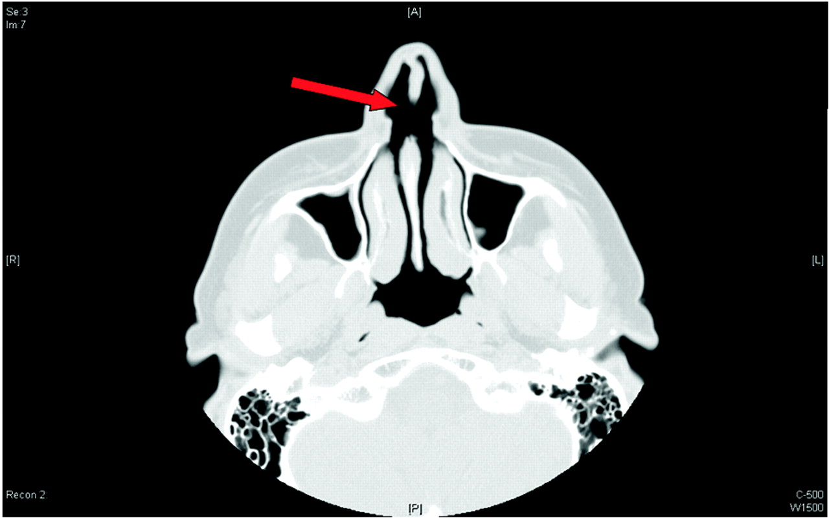

Slide 17
TREATMENT
No Treatment
Treatment of the cause
Regular application of Lubricants
Silicon button prosthesis
Surgical Closure
- Failure rates 45- 90%

Slide 18
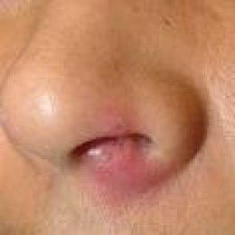
BOIL NOSE

Slide 19
BOIL NOSE (FURUNCLE)
An acute inflammation of the nasal hair follicle by Staphylococcus Aureus

Slide 20
PREDISPOSING FACTORS
Nose picking
Nasal hair plucking
Immuno-compromized

Slide 21
CLINICAL FEATURES
Painful swelling at nasal tip & vestibule
Constitutional symptoms
O/E Red tender nodule in the nasal vestibule

Slide 22
COMPLICATIONS
Septal Abscess
Perichondritis
Cellulitis
Cavernous sinus thrombosis
Meningitis

Slide 23
TREATMENT
Hot Fomentation
Antibiotics
Analgesics/ Antipyretics
I/D if abscess forms
Treat the complications

Slide 24
THANK YOU

