Slide 1
Normal Labour
Lt Col Ambreen Anwer
FRCOG

Slide 2
Labour
Onset of regular uterine contractions associated with effacement and cervical dilatation so that leads to expulsion of products of conception.

Slide 3
Initiation of labour
Average human pregnancy lasts 280 days
What triggers labour ?
We do’nt know!!
Most likely Feto-maternal unit?

Slide 4
Phases of Labour
Phase 0- Quisence
Progesterone, NO, Relaxin
Phase 1- Activation
Oestrogen, CRH
Phase 2- Stimulation
PG, Oxytocin
Phase 3- Involution
Oxytocin, thrombin

Slide 5
Hypothesis
Placental CRH
Fetal Steroids (Cortisol, DHEAS)
1.Placental Oxytocin
2. PGE2, PGF2 alpha
3. COX 1, 2

Slide 6
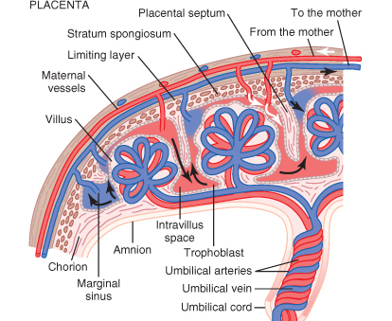
Placenta and Membranes
COX 1/COX 2
Gap Junctions
Arachidonic acid

Slide 7
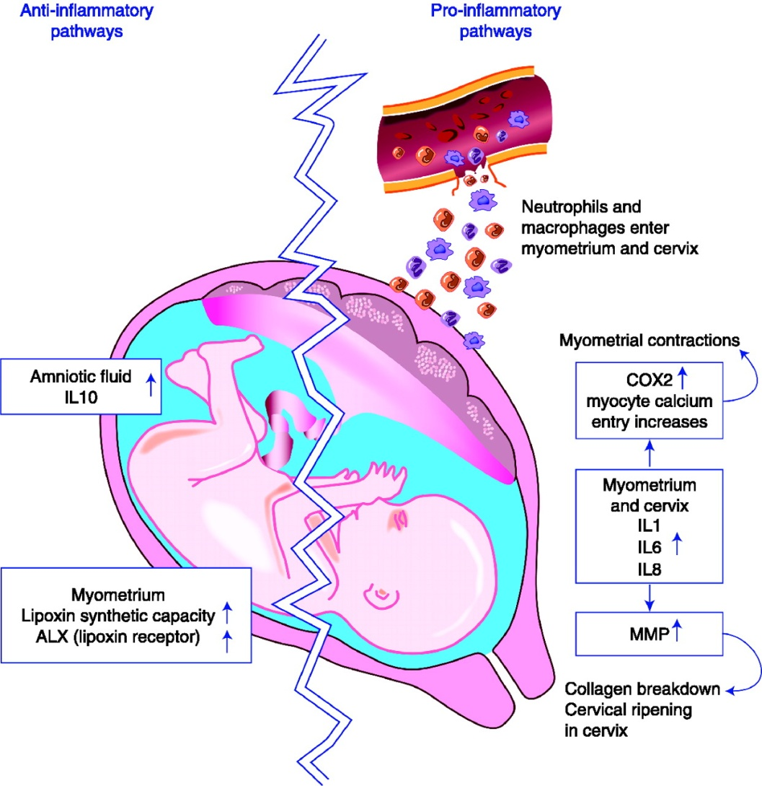
Physiology of Normal Labour
Notes:
Schematic diagram of the pro- and anti-inflammatory pathways operating in labour. Pro-inflammatory pathways are shown on the right hand side of the diagram. Parturition is associated with the influx of leukocytes (principally neutrophils and macrophages) into the myometrium and cervix during parturition. These cells release cytokines such as interleukin (IL)1, IL6 and IL8. These cytokines upregulate matrix metalloproteinase (MMP) expression and activity in the cervix, causing collagen breakdown and cervical ripening. In the myometrium, IL1 and possibly the other cytokines increase the expression of cyclooxygenase (COX)2, leading to increased prostaglandin production. This, together with IL1's activity in increasing calcium entry into myometrial cells will stimulate myometrial contraction. In parallel with these pro-inflammatory events, anti-inflammatory events are also upregulated in labour. Specifically, amniotic fluid IL10 production is increased. In the myometrium, synthetic capacity for the lipoxin pathway and its receptor (ALX) is also upregulated during labour. The upregulation of the anti-inflammatory pathway likely acts as a counterbalance to the pro-inflammatory pathway during the process of parturition. Inappropriate early activation of the pro-inflammatory pathway may initiate preterm labour, and thus strategies to upregulate the anti-inflammatory pathway are of interest in prevention or treatment of preterm birth. Schematic diagram of the pro- and anti-inflammatory pathways operating in labour. Pro-inflammatory pathways are shown on the right hand side of the diagram. Parturition is associated with the influx of leukocytes (principally neutrophils and macrophages) into the myometrium and cervix during parturition. These cells release cytokines such as interleukin (IL)1, IL6 and IL8. These cytokines upregulate matrix metalloproteinase (MMP) expression and activity in the cervix, causing collagen breakdown and cervical ripening. In the myometrium, IL1 and possibly the other cytokines increase the expression of cyclooxygenase (COX)2, leading to increased prostaglandin production. This, together with IL1's activity in increasing calcium entry into myometrial cells will stimulate myometrial contraction. In parallel with these pro-inflammatory events, anti-inflammatory events are also upregulated in labour. Specifically, amniotic fluid IL10 production is increased. In the myometrium, synthetic capacity for the lipoxin pathway and its receptor (ALX) is also upregulated during labour. The upregulation of the anti-inflammatory pathway likely acts as a counterbalance to the pro-inflammatory pathway during the process of parturition. Inappropriate early activation of the pro-inflammatory pathway may initiate preterm labour, and thus strategies to upregulate the anti-inflammatory pathway are of interest in prevention or treatment of preterm birth.

Slide 8
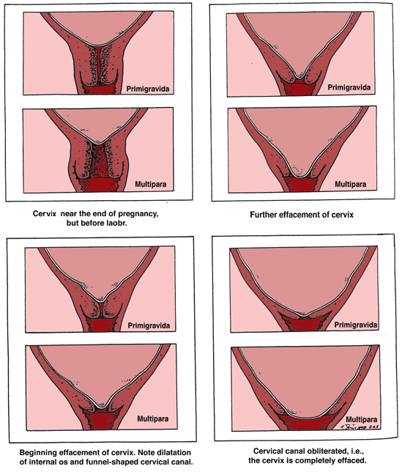
Physiology of Normal Labour

Slide 9
Latent Phase
It starts from onset of labour until the cervix reaches 3 cm diltation
Once 3 cm diltation is reached , labour enters the active phase
Lasts 8 hours or less
Contraction lasting < 20 sceonds
At least 2/10 min contractions

Slide 10
Active Phase
Contractions at least 3 / 10 min
each lasting < 40 sceonds
The cervix should dilate at a rate of 1 cm / hour or faster

Slide 11
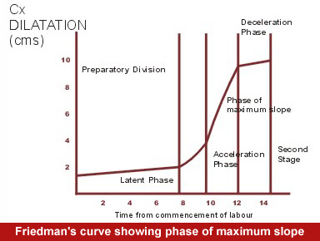
Friedman Curve

Slide 12
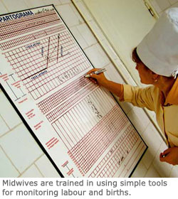
Partogram

Slide 13
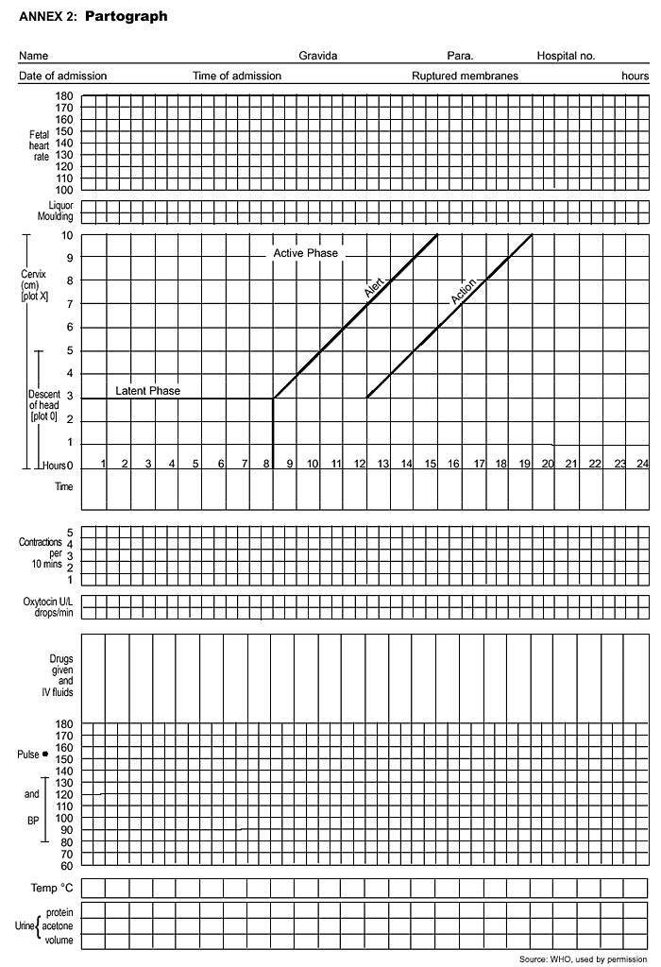
Fetal Condition
Progress of Labour
Maternal Condition

Slide 14
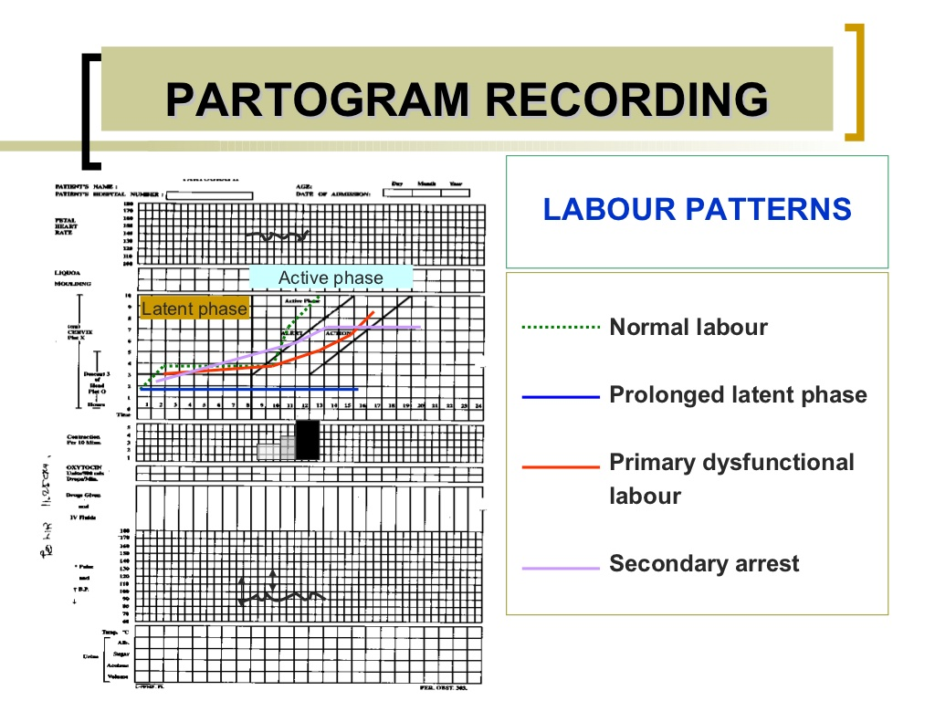

Slide 15
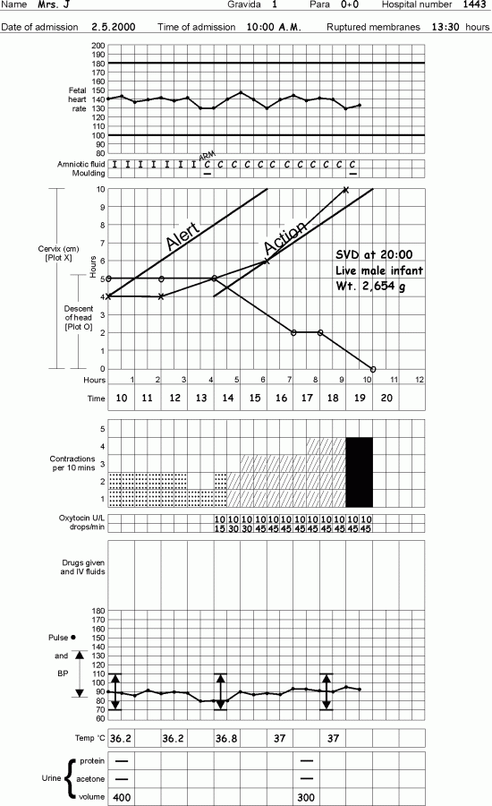
Notes:
Oxytocin Stimulation

Slide 16
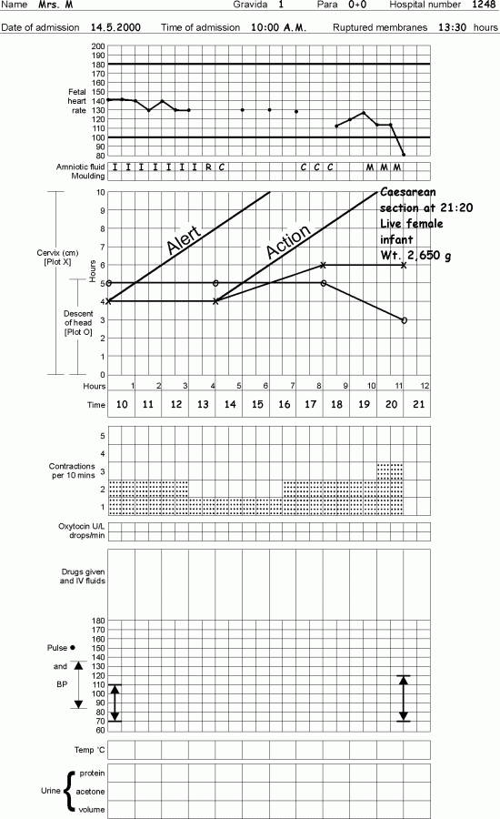
Notes:
Prolonged active phase -PG

Slide 17
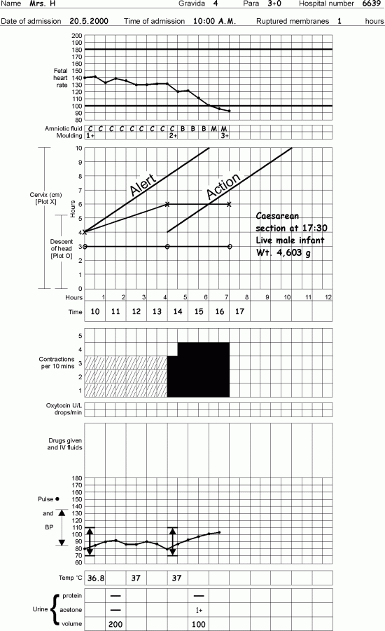
Notes:
Secondary arrest of cx dilatation despite strong contractions _ MG

Slide 18
