Slide 1
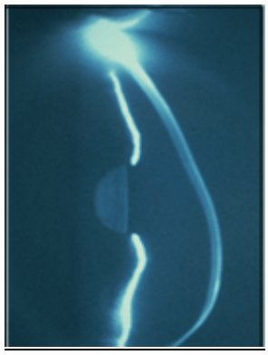
KERATOCONUS

Slide 2
ROOT AND MEANING
KERATO HORN , CORNEA
KONOS CONE

Slide 3
DEFINITION
Keratoconus is a noninflammatory , ectatic corneal condition characterized by central or paracentral stromal thinning , apical protrusion and irregular astigmatism

Slide 4
HISTORICAL BACKGROUND
BRITISH PHYSICIAN
JHON NOTTINGHAM 1854
PRACTICAL OBSERVATIONS ON CONICAL CORNEA

Slide 5
EPIDEMIOLOGY
400 – 600 / 100 , 000 individuals
Male / Female ratio
Laterality

Slide 6
GENETICS
Familial incidence 65%
Autosomal dominant with variable penetrance

Slide 7
PATHOPHYSIOLOGY
Antioxidant deficiency
Proteinase and antiproteinase imbalance
Apoptosis

Slide 8
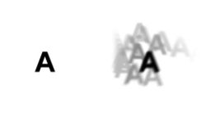
SYMPTOMS AND PRESENTATION
Late teens
Blurring of vision
Shadowing around images
Glare, halos, ocular irritation
Frequent changes in spectacle number

Slide 9
EARLY SIGNS
IRREGULAR ASTIGMATISM
RED REFLEX ……. OIL DROPLET SIGN
SCISSORING REFLEX
VOGT ‘S STRAIE
FLEISCHER’S RING
PROMINENT CORNEAL NERVES
CORNEAL TOPOGRAPH

Slide 15
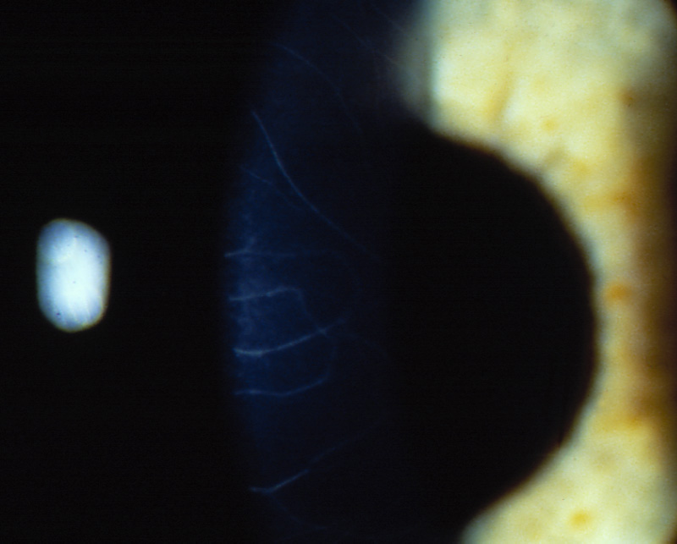

Slide 18
LATE SIGNS
Progressive corneal thinning
Munson’s sign
Central corneal scarring

Slide 21
Systemic associations of Keratoconus
ATOPY
Asthama
Atopic keratoconjunctivitis
Hay fever
Eczema
CONNECTIVE TISSUE DISORDERS
Marfan’s syndrome
Osteogenesis imperfecta
MISCELLANEOUS
Down’s
Turner’s syndrome

Slide 22
OCULAR ASOCIATIONS
RETINITIS PIGMENTOSA
VERNAL CONJUNCTIVITIS

Slide 23
COMPLICATIONS
High Refractive errors:
Intolerance to glasses
Acute Hydrops :
Rupture Descemet’s membrane →Aqueous influx → Corneal edema→ Sudden drop in vision / Opacity

Slide 24
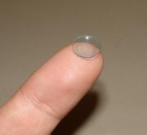
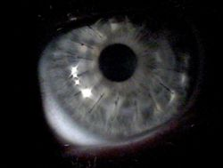
TREATMENT OPTIONS
SPECTACLES
SOFT CONTACT LENSES
HARD CONTACT LENSES
INTRA CORNEAL RINGS ….. INTACS
CORNEAL CROSSLINKAGE WITH RIBOFLAVIN
PENETRATING KERATOPLASTY
LAMELLAR KERATOPLASTY

Slide 26
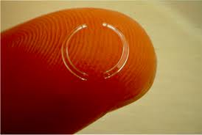
INTACS
Several studies have
demonstrated that
INTACS are able to
improve the corneal
shape & VA of patients
with Keratoconus &
central clear cornea

Slide 29
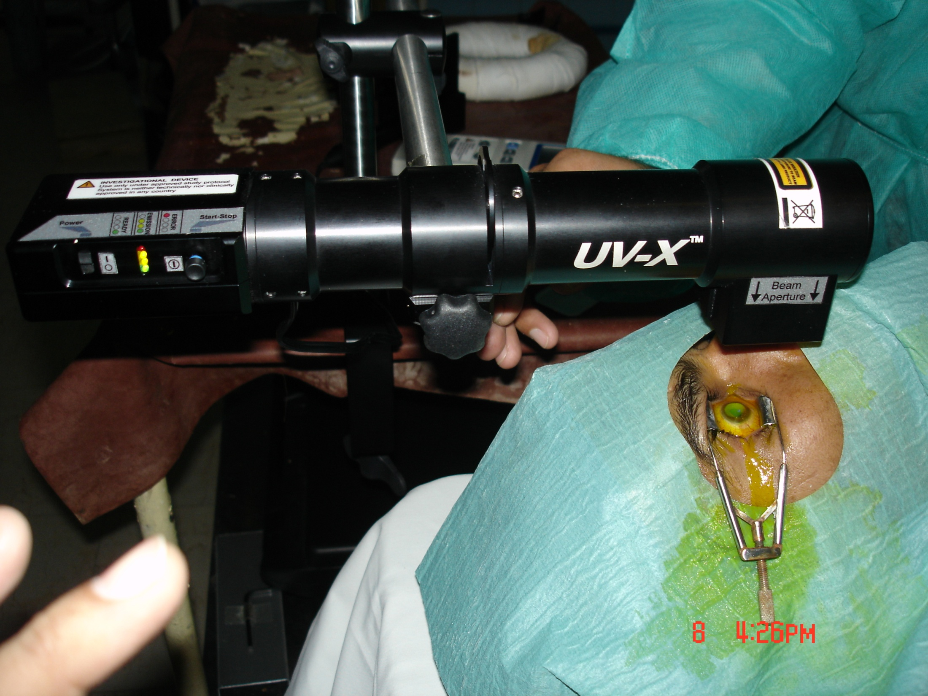

Slide 30
THANKYOU

