Slide 1
Growth Monitoring
Brig Shoaib Ahmed
FCPS.,MRCPI

Slide 2
Gaussian Curve
Any data from the population follow gaussian curve ,bell like pattern.Standard deviation(z score) abbreviated as σ(sigma).
1SD =68.26
2SD=95.44
3SD=99.74

Slide 3
Gaussian Curve

Slide 7
Upper-to-lower Body Segment Ratio
At birth, the normal ratio should be 1.7, and it falls to 1.3 by age 3
The average upper-to-lower body segment ratio is 1.7 at birth and decreases to 1.0 at 10 years of age with leg growth.
Arm span exceeds height by 5.3 cm (2.1 in) in the average adult man and by 1.2 cm (0.5 in) in the average adult woman

Slide 8
Normal Growth Velocity at Various Life Stages
First year
23 to 27 cm (9 to 11 in)
Second year
10 to 14 cm (4 to 6 in)
Fourth year
6 to 7 cm (2 to 3 in)
Prepubertal nadir
5 to 5.5 cm (2 to 2.2 in)
Pubertal growth spurt
Girls: 8 to 12 cm (3 to 5 in)
Boys: 10 to 14 cm (4 to 6 in

Slide 9
Body Proportions

Slide 10
Body Proportions
Body proportions change dramatically.
At birth, head size is ¼ of overall length.
At 16, head doubles in size but 1/8 overall length.

Slide 11
Weighing
Explain to the mother the reasons for weighing the child
Weighing machine should be placed on a smooth horizontal place and enough light should be present so that readings are easily visible.
Check needle is on zero.
Observe readings from the centre

Slide 12
Weigh a child using tared weighing

Slide 13
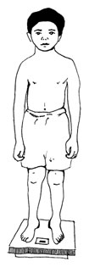

Slide 14
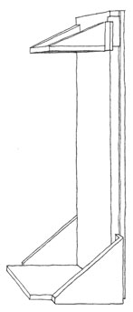
Measuring length or height
infantometer)
stadiometer

Slide 15
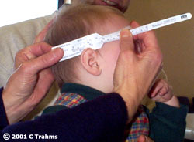

Slide 16
Determine BMI (body mass index)
BMI is a number that associates a person’s weight with his or her height/length.
BMI can be a useful growth indicator when it is plotted on a graph against a child’s age.
BMI is calculated as follows:
Weight in kg ÷ squared length/height in meters
Another way calculate is as follow
Weight (kg) ÷ Height (cm) ÷ Height (cm) X 10,000
Weight (lb) ÷ Height (in) ÷ Height (in) x 703
It is very important to use a length measurement for a child less than 2 years old and a height measurement for a child age 2 years or older

Slide 17
Centile Terminology

Slide 18
CLASSIFICATION
A. CLINICAL ( WELLCOME )
Parameter: weight for age + oedema
Reference standard (50th percentile)
Grades:
80-60 % without oedema is under weight
80-60% with oedema is Kwashiorkor
< 60 % with oedema is Marasmus-Kwash
< 60 % without oedema is Marasmus

Slide 19
WHO (Wasting)
z-score(SD)Below median WFH
Moderate……-3 ≤ z score
< -2 Severe…………z score < -3
WHO ( Stunting)
score below median HFA
Moderate… .……-3≤z score
<-2
Severe………………z-score < -3

Slide 20
Classification
Gomez
Weight below % median WFA
Mild (grade 1)……………… ….75%–90% WFA Moderate (grade 2)…………. 60%–74% WFA Severe ( grade 3)………… …..<60% WFA
Waterlow
Mild……………… 80%–90% WFH
Moderate……. .70%–80% WFH Severe …………..<70% WFH

Slide 22
Exam Preparation
Plan according to date sheet
Calculate how many days left see calender
Easy topics first and difficult topics later
At least 2 revisions .Before exam one short revision
Study diverse topics daily

Slide 24
How to Study
Hours of study
Light
Book Distance
Environment
Duration of each session
Comprehend
Recall
Free time

Slide 25
How to attempt question paper?
Read top to bottom.
Comprehend any instructions
Make a plan of paper and of each question
Easy first
Keep recalling difficult question answer
Comprehend question thoroughly
May write data summary on paper
Write only what is asked
Recheck if time

