Slide 1
CONGENITAL ANOMALIES OF EAR

Slide 2
ANATOMY

Slide 3
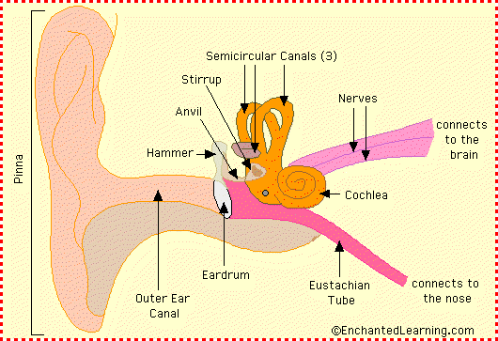
ANATOMY OF EAR
Both functionally and anatomically, it can be divided into three parts.
External ear
Middle ear
Inner ear

Slide 4
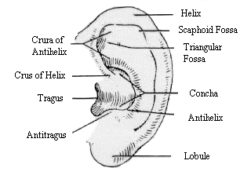
External Ear
Portion external to the tympanic membrane.
The Auricle
elastic cartilage
External Auditory Canal
Lateral Portion –
cartilaginous
containing ceruminous and sebaceous glands.
Medial Portion-
Bony
no skin appendages
comprises two-thirds of the total canal in adults

Slide 5
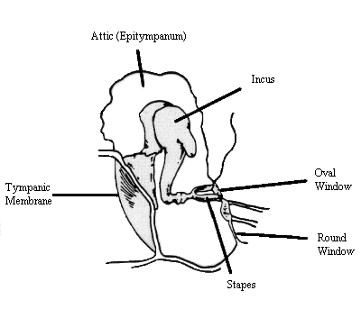
Middle Ear
This is an air-containing space which communicates with the nasopharynx via
the eustachian tube.
Normally sealed laterally by the tympanic
membrane.
Its function is to transmit and amplify sound waves from tympanic membrane to the stapes footplate

Slide 6
Middle Ear..
Tympanic membrane
Ovoid
conical shape
pars flaccida
pars tensa.
Ossicles
involved in sound conduction
Malleus
Incus
stapes

Slide 7
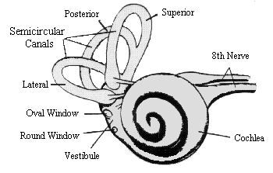
Inner Ear
consists of a fluid-filled labyrinth which functions to convert mechanical energy into neural impulses.
labyrinth –two parts
Bony labyrinth
Membranous labyrinth

Slide 8
Inner Ear..
The bony labyrinth - three main divisions :
Vestibule - just medial to the oval window, and contains the utricle and the saccule, two organs of balance.
The Cochlea - a snail-shaped chamber anterior to the vestibule.It communicates with the middle ear via the round window.
The Semicircular Canals -detect angular acceleration. They consist of a superior, posterior and lateral, or horizontal canals

Slide 9
Inner Ear..
The bony labyrinth is subdivided into smaller compartments by the membranous labyrinth.
Fluid surrounding the membranous labyrinth is called perilymph; fluid within is called endolymph.
Organ of Corti – lies in membranous labyrinth.

Slide 10
EMBRYOLOGY

Slide 11
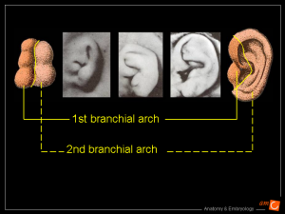
Embryology of Ext. ear
Development of the
external ear begins
during the fourth week of gestation as six
mesenchymal
Proliferations enlarge to
form ridges known as the hillocks of His.

Slide 12
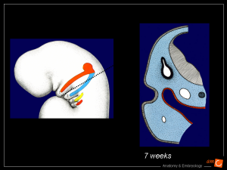
Embryology of Ext. ear..
These hillocks, which surround the first branchial groove or primitive meatus, fuse to form the primitive auricle by the third month of gestation.
The EAC develops from the first branchial groove beginning in the eighth week of gestation.

Slide 13
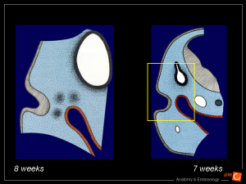
Embryology of Ext. ear..
Epithelial cells from the meatus proliferate forming a solid core of cells, known as the meatal plug.
This solid core will then recanalize to form the epithelial lined EAC, but not until the sixth or seventh month of gestation.

Slide 14
Congenital anomalies of Auricle
Anotia –total absence of auricle.
Microtia –pinna is rudimentary & malformed.
Protruding or Bat ears
Auricular appendages or Accessory auricles – contain a bar of elastic cartilage.
Congenital aural sinuses – commonly found in preauricular region.

Slide 15
Congenital anomalies of Auricle
Congenital aural fistulae – open superiorly in the floor of the EAM & inferiorly at the anterior border of SCM
Congenital syndromes ass. with microtia & deformities of pinna –
Potter’s syndrome
Treacher Collins syndrome
Fraser syndrome
Otomandibular syndrome of Konigsmark
Branchio-otic dysplasia

Slide 16
Congenital anomalies of EAC
Congenital meatal atresia & stenosis
Can occur unilaterally or bilaterally
Usually accompained by auricular deformity.

Slide 17
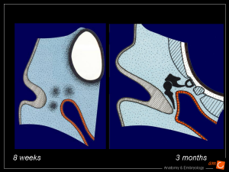
Embryology of Middle ear
The core of cells forming meatal plug, migrates medially toward the outgrowth of the first branchial pouch, which will eventually form the middle ear cleft.
The meatal plug contacts the middle ear cleft by the ninth week of gestation.

Slide 18
Embryology of Middle Ear..
Ossicular development begins in the fourth week and, at this time, the malleus and incus appear as a fused mass.
Separation into two distinct ossicles typically occurs by the eighth week of gestation.

Slide 19
Embryology of Middle Ear..
The first branchial arch, Meckel’s cartilage, contributes to the development of the head and neck of the malleus and the body and short process of the incus.

Slide 20
Embryology of Middle Ear..
The second branchial arch, Reichert’s cartilage, leads to the development of the manubrium of the malleus, the long process of the incus and the stapes suprastructure.
By the sixteenth week of gestation, the ossicles are of adult size.

Slide 21
Congenital anomalies of Ext. & Middle Ear
External & middle ear abnormalities are generally associated and classified into 3 types
Type 1 (mild) –
Auricle is normal
EAC is small or atretic
Tympanic cavity is normal or small
Middle ear structures show minor deformities

Slide 22
Congenital anomalies of Ext. & Middle Ear
Type 2 (medium) –
Pinna is rarely normal
EAC is aplastic
Middle ear cavity is reduced in size
Malleus & incus are deformed & fixed
Facial nerve always takes an abnormal course

Slide 23
Congenital anomalies of Ext. & Middle Ear
Type 3 (severe) –
Pinna is severely malformed or absent
EAC is absent
Tympanic cavity is either very small or missing
Associated inner ear deformities
More commonly encountered as part of craniofacial syndromes

Slide 24
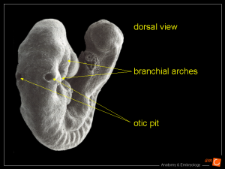
Embryology of Inner Ear
Inner ear development from the otic placode begins during the third week of gestation.
Invagination of the otic placode to form the otic vesicle is apparent by week four, and by the sixth week the semicircular canals have taken shape.

Slide 25
Embryology of Inner Ear..
The utricle and saccule have formed by the eighth week
The three Semi circular canals appear as outpouchings from posterior part of the vestibule

Slide 26
Embryology of Inner Ear..
The membranous labyrinth is entirely developed by fifteen weeks gestation and ossification of the surrounding otic capsule is complete by twenty-three weeks gestation.
Development of the cochlea begins during the seventh week, and by week twelve the complete two and a half turns have formed.

Slide 27
Congenital anomalies of Inner Ear
Aplasia – as a result of genetic factors or toxic influence caused by certain forms of maternal illness during first trimester
Michel type – complete failure of inner ear development.
Mondini type – incomplete development of the bony &membranous labyrinth.
Scheibe type – cochleocaccular aplasia
Alexander type – mambranous cichlear aplasia.

Slide 28
Congenital anomalies of Inner Ear
Abiotrophy – degeneration of parts of the auditory apparatus .
Essentially ectodermal – of the cochlear duct or scala media e.g. Waardenburg’s syndrome, Cogan syndrome
Essentially mesodermal – of the sensory end organs e.g.Alport’s syndrome, Marfan’s syndrome
Essentially neuroectodermal – of the nerve element e.g.von Recklinghausen’s syndrome.

Slide 29
Conditions displaying middle &inner ear abnormalities
Treacher Collins syndrome
Apert’s syndrome
Klippel Feil syndrome
Turner syndrome
Patau syndrome
Edward’s syndrome
Down’s syndrome
Pierre Robin syndrome

