Slide 1
ANATOMY OF NOSE AND PARANASAL SINUSES Lieutenant Colonel Mian Amer Majeed MBBS, MCPS, FCPS (ENT, DO-HNS (London) ENT DEPT MH RWP

Slide 2
The Nasal Cavity: Functions
The superior part of the respiratory tract
A passageway for air to lungs
Organ of smell
Aids in phonation
Filters impurities esp. dust from inspired air
Warms and humidifies inspired air
Receives secretions from paranasalsinuses and nasolacrimal duct

Slide 3
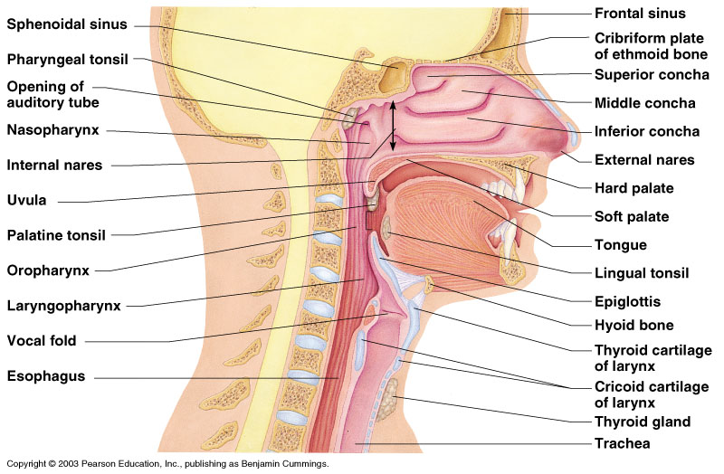
Slide 13.3b
Upper Respiratory Tract
Figure 13.2

Slide 4
DEVELOPMENT OF NOSE
4th week FACIAL PROMINENCES
Frontonasal process forms forehead ,bridge of nose, medial & lateral nasal prominences
Maxillary process forms cheeks & lateral portion of upper lip
Lateral nasal process forms alae of nose
Medial nasal process forms nasal septum,philtrum,premaxilla& primary palate
Mandibularprocess forms lower lip

Slide 5
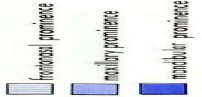
• 5 facial primordia
• Frontonasal prominence
• Paired maxillary prominences
• Paired mandibular prominences
• Surround primordial mouth (stomodeum)
• Frontonasal prominence forms forehead and nose and a short margin of mouth
• Nasal placodes (and pit): surrounded by medial & lateral nasal prominences
• Nasal pit remains connected to mouth
• Maxillary prominences grow toward each other, pushing nasal prominences
medially

Slide 6
• Medial nasal prominences merge with each other and with lateral nasal & maxillary prominences
• Nasolacrimal groove: between lateral nasal and maxillary prominences
becomes nasolacrimal duct
• Duct forms as solid epithelial cord that later canalizes
• Intermaxillary segment merges with medial nasal prominences gives rise to philtrum, premaxillary bones, primary palate

Slide 7
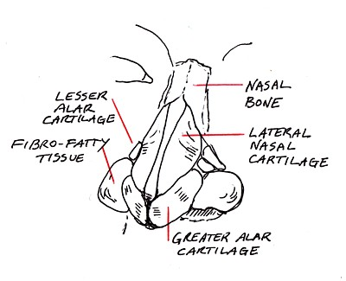
The Nasal Cavity includes internal and external parts
The internal part is much larger than the external part
The external nose is the part that projects from the face.
Its supporting skeleton is comprised of bone and cartilage.
External Nose, The Bones:
Nasal
Frontal (Nasal Part)
Maxilla (Frontal Process)
The Cartilages

Slide 8
External Nose

Slide 9
The Nasal Framework

Slide 10
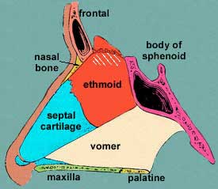
The entire nasal cavity extends from the nares (nostrils) anteriorly to the choanae posteriorly
Choanae
It is divided into 2 parts by an osseocartilaginous nasal septum

Slide 11
The Nasal Cavity
Each half of the nasal cavity has a:
Floor
Roof
Lateral wall
Septal wall

Slide 12
The Floor
Palatine process maxilla
Horizontal plate palatine bone
(the superior surface of the hard palate)

Slide 13
The Roof
Narrow
Formed by a number of bones and cartilages
Anterior part – corresponds with bridge of nose
Intermediate part – formed by cribriform plate
Posterior part – formed by inferior surface, sphenoid body
Nasal Cartilages,Nasal, Frontal, Ethmoid,SphenoidBones

Slide 14
The Nasal Septum (the medial wall)
Divides the nasal cavity into right and left halves
It is part osseous and part cartilaginous
Perpendicular Plate (ethmoid)
Septal Cartilage
Vomer

Slide 15
The Lateral Walls
Marked by 3 projections:
Superior concha
Middle concha
Inferior concha
The area below each concha (turbinate) is referred to as a meatus.

Slide 16
Spheno-ethmoidal recess
above superior turbinate
sphenoid sinus opening
Superior meatus
below superior turbinate
posterior ethmoid opening
Middle meatus
bulla ethmoidalis: middle ethmoidal cells
semilunar hiatus
uncinate process
infundibulum: frontal, anterior ethmoid, maxillary sinus
Inferior meatus
nasolacrimal duct

Slide 18
Openings Into the Nasal Region
Sphenoid sinus opens into sphenoethmoidal recess
Anterior & middle ethmoid air cells, maxillary and frontal sinuses open into middle meatus
Posterior ethmoidal air cells open into superior meatus
Nasolacrimal Canal drains intoInferior Meatus

Slide 19
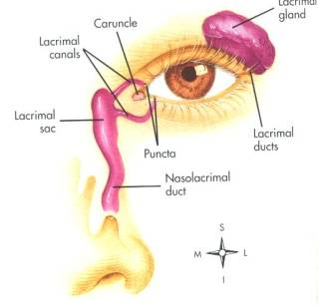
The Nasolacrimal Canal
The Nasolacrimal Canal conveys tears from the orbit to the inferior nasal meatus

Slide 20
LINING MEMBRANE OF NOSE
Vestibule
anteroinferior
Skin-hair follicles,sebaceousglnds
Olfactory region
Upper 1/3
Paler mucous membrane
Respiratory region
Lower 2/3
Pseudostratified ciliated columner
Serous,mucus glands

Slide 21
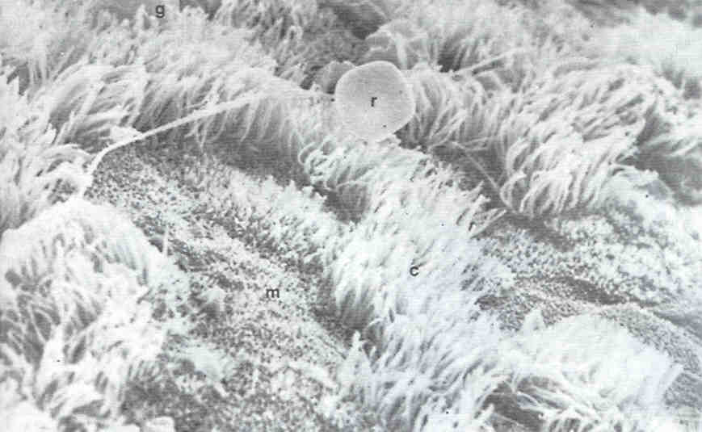
Pseudostratified ciliated columner epithelium

Slide 22
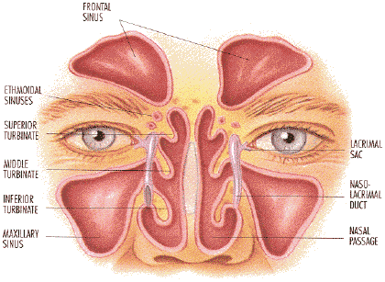
Paranasal Air Sinuses
Frontal
Ethmoid
Maxilla
Sphenoid
Air filled extensions of the respiratory part of the nasal cavity are found within these bones. They are called the paranasal sinuses.

Slide 23
The Paranasal Sinuses
Functions:
Resonators of the voice
They also reduce the skulls weight
The paranasal sinuses are lined with mucoperiosteum (Mucous membrane and periosteum so intimately united as to form nearly a single membrane)
The mucus which is produced is moved into the nose primarily via ciliary action
Apertures communicate between the sinuses and the nasal cavity
Sinusitis is inflammation and swelling of the mucosa of one or more of these paranasal sinuses

Slide 24
MAXILLARY SINUS
Antrum of Highmore
Largest (15 ml)
Pyramidal
Floor 1 cm below nasal floor
Dental infections
Opens in infundibulum of middle meatus

Slide 25
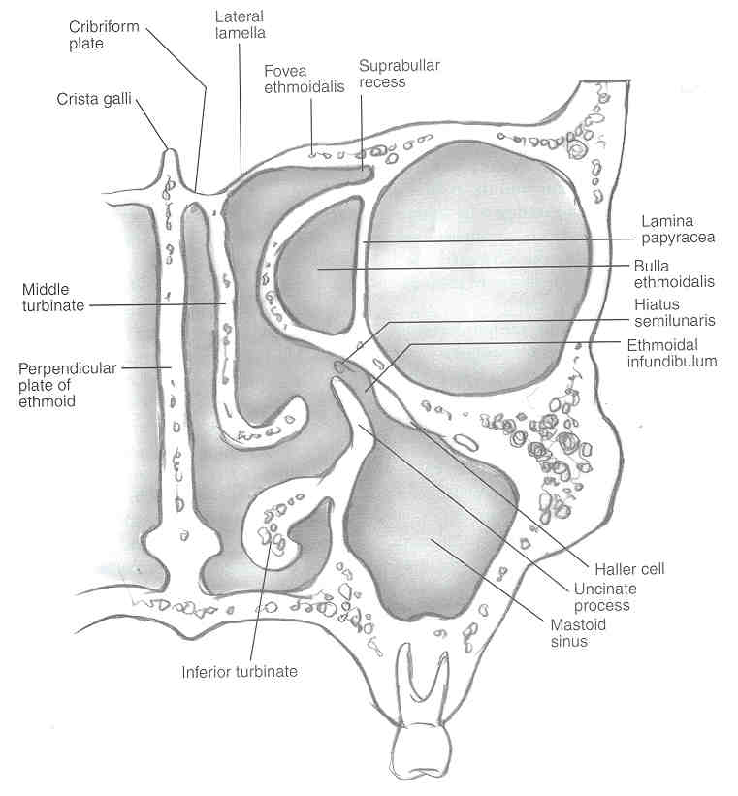
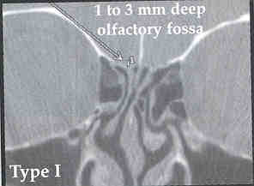
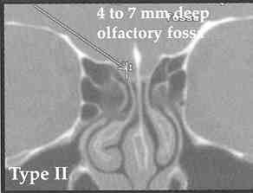
Ethmoid Roof
Anterior 2/3
Posterior 1/3
Keros I
Keros II
Keros III

Slide 26
FRONTAL SINUS
Between inner and outer tables of frontal bone.
Asymmetric.
Opens into the middle meatus.
Frontal recess 55%
Not into the infundibulum 30%
Into infundibulum 15%

Slide 28
ETHMOIDAL SINUSES
3 to 18 in number
b/w upper 3rd of lateral wall of nose and medial wall of orbit
LAMINA PAPYRACEA seperates it from the orbit
Anterior cells----middle meatus
Middle cells----bulla ethmoidalis
Posterior cells---superior meatus

Slide 31
SPHENOID SINUS
Lies in the body of sphenoid
Asymmetric
Opens into spheno-ethmoidal recess
Roof is related to
Pituitary gland
Cavernous sinus
ICA
CN III,IV,VI,
CN V1,V2

Slide 34
Blood Supply of Nasal Cavity
(1) branches from the internal carotid, namely the branches of the anterior and posterior ethmoid arteries from the ophthalmic artery, and
(2) branches from the external carotid, namely the sphenopalatine, greater palatine, superior labial, and angular arteries.

Slide 35
The external nose is supplied by the facial artery, which becomes the angular artery coursing over the superomedial aspect of the nose.
The dorsal regions of the nose are supplied by branches of the maxillary artery (namely the infraorbital) and ophthalmic arteries (which are from the internal carotid system).

Slide 36
Blood Supply of Nasal Cavity primarily from branches of maxillary a.
Sphenopalatine a.
Maxillary a.

Slide 37
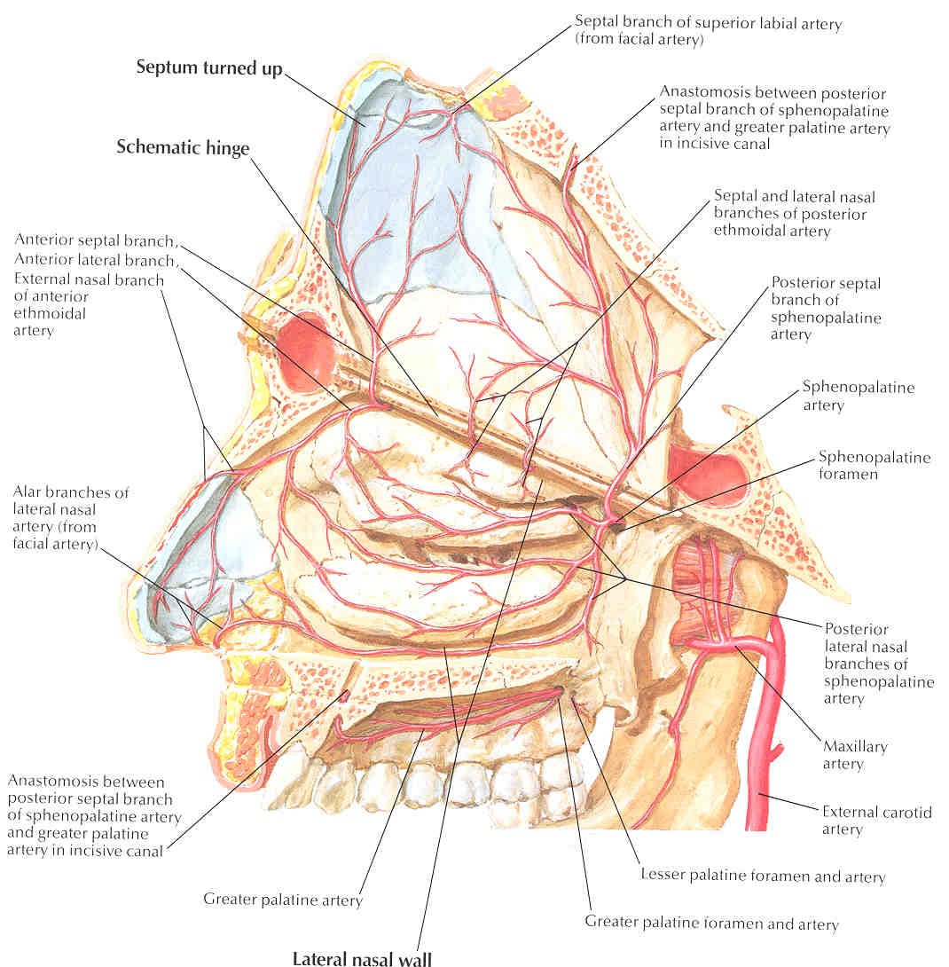

Slide 38
Venous Drainage
FACIAL VEIN
ANGULAR VEIN
CAVERNOUS SINUS
OPHTHALMIC VEIN
They are significant for their direct communication with the cavernous sinus and for their lack of valves; these features potentiated the intracranial spread of infection.

Slide 39
Little’s area
Anteroinferior, just above the vestibule.
4 arteries, kiesselbach’s plexus.
Site of anterior epistaxis.
Woodruff’s area
Under posterior end of inferior turbinate.
Sphenopalatine a. with posterior pharyngeal a.
Site of posterior epistaxis.
Retrocolumellar vein
Runs vertically downward behind columella.
Crosses floor,joins venous plexus on lateral nasal wall.
site of venous bleeding.

Slide 40
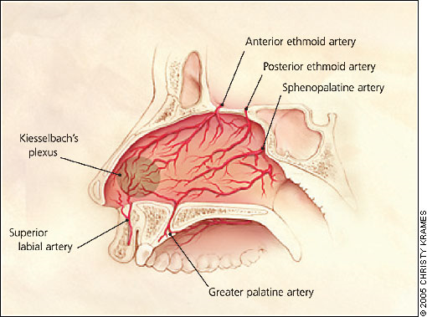
KEISELBACH’S PLEXUS

Slide 41
Sensory Nerve Supply
The sensation of the nose is derived from the first 2 branches of the trigeminal nerve.
Ophthalmic division
Lacrimal- Skin of lateral orbital area except lacrimal gland
Frontal - Skin of forehead and scalp
Supraorbital - Eyelid skin, forehead, and scalp
Supratrochlear - Medial eyelid and medial forehead
Nasociliary - Skin of the nose and mucous membrane of anterior nasal cavity

Slide 42
Maxillary division
Maxillary
Infraorbital - External nares
Zygomatic
Superior posterior dental
Superior anterior dental - Mediates sneeze reflex
Sphenopalatine
The parasympathetic supply is derived from the greater superficial petrosal (GSP) branch of cranial nerve VII. The GSP joins the deep petrosal nerve (sympathetic supply), which comes from the carotid plexus to form the vidian nerve in the vidian canal. The vidian nerve travels through the pterygopalatine ganglion (with only the parasympathetic nerves forming synapses here) to the lacrimal gland and glands of the nose and palate via the maxillary division of the trigeminal nerve.

Slide 43
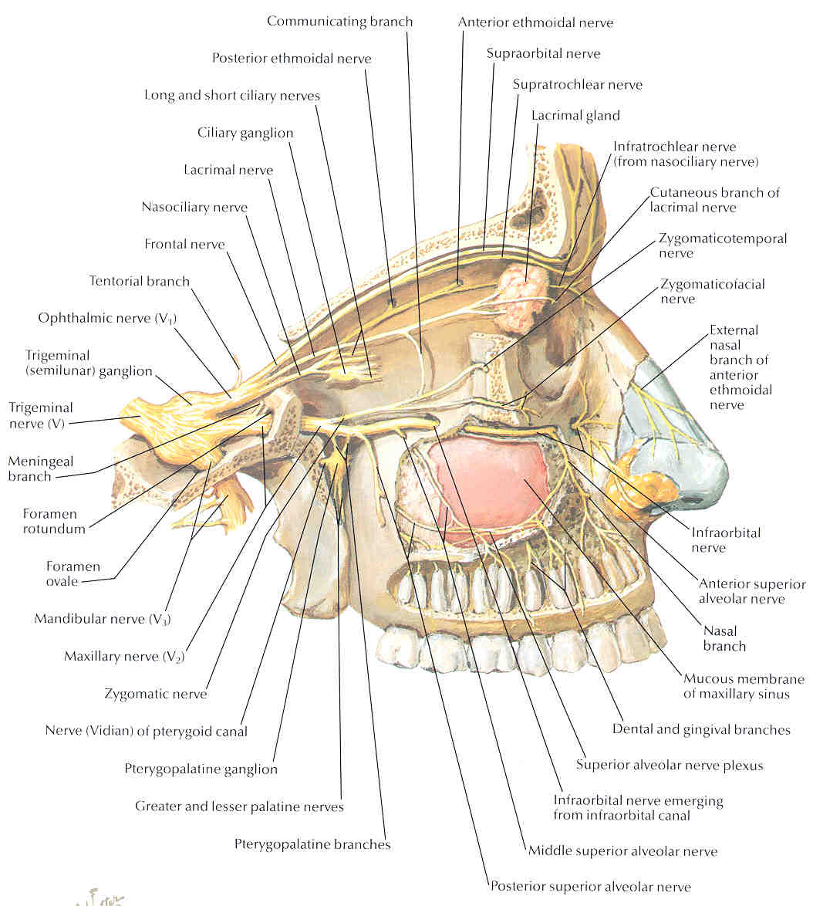
Innervation

Slide 44
OLFACTORY NERVES
The superior most region of the nasal cavity
Contains 12 to 20 olfactory nerves that pass through cribriform plate to end in olfactory bulb
Carry sheaths of dua,arachnoid and pia
Injury causes CSF rhinorrhoea

Slide 45
Innervation of Nasal Cavity
CN I – Olfactory Nerves (SVA)
Anterior ethmoidal branch of V₁ (GSA)
Posterior nasal branches of V₂ (GSA)
Cut nasopalatine branch of V₂ to septum (GSA)

Slide 46
THANKYOU

