Slide 1
CORNEAL REFRACTIVE SURGERY
Major m kashif hanif
DOMS.FCPS
Cl. eye splt
AFIO RWP

Slide 2
Sequence of presentation
Brief overview of anatomy of cornea
Brief overview of physiology of cornea
Corneal refractive surgery

Slide 3
Gross anatomy of cornea
11.5mm horizontal diameter
10.5mm vertical diameter
1 mm thick periphery
0.5mm thick centrally
Anterior surface radius 7.7mm
Posterior surface radius 6.8mm

Slide 4
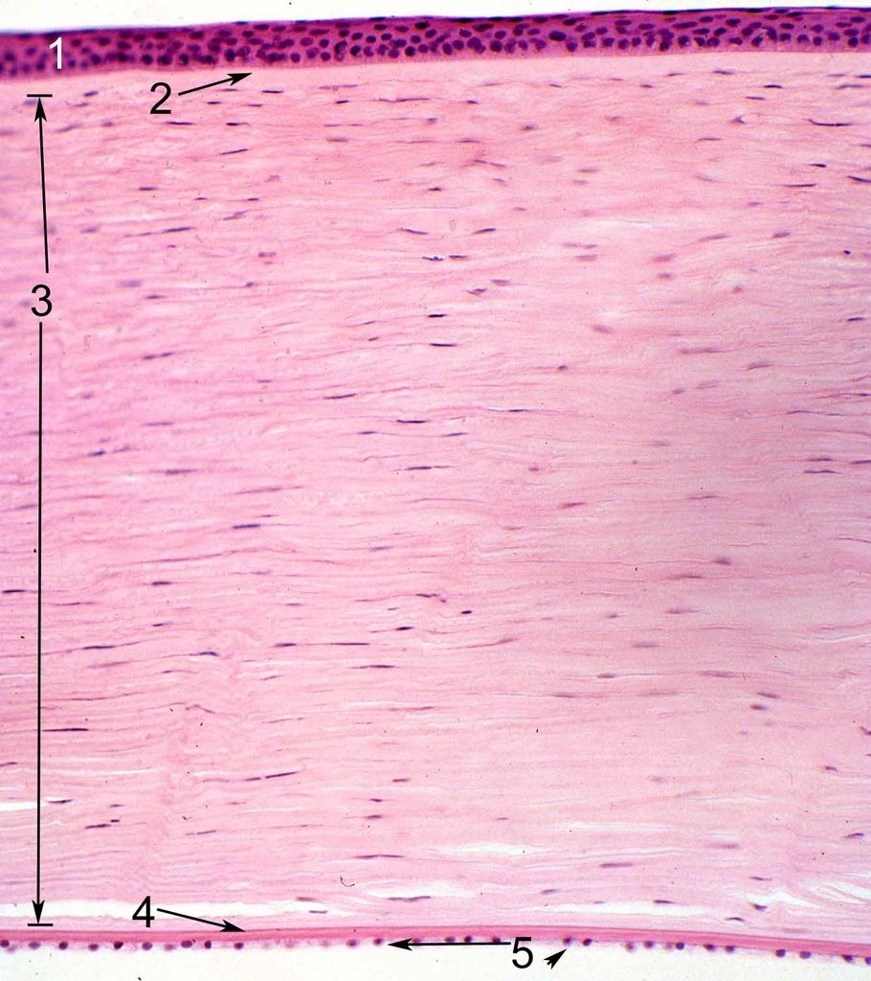
Microscopic anatomy
Epithelium
5-6 layers thick
Stratified squamous , nonkeratinised
Superficial cells have microvilli
Basement membrane strongly attached to Bowman’s layer
Notes:
This slide shows hema $ eosine stained section of cornea revealing 5 layers namely

Slide 5
Bowman’s layer
8-12 microns
Acellular
interwoven collagen fibrils
Incapable of regeneration
Ends abruptly at limbus
Notes:
Consists of interwoven collagen fibrils
Incapable of regeneration, replaced by fibrous tissue if damaged (i.e. scars)

Slide 6
Stroma
90% of cornea thickness
400microns centrally
80% water
Glycosaminoglycans
Notes:
Glycosaminoglycans in extracellular matrix
3 major fractions
Keratan sulphate (50%)
Chondroitin phosphate (25%)
Chondroitin sulphate (25%)

Slide 7
Descemet’s membrane
10microns thick
Type IV collagen fibrils
Basement membrane of the endothelium
Secreted and regenerated by endothelial cells
Terminates abruptly at limbus (Schwalbes line)

Slide 8
Endothelium
Single layer, polygonal, cuboidal cells
Tight junctions
Incapable of regeneration
Lines passages of trabecular meshwork
Notes:
Tight junctions (control of corneal hydration)

Slide 9
Physiology of cornea
3 main functions
Light transmission
Light refraction
Protection
Corneal metabolism
Energy needed for maintenance of transparency and dehydration
Glucose
Oxygen
Notes:
Light refraction
Total refractive power of cornea 43 D (70% of eye’s refractive power)
Refractive index of cornea 1.376
Glucose
Cornea obtains glucose mainly from aqueous
Tears and limbal capillaries appear to provide minimal contribution
ATP obtained through glycolysis and Kreb’s cycle
Oxygen
Endothelium acquires oxygen from aqueous
Epithelium acquires oxygen from either capillaries at the limbus or precorneal film

Slide 10
Ametropia
A refractive error (ametropia) is a disorder that occurs when parallel rays of light entering the non-accommodating eye are not focused on the retina

Slide 11
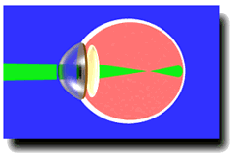
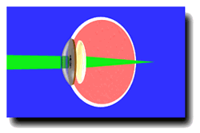
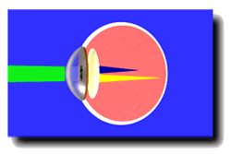
Normal Eye
Myopia
Hypermetropia
Astigmatism
Notes:
Astigmatism occurs when incident light rays do not converge at a single focal point

Slide 12
Aim Of Refractive Surgery
Alter refractive state of eye , enable patients to see without visual aids

Slide 13
refractive surgery divided into four major areas:
1. INCISIONAL TECHNIQUES
2. INTRASTROMAL CORNEAL RINGS (INTACS)
3. THERMAL TECHNIQUES
4. LAMELLAR PROCEDURES

Slide 14
INCISIONAL TECHNIQUES

Slide 15
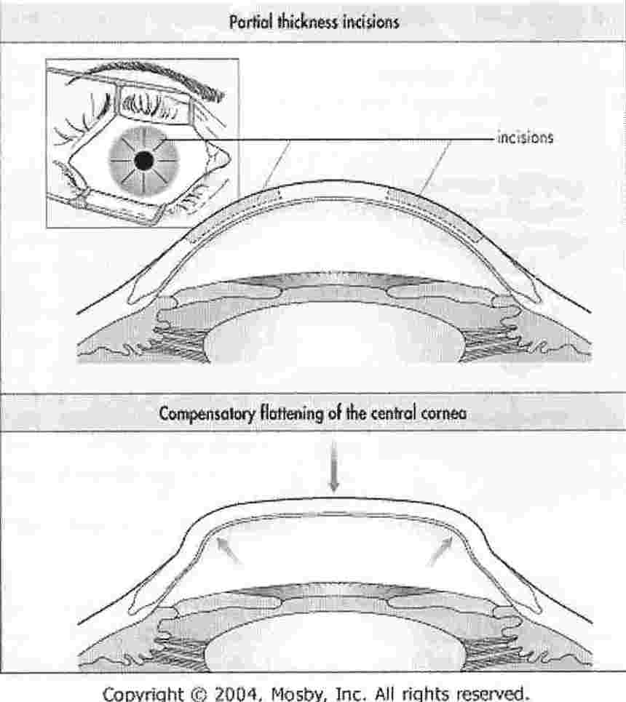
Radial Keratotomy
Sato,1939
radial cuts
pattern : spokes of a bicycle wheel
4-16 incisions
Extra-pupillary region
Notes:
Sato 1939 intro as solution to keratoconus – modified by Fyodorov
procedure involves radial cuts on epithelial side of cornea to stroma

Slide 16
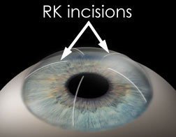
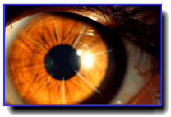
Radial Keratotomy
Notes:
Sato 1939 intro as solution to keratoconus – modified by Fyodorov
procedure involves radial cuts on epithelial side of cornea to stroma

Slide 17
Complications
Glare, star bursts
Fluctuation of vision
Regression, progression of refractive effect
Corneal perforation into the anterior chamber
Infectious keratitis and endophthalmitis
Notes:
Radial keratotomy has been performed infrequently since the advent of PRK and LASIK

Slide 18
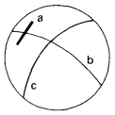
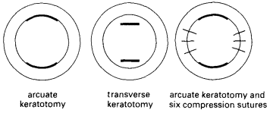
Incisional Astigmatic Keratotomy
Incision in the cornea flattens the meridian in which it is made and steepens the meridian 90 degrees away.
Single or paired
Optical zone between 6.0 mm and 7.0 mm
Notes:
Astigmatic keratotomy makes use of the principle that a transverse or arcuate incision in the cornea flattens the meridian in which it is made and steepens the meridian 90 degrees away.These incisions are usually single or paired, typically maintaining an optical zone between 6.0 mm and 7.0 mm
A corneal incision (a) causes flattening of surface curvature in the same meridian as the incision (c) and steepening of the meridian 90° away (b).

Slide 19
Relaxing incisions may be combined with compression sutures placed 90° away from them to reduce large degrees of corneal astigmatism
Notes:
A tight corneal suture flattens the cornea adjacent
to it and displaces the corneal apex away from
it, causing the cornea to bulge away.

Slide 20
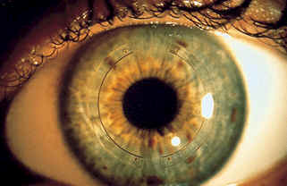
INTRASTROMAL CORNEAL RINGS

Slide 21
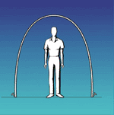
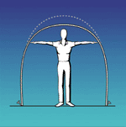
Intrastromal Corneal Rings
The ring segments flatten cornea similarly to the way you can flatten the top of a tent by pushing on the sides.

Slide 22
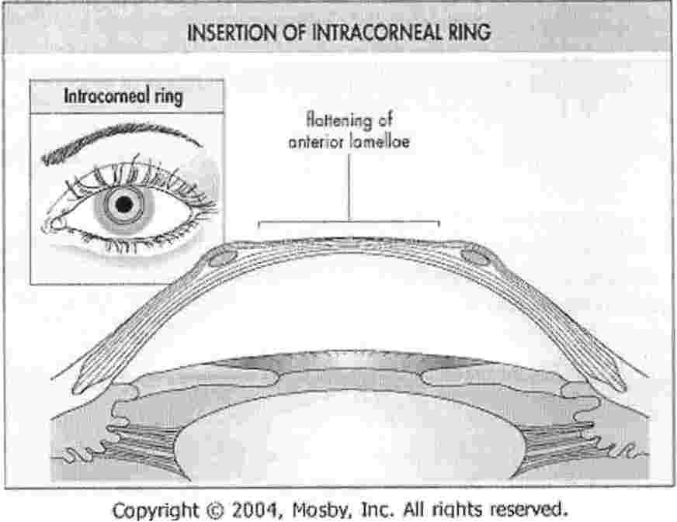
Notes:
partial thickness corneal incision are given followed by the application of a suction ring and the use of a stromal separator
Arcuate plastic segments of prescribed thickness are then positioned within the channels and the incision is closed.²⁹¹

Slide 23
Intrastromal corneal Rings
Indicated for low myopia (1-3D) and min astigmatism < 1.00D
Advantage: reversible, natural corneal physiology maintained, no use of lasers , no removal of tissue

Slide 24
Complications
Fluctuation of vision
Under- or over-correction
Induced regular or irregular astigmatism
Glare , haloes
Corneal perforation
Pain
Infectious keratitis

Slide 25
THERMAL PROCEDURES

Slide 26
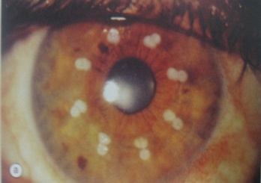
Thermokeratoplasty
Hypermetropia +0.75 D to +3.25 D
Astigmatism less than or equal to 0.75 D
Spherical equivalent +0.75 D to +3.00 D

Slide 27
This technique modifies the central corneal curvature by heat-induced shrinkage of collagen fibers in the midperiphery of the cornea.
Noncontact Technique
Holmium laser thermokeratoplasty (LTK)
Conductive Keratoplasty
contact probe
Notes:
Treatment can be applied by a noncontact laser or by contact probes
Noncontact Technique. Holmium laser thermokeratoplasty (LTK) is a noncontact procedure in which two concentric rings of eight simultaneous spots of laser energy are applied to the midperiphery of the cornea to modify/steepen the central corneal curvature. Disadvantages include early overcorrection, the inability to treat astigmatism, the possibility of inducing astigmatism, substantial regression, and possible mid-peripheral corneal scarring
Conductive Keratoplasty. Conductive keratoplasty uses a contact probe by inserting the tip sequentially in multiple locations of the peripheral cornea

Slide 28
LAMELLAR PROCEDURES

Slide 29
Lamellar Procedures
Laser in situ keratomileusis
Laser Epithelial Keratomileusis
Epithelial LASIK

Slide 30
What is Laser?
Light Amplification by Stimulated Emission of Radiation (LASER)
Ground state
Pumping
Atoms in the excited state are unstable and their electrons tend to spontaneously return to the ground state by emitting light energy
Notes:
All atoms are most stable in their lowest energy state, known as the ground state. Energy is delivered to atoms in a laser active medium by a process called pumping in which atoms are excited by photons . Atoms in the excited state are unstable and their electrons tend to spontaneously return to the ground state by emitting light energy

Slide 31
What Is An Excimer Laser?
EXCIMER= “excited dimer”
Argon or Xenon bound with a halogen eg. Fluorine or Chloride
diatomic gas halide - temporary excited state
Notes:
refers to inert gas eg. Argon or Xenon bound with a halogen eg. Fluorine or Chloride
combination=diatomic gas halide - temporary excited state

Slide 32
Excimer Laser
During decay → emits UV of 193nm λ
Remove controlled amounts of tissue with extreme precision

Slide 33
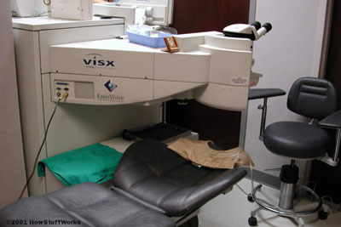
Photorefractive keratectomy
Indication
myopia up to 6D
astigmatism up to 3D
Hypermetropia up to 3D
Myopia
10um of ablation = 1D of myopia
Hypermetropia
Notes:
PRK is able to correct myopia up to 6 D astigmatism upto 3D and low hypermetropia
Myopia is treated by ablating the central anterior corneal surface so that it becomes flatter
hypermetropia is treated by ablation of the periphery so that the centre becomes steeper.

Slide 34
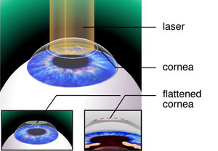
Photorefractive Keratectomy
Technique
The visual axis is marked and the corneal epithelium removed
The patient fixates on the aiming beam of the laser
The laser is applied to ablate only bowmans layer and anterior stroma
Notes:
By keratotome

Slide 35
30-60 seconds
Bandage contact lens
The cornea usually heals within 48-72 hours
Subepithelial haze
Post-op period
Topical steroids and NSAIDs.
Antibiotics
Notes:
This usually takes 30-60 seconds
bandage contact lens
The cornea usually heals within 48-72 hours aided by a bandage contact lens
A subepithelial haze develops within 2 weeks & may persist for 1-6 months
In the post-op period, pt may experience tearing, photophobia, blurred vision, and discomfort due to abrasion of central epithelium.
This can be controlled with topical steroids and NSAIDs.
Antibiotics continued 2wks, and steroids for up to 3 months post-op

Slide 36
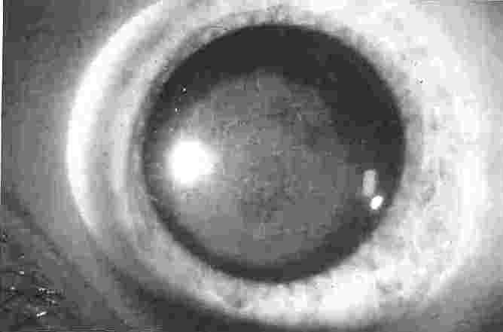
Complications
Slow healing epithelial defects
Corneal haze
Haloes
Dry eyes
Decentred ablations
Scarring
Abnormal epithelial healing
Irregular astigmatism
Hypoaesthesia
Sterile infiltrates
Infection
Notes:
PRK is able to correct myopia up to 6 D astigmatism upto 3D and low hypermetropia

Slide 37
LASER EPITELIAL KERATOMILEUSIS (LASEK)

Slide 38
Laser Epitelial Keratomileusis
Indication
Myopia 8D
Hypermetropia 3D
Astigmatism 3D
LASEK works well for patients who are unsuitable for LASIK such as those with very thin cornea

Slide 39
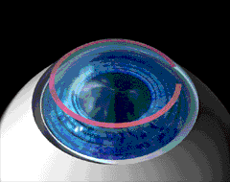
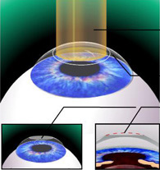
Alchol 20% is applied for 30-40 seconds and an epithelial sheet is cleaved at the basement membrane
Laser is applied
Notes:
Laser epithelial keratomileusis (LASEK) is a modification of PRK that attempts to preserve the epithelium. After alcohol is applied to the corneal epithelium, an epithelial trephine and spatula are used to loosen, and roll up the epithelium, which remains attached at a nasal or superior hinge. Photoablation is then performed, and the epithelium is unrolled back over the central corneal stroma. A bandage contact lens is used for several days until the surface re-epithelializes.

Slide 40
Comlpications
Pain
Corneal haze
Over / undercorrection
Loss of sharpness of vision
Infection
Notes:
The actual laser treatment itself is painless. However, 2-3 hours after treatment most patients will develop mild to moderate pain which usually lasts a few hours. Anaesthetic eye drops can relieve this
Some patients can develop a mild degree of haze on the cornea over the treated area. This is maximal at 6 weeks post op and generally disappears within 3-6 months. This is a deposition of glycosoaminoglycans or "GAG"s
if one person's cornea is a little more or less dense than the average, then the laser will take off a little more or less tissue. People also vary in their healing characteristics
This can be caused by micro irregularities on the cornea due to healing problems

Slide 41
Epithelial Lasik
Instead of using alcohol to loosen the epithelium, an epikeratome is used
Instead of using an oscillating sharp blade to incise the cornea beneath Bowman’s membrane, the epikeratome uses a blunt oscillating separator
Notes:
An alternative surface ablation procedure to LASEK is epi-LASIK. Instead of using alcohol to loosen the epithelium, an epikeratome is used to dissect an epithelial sheet from Bowman’s membrane. The epikeratome is similar in design to a mechanical microkeratome used for LASIK. Instead of using an oscillating sharp blade to incise the cornea beneath Bowman’s membrane, the epikeratome uses a blunt oscillating separator that moves across the cornea held under high pressure with a suction ring. This separator lifts a sheet of epithelium from Bowman’s membrane.

Slide 42
LASER IN-SITU KERATOMILEUSIS (LASIK)

Slide 43
LASER ASSISTED IN-SITU KERATOMILEUSIS (LASIK)
Concept first intro by Jose Barraquer, 1964
founder : Dr Ionas Pallikaris- first to use microkeratome and laser
KERATOMILEUSIS = “to shape cornea”
IN-SITU = “ in place”
LASIK = “to shape cornea in place”
Notes:
Concept first intro by Jose Barraquer, 1964
founder : Dr Ionas Pallikaris- first to use microkeratome to cut thin flap of cornea and laser to remove tissue

Slide 44
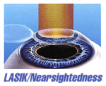
Principles Of Lasik
Notes:
To treat MYOPIA, the central cornea must be made flatter. This is accomplished by removing tissue from the center of the cornea.

Slide 45
Principles Of Lasik
Notes:
To treat HYPEROPIA, the central cornea must be made steeper. This is accomplished by directing the laser beam to remove tissue from around this area

Slide 46
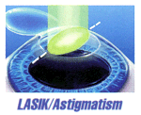
Principles Of Lasik
Notes:
To treat ASTIGMATISM the cornea must be made more spherical. By changing the pattern of the beam, tissue is removed in one direction more than the other.

Slide 47
Inclusion Criteria
Myopia : 1-15D
Hypermetropia : 1-4D
Astigmatism : up to 5D
Adequate corneal thickness > 45O μm

Slide 48
Inclusion Criteria
Age: > 21 years old, no max age.
stable refraction over past 24 months
Central K’s: > 39D - < 47D

Slide 49
Exclusion Criteria
Immunocompromise
Corneal irregularities
Pachymetry < 450μm
Ocular herpes within the last year
Progressive myopia
Notes:
Corneal irregularities: keratoconus, dystrophies, infections (Herpes)
Pachymetry < 450μm => irregular astigmatism, distortion, corneal rupture
Ocular herpes within the last yr
Progressive myopia

Slide 50
Ideal Candidate
Be at least 18 years of age
Stable vision for at least one year
Adequate thickness of the cornea
Healthy eyes

Slide 51
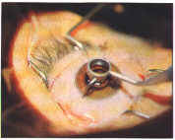
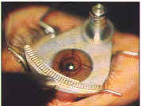
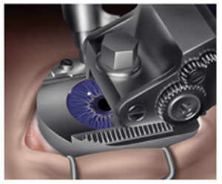
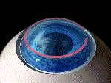
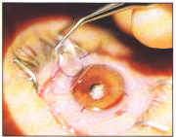
Basic Lasik Procedure
2
3
Suction ring applied (65mmHg)
Under L/A, cornea is marked
Microkeratome cut hinged flap
4
5
6
Flap folded to expose stromal bed
Flap repositioned
Stromal ablated
Notes:
…..
A suction ring is applied to the anesthetized cornea which raises the intraocular pressure to over 65mmhg
The ring is centered on the cornea & provides a guide track into which an automated microkeratome is inserted . The keratome is mechanically advanced across the cornea to create a very thn flap flap of ~160microns thickness ,consisting of corneal epithelium, Bowman’s membrane, and superficial stroma, hinged at the 12 o’clock position
Flap folded to expose stromal bed
Suction is released & the bed is treated with the excimer laser as for PRK
The flap is repositined and allowed to settle undisturbed for 30seconds.a BCTL

Slide 52
Antibiotics and corticosteroid therapy(4-6wk tapered course), tear supplements
Followup on 1 day, 1 wk, 3wks, 3 months, 6months
Avoid water in eyes - no shower, hot tub or swimming- first 2wks
Avoid eye rubbing → dislocation of flap

Slide 53
Complications
INTRAOPERATIVE: free flap, loss of corneal flap, wrinkling of flap , perforated or thin flap, corneal perforation, bleeding from neovessels
POSTOPERATIVE: displaced flaps, corneal infection, diffuse lamellar keratitis , dry eyes , Subepithelial haze , Epithelial defects , ectasia

Slide 54
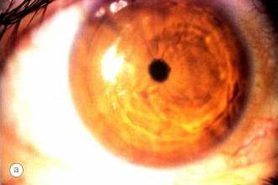
Complications
Notes:
Wrinkling of flap

Slide 55
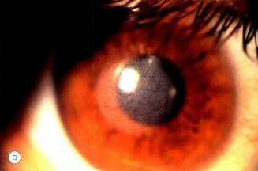
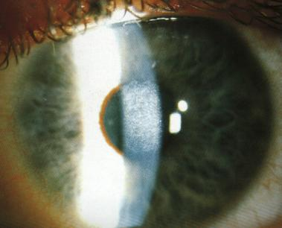
Blurred vision
Corneal haze
Notes:
These pic show post op corneal haze
Pt may complain of blurred vision Due to corneal haze, oedema, epithelial defects, under / overcorrection

Slide 56
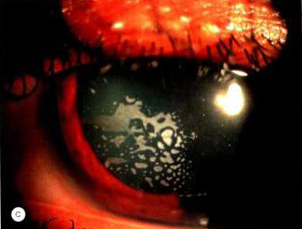
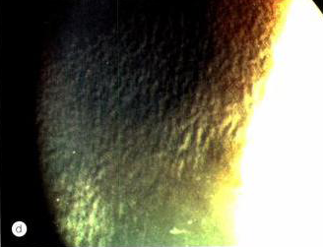
Complications
Epithelial ingrowth
Diffuse lamellar keratitis
Notes:
Epithelial ingrowth
Diffuse lamellar keratitis (sands of Sahara) may develop 1-7 days following LASIK. It is characterized by granular deposits at the flap interface. Treatment is with intensive topical antibiotics and steroids

Slide 57
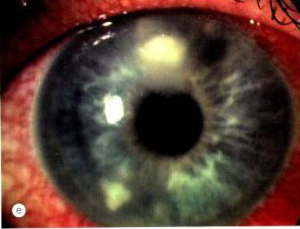
Complications
Notes:
Bacterial keratitis

Slide 58
Complications
Corneal hypoesthesia
Dry eyes:
Notes:
Corneal hypoesthesia
d/2 Cutting corneal nerves ↓ sensitivity
Dry eyes:
d/2 Conjunctival goblet cell damage

Slide 59
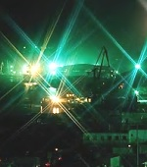
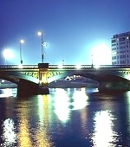
Complications
Night vision problems
Haloes
starbursts
Notes:
NIGHT Vision PROBLEMS: including haloes and starbursts.
bcoz at ni pupillary diam icreases and optical zone diam becomes < pupil diam

Slide 60
Complications
Discomfort
Photophobia
Conjunctival haemorrhage
Notes:
DISCOMFORT: first 24 hrs, but not as painful as PRK, d/2 keratotome and speculum
PHOTOPHOBIA: related to healing or haze
CONJUNCTIVAL HAEMORHAGE – d/2 application of suction ring

Slide 61
Comparison
 | PRK | LASIK | LASEK
Myopia | 6D | 15D | 8D
Hypermetropia | 3D | 4D | 3D
Astigmatism | 3D | 5D | 3D
Flap thickness | The epithelium and stroma are cut to a thickness of 100-180 microns | The epithelium and stroma are cut to a thickness of 100-180 microns | The epithelium is cut to a thickness of 50 microns
Procedure | Uses a microkeratome knife and excimer laser | Uses a microkeratome knife and excimer laser | Uses a alcohol , trephine and excimer laser
Pain | From epithelial defect | Minimal | Minimal

Slide 62
 | PRK | LASIK | LASEK
Visual rehabilitation | Prolonged (upto 1week) | Rapid 2 days | Rapid 4-7 days
Cornel haze | Upto 10% | Minimal | Minimal
Asigmatism | 1% | 3-10% | 1%
Advantages | Better choice for poor LASIK candidates including people with less Corneal tissue | Appropriate for people who have more corneal tissue, less Discomfort than LASEK, almost no pain, 6/6vision or better is Typically achieved, corneal haze very rare, immediate clear vision, Follow -up enhancements are easier if needed. | Better choice for people with less Corneal tissue, fewer haze outcomes than LASIK, no complications of stromal flap as in LASIK, less risk of dry eye than LASIK. Lost LASEK flap less risky than a lost LASIK flap, lowers risk of DLK

Slide 63
 | PRK | LASIK | LASEK
Disadvantages | More discomfort than LASIK, more corneal haze , takes longer to heal than LASIK | Those with thinner corneas may suffer less than ideal results, flap may dislodge with trauma, uneven flap edges may lead to astigmatism, flap may result in scars | More discomfort than LASIK, takes longer to heal than LASIK, Trauma, such as being hit in the eye may cause flap to dislodge, uneven flap edges Leading to astigmatism

Slide 64
Femtosecond Lenticule Extraction (FLEx)
The surgeon makes a flap in the anterior cornea similar to the flap created in LASIK
The flap is lifted and the lenticule is removed and discarded
The flap is repositioned, as in LASIK
The removal of the lenticule reduces the curvature of the cornea, thereby reducing myopia
Notes:
a new laser refractive surgery procedure designed for the correction of myopia.
A variation of FLEx is another investigational procedure called small-incision lenticule extraction (SMILE).
In the SMILE procedure, the corneal flap is not created instead a small incision is made in the mid-periphery of the cornea with the laser, and the lenticule is removed through this self-sealing incision.

Slide 65
THANKS

