Slide 2
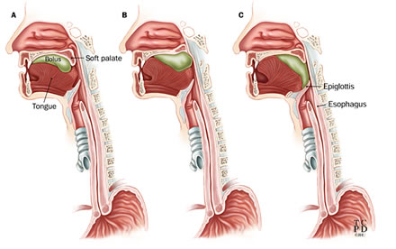
MANAGEMENT OF DYSPHAGIA

Slide 3
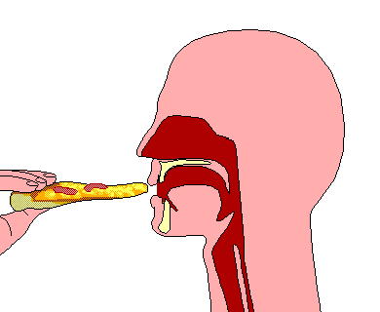
Dysphagia
Difficulty in swallowing which may affect any part of swallowing pathway from the mouth to the stomach
Notes:
The esophagus starts at the junction of the inferior pharyngeal constrictor and cricopharyngeus. The esophagus is about 18 to 26 cm in length ending at the at the distal margin of the lower esophageal sphincter (LES). The UES is form by inferior pharyngeal constrictor and the cricopharyngeus. The LES is a thickened segment of circular smooth muscle that lies within the diaphragmatic hiatus. Structures extrinsic to the esophagus make indentations which are noted during endoscopy. These include the anterior body of C7 (worsen by osteophytes), trachea anteriorly, the arch of the aorta, the left mainstem bronchus, and the diaphragmatic hiatus. It involves conversion of food from the solid to the semisolid state. This phase requires intact dentition and is negatively affected by poor salivary gland function (lubrication), surgical defects, and neurologic disorders.

Slide 4
Physiology of swallowing
Oral phase
Preparation of bolus
Pharyngeal phase
Closure of the nasopharynx
Closure of oropharyngeal isthmus
Closure of larynx
Contraction of pharyngeal muscles
Oesophageal phase

Slide 5
Causes of Dysphagia
Preoesophaygeal causes
Oral phase
Disturbance in mastication
Trismus
Fractures of mandible
Tumours of upper or lower jaw
Disorders of TM joint
Disturbance in lubrication
Xerostomia
Mikulicz disease

Slide 6
Causes of Dysphagia
Preoesophaygeal causes
Oral phase
Disturbance in motility of tongue
Paralysis of tongue
Painful ulcers
Tumours
surgery
Defects of palate
Cleft palate
Oronasal fistula
Lesions of buccal cavity and floor of mouth
Stomatitis
Ulcerative lesions
Ludwig’s angina

Slide 7
Causes of Dysphagia
Preoesophaygeal causes
Pharyngeal phase
obstructive lesions
Tumours of tonsil, soft palate, pharynx, base of tongue, supraglottis
Obstructive hypertrophic tonsils
Inflammatory conditions
Acute tonsillitis
Peritonsillar abscess
Retro/parapharyngeal abscess
Acute epiglottitis
Edema larynx

Slide 8
Causes of Dysphagia
Preoesophaygeal causes
Pharyngeal phase
Spasmodic conditions
Tetanus, rabies
Paralytic conditions
Soft palate paralysis due to diphtheria
Bulbar palsy
CVA

Slide 9
Causes of Dysphagia
Oesophageal causes
Lumen
Atresia
Foreign body
Strictures
Benign or malignant tumours
Wall
acute or chronic oesophagitis
Hypomotility disorders
Achalasia
Scleroderma
Amyotropic lateral sclerosis
Hypermotility disorders
Cricopharyngeal spasm
Diffuse oesphageal spasm
Outside the wall
Hypopharyngeal diverticulum
Hiatus hernia
Thyroid lesions
Dysphagia lusoria

Slide 10
Causes
CONGENITAL
Choanal atresia
Cleft lip and palate
Laryngomalacia
Laryngeal cleft
Tracheosesophageal fistula and oesophageal atresia
Vascular rings
ACQUIRED
Traumatic (accidental ,iatragenic,blunt ,penetrating trauma,head injury ,cranial nerve damage)
Infections(tonsillitis pharyngitis,quincy,acute supraglotitis,tuberculosis,neck space abcesses)
Inflammatory(GERD,stricture formation,plummer vinson syndrome,autoimmune disorders like scleroderma,SLE,rheumatoid arthritis,sarcoidosis)
Oesophageal motility disorders(achalsia,diffuse esophageal spasm,nutcracker esophagus)

Slide 11
NEOPLASTIC
Benign tumours of the oral cavity ,pharynx and oesophagus
Malignant tumours of the oral cavity ,pharynx and oesophagus
Nasopharyngeal carcinoma
Skull base tumours
Leukemias and lymphomas
Enlarged mediastinal lymphnode
NEUROLOGICAL
CVA
Isolated recurrent laryngeal nerve palsy
Parkinsons disease
MS
Myesthenia gravis
AGEING (presbydysphagia)
MISCELLANEOUS (foreign bodies,caustic stricture,pharyngeal pouch ,globus pharyngeus,tracheostomy patient , thyroid disease

Slide 12
Evaluation of Dysphagia
History
Review of Systems
Physical Exam
Imaging Studies

Slide 13
History
Age
Onset
Duration
Level of sensation of dysphagia
Type of food
Weight loss
Ingestion of caustic substances
Previous surgery/trauma

Slide 14
History
Associated symptoms
Odynophagia
Regurgitation
Hoarseness
Referred otalgia
Coughing after eating/recurrent chest infections

Slide 15
Review of Systems
Ask about common systemic processes associated with dysphagia:
Tobacco/Alcohol
Medications – antihistamines, anticholinergics, antidepressants, antihypertensives
Osteoarthritis
Systemic neuromuscular disorders
Auto-Immune disorders
Psychiatric state
Notes:
Review of systems often reveals systemic diseases that cause dysphagia. These include spinal osteoarthritis, tuberculosis, and thyroid enlargement. Systemic neuromuscular or autoimmune disorders may cause problems with esophageal motility. Otalgia may indicate upper digestive tract malignancy. Use of alcohol or tobacco raises suspicion of malignancy. A family history of digestive disease should be sought, such as history of oculopharyngeal dysphagia and muscular dystrophy. Use of certain medications such as antihistamines, anticholinergics, antidepressants, and antihypertensives can affect salivary gland function or the neurology of swallowing.

Slide 18
Examination
General physical examination
Weight loss
Malnutrition
Pallor
Koilonychia
Jaundice
Voice quality
Oral cavity examination
Mouth opening
Tongue movements
Gag reflex

Slide 19
Examination
IDL/Nasolaryngoscopy
Pooling of secretions
Any visible growth
Status of VC
Neck
Lymph nodes
Other neck masses
Laryngeal crepitus
Integrity of laryngeal cartilages

Slide 20
Investigations
Blood tests
Full blood count
ESR and C reactive protein
Liver function tests
Renal function tests
Serum electrolytes
Thyroid function tests

Slide 21
Investigations
X Rays
Barium swallow
CT scans
MRI
FEES
Videoflouroscopy
Manometry
24 hour ambulatory oesophageal pH monitoring

Slide 22
X-Rays
Uses:
Suspected infectious cause of dysphagia with gross displacement of structures.
Advantages | Disadvantages
cheap | Radiation
Fast | Poor anatomic detail
 | No assessment of swallowing
Notes:
Plain films are indicated in diagnosing specific causes of dysphagia, such as inflammatory (epiglottitis, retropharyngeal abscess) or radio-opaque foreign bodies. The advantages of this modality are that it is cheap and quick. The disadvantages are its inability to detect mechanics of the swallow and inability to resolve mucosal surfaces.

Slide 23
Barium swallow
Uses: structural disorders, e.g. pharyngeal pouch, stricture, hiatus hernia, or an obstructing oesophageal lesion. Can use air contrast.
Advantages | Disadvantages
Good anatomic detail | Radiation
Widely available | Logistics in bedridden pts.
 | Cannot detect dynamic disorders and pharyngeal causes
Notes:
The barium esophagram involves the use of a cup of liquid barium that is swallowed, then followed fluoroscopically to the stomach. Because the study is documented only on plain film, it is not considered a dynamic swallow study. The air contrast esophagram uses effervescent granules followed by administration of barium to provide better anatomic detail. The advantages of the study are that it is widely available, and with air contrast it provides better anatomic detail. The disadvantages are that the study involves radiation exposure, the logistics are difficult in bedridden patients, and the study is not a dynamic one so it cannot adequately detect dynamic dysfunction. The study is indicated in patients in whom structural disorders are suspected (e.g. dysphagia to solid foods and not to liquids) because of its relatively good level of anatomic detail.

Slide 24
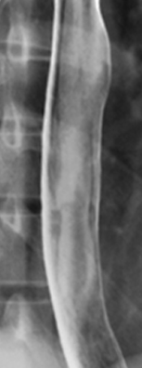
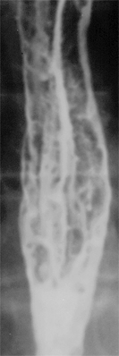
Air Contrast Barium Esophagram
Normal
Fungal Plaques

Slide 25
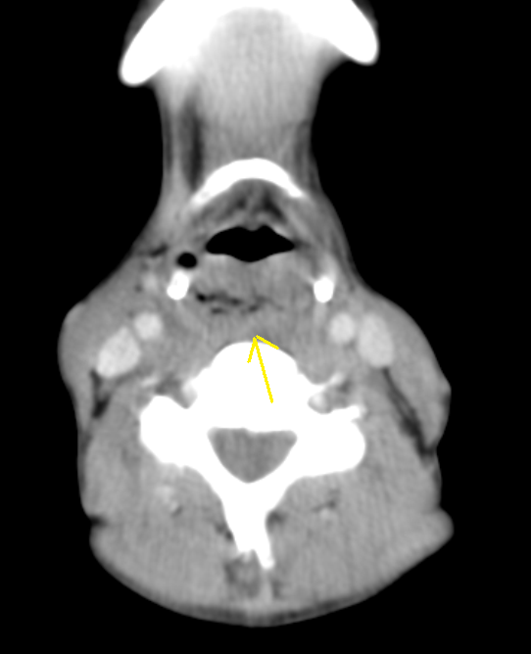
Computed Tomography
Patients with malignant dysphagia
Patients with dysphagia due to extrinsic compression
Neck chest and abdomen to stage the disease

Slide 26
Magnetic resonance imaging
When neurological causes of dysphagia are suspected
Multiple sclerosis
Cerebral tumours
Intracranial extension of nasopharyngeal carcinoma

Slide 27
VIDEOFLOUROSCOPY
Uses – excellent to evaluate dynamic (e.g. neuromuscular, aspiration) swallow disorders.
Advantages | Disadvantages
Gives good anatomic detail | Radiation
Evaluates all phases of swallowing
Gold standard for evaluating the swallowing mechanism | Logistics
Notes:
The modified barium swallow is a study in which puree, liquid, and/or solid consistency barium is administered in varying amounts while the fluoroscopic image (lateral and anterior-posterior) is recorded on videotape for later review and analysis. The study requires the presence of a speech and language pathologist and a radiologist. The patient is placed erect and varying consistencies of barium items are fed to the patient, depending on the patient’s symptoms (e.g. solid bolus for the patient with complaints of obstruction, liquid bolus for the patient with complaints of aspiration). For the oral/pharyngeal portion of the exam, a mouth full of liquid barium is given and held there for 10 seconds, and then swallowed. Any incidence of leakage is observed before the swallow, giving insight into the coordination of the oral and pharyngeal stages of swallowing. Volume of the swallow, leakage into the nasal cavity, and entry into the laryngeal vestibule can all be seen in this portion of the exam. The modified barium swallow is useful in testing the ability to protect the airway because of the ability to directly visualize contrast penetrating the laryngeal vestibule during swallowing.
If contrast enters the patient’s vestibule and the patient coughs immediately, the entry may only have been incidental. However, any entry into the larynx without the patient’s awareness is abnormal. “Penetration,” (entry of contrast into the larynx during swallowing) is distinguished from “aspiration,” (entry of contrast into the airways before or after swallowing). The pharyngoesophageal segment (made up mainly of the cricopharyngeus) is studied in the modified barium swallow, noting anatomic weakness as well as its ability to relax at the end of the pharyngeal stage. The esophageal segment is assessed next with the patient both erect and supine to test the adequacy of peristalsis. Advantages of the modified barium swallow are that it is a comprehensive test evaluating all phases of swallowing, gives good anatomic detail, and can be reviewed later in a multidisciplinary setting. The disadvantages include the radiation exposure to the patient, the difficulty in coordinating scheduling, logistics in bedridden patients, its inability to directly assess sensation, and its less than ideal rendering of the anatomy, as it relies on radiographic shadows.

Slide 28
Fiberoptic Endoscopic Evaluation of Swallowing
Uses –pooling in hypopharynx, reduced/absent edolaryngeal sensation and aspiration can be detected
Advantages | Disadvantages
Portable | Blind spot
Allows assessment of sensation | Cannot evaluate cricopharyngeus directly
Cheap | Cannot eval. esophagus
No radiation
Notes:
The flexible endoscopic evaluation of swallowing utilizes commonly available and portable equipment to evaluate swallowing. In this study, the flexible nasopharyngoscope is passed thought the nose to the nasopharynx in order to view the upper aerodigestive tract. Anatomy and function of the upper aerodigestive tract are assessed (palate, pharynx, larynx function, salivary pooling, and sensation). Then swallowing is assessed with boluses of varying consistencies. A description of the study follows: First, the flexible scope is passed through he anesthetized nasal fossa with the tip in the posterior part of the nasal fossa. The palate is checked from the nasopharyngeal surface. Subtle palate weakness can be detected. Oral sounds, e.g. “k,k,k,” “ss,” and spontaneous speech are observed as part of palate function testing. Even mild unilateral weakness can be detected with this test. After checking the palate, the tip of the scope is moved beyond the edge of the palate and is turned downward. This allows a panoramic assessment of the laryngopharynx and observation of pooling of secretions in the piriform sinuses, vallecula, and laryngeal vestibule. Next, the tip of the fiberscope is positioned parallel to the posterior pharyngeal wall opposite to the epiglottis to obtain a larynx view. Vocal cord mobility and closure are assessed in this view. Sensory testing can be performed at this point by touching the tip of the fiberscope to various points on the hypopharynx and larynx to assess symmetry of reaction.
A more quantitative sensory testing modality involves the use of controlled pulses of air in set pressures to determine sensory threshold of laryngeal closure. After this structural assessment the tip of the endoscope is pulled back to the level of the soft palate and food of various consistencies is administered. This is often followed by administration of methylene blue dye. This allows visualization of leakage during the oral phase, visualization of overflow aspiration from the hypopharynx and visualization of tell-tale signs of aspiration with blue dye staining the laryngeal vestibule. Overall, the advantages of the FEES are that the equipment is simple, widely available, portable, does not expose the patient to radiation, can be used to train the patient in speech therapy via biofeedback. It allows a better assessment of neurologic status (including sensation) and gives a more detailed rendering of the anatomy than is available from other methodologies. The disadvantages of the FEES include the "blind spot" that occurs during the swallow, which prevents direct visualization of aspiration and penetration, and the fact that the cricopharyngeus and esophagus cannot be assessed. FEES is indicated in evaluation of oral and pharyngeal sources of dysphagia.

Slide 29
Manometry
Uses: disorders in which intraluminal pressures must be measured (achalasia, esophageal spasm, etc.)
Advantages | Disadvantages
It is the only test of pressure wave physiology | Cannot diagnose visible lesions
Helpful in atypical chest pain | Unpleasant for patient
 | Techincally demanding
Notes:
Manometry uses a catheter that measures pressures at various intervals along the length of the esophagus. With each swallow, data on strength, timing, and sequencing of pressure events are obtained. The advantage of the study is that it is an actual test of pressure wave physiology. The disadvantages of the study are that it is not widely available, cannot diagnose visible lesions, is unpleasant, and is a technically demanding study to perform. For these reasons this study is rarely used except in cases where elevated intraluminal pressures must be followed (e.g. achalasia). The study may be indicated for patients who need recurrent intraluminal pressure assessment for achalasia or diffuse esophageal spasm

Slide 30
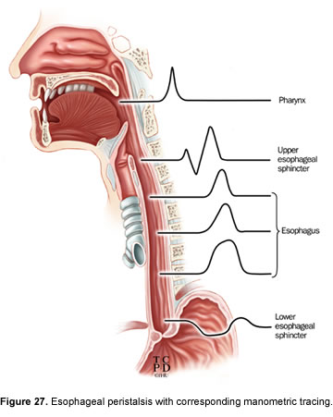
Manometry

Slide 31
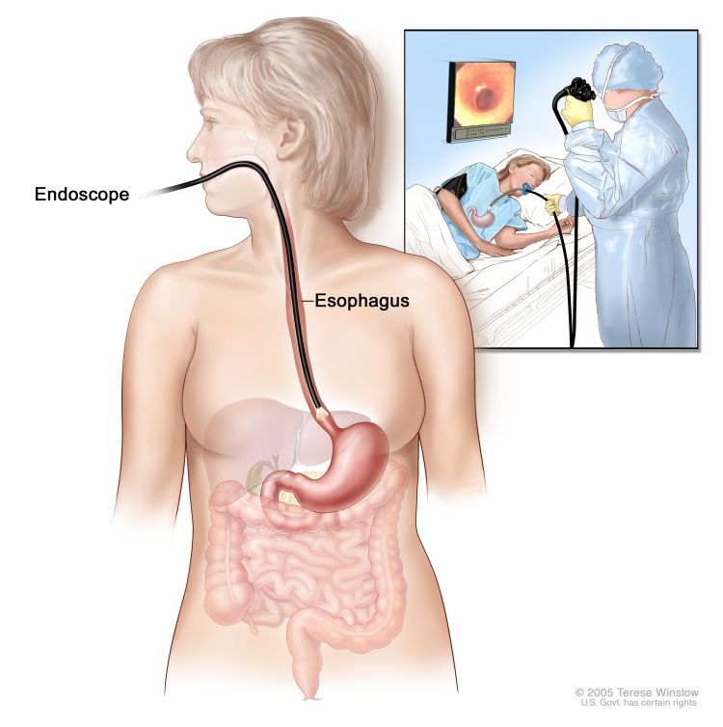
Direct pharyngoscopy and rigid endoscopy
To visualize and biopsy the upper esophagus and pharynx
To remove foreign bodies
Most reliable way of examining the post cricoid area

Slide 32
24 hours ambulatory oesophageal pH monitoring
Most accurate method of diagnosing gastro esophageal reflux
pH sensor placed 5 cm above the LES
Normal pH 5-7
In GERD less than 4

Slide 33
Common causes of Dysphagia

Slide 34
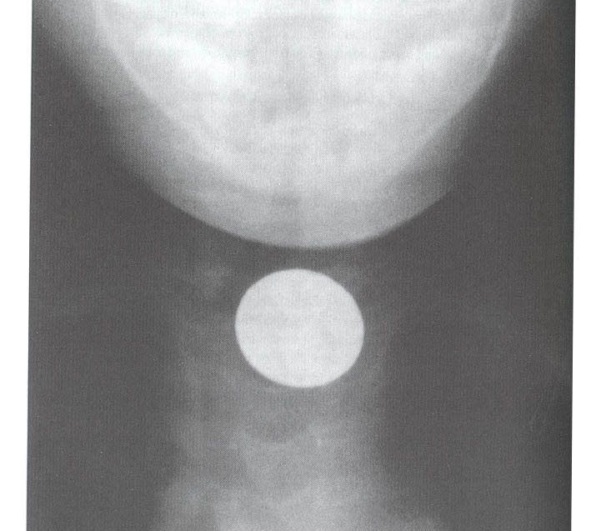
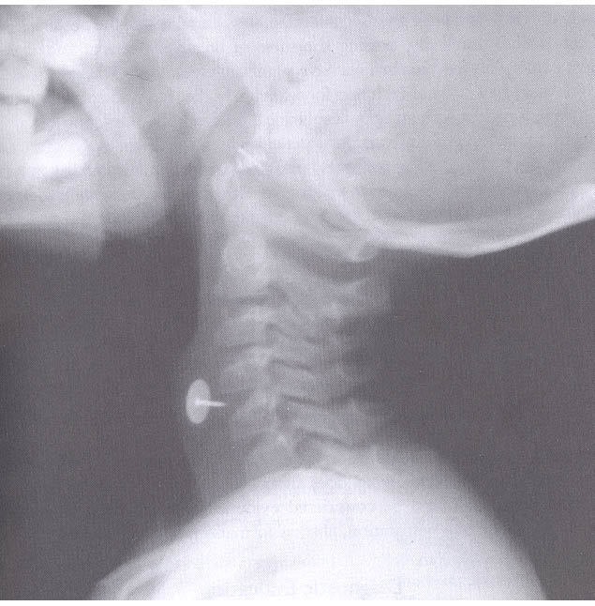
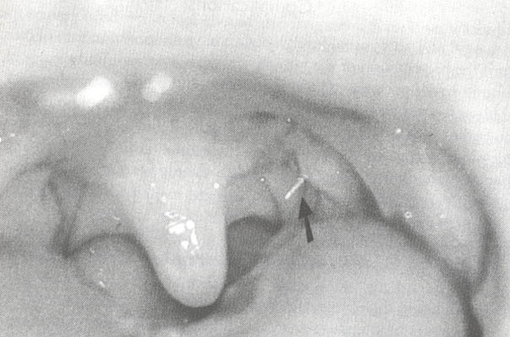
Foreign Bodies
Notes:
In management of esophageal foreign bodies, airway protection is critical as esophageal foreign bodies may become airway foreign bodies. Asymptomatic coins in the distal esophagus should be given 12 hours to pass, whereas coins in the mid to upper esophagus should be removed as soon as possible to avoid regurgitation of the coin into the airway. Rigid and flexible endoscopy are equally efficacious for most foreign bodies. Flexible endoscopy does not require general anesthesia, but it also does not protect the trachea. Sharp or pointed objects may cause significant trauma and should be removed via rigid endoscopy. After removal of a foreign body, a chest X-ray should be obtained and the patient should be observed for 24 hours for signs and symptoms of mediastinitis. Button batteries are particularly dangerous and should be removed immediately because their ability to cause direct corrosion, low voltage burns, and direct pressure necrosis, leading to complications such as perforation, and tracheal and aortic fistulas. They can be distinguished from coins because button batteries have a halo on PA films because of their bilaminar structure. Careful endoscopy should be performed at the time of removal, minding the fact that the battery may have corroded the esophageal wall. Barium esophagrams should be performed 24 hours after removal of a button battery and again 14 days later to check for fistulization. Alternative methods to address foreign bodies includes the use of Balloon catheters to remove foreign bodies, but they do not provide for control of the foreign body. Glucagon has been shown to relax the lower esophageal sphincter, but it is not successful in foreign body treatment when other pathology is present.

Slide 35
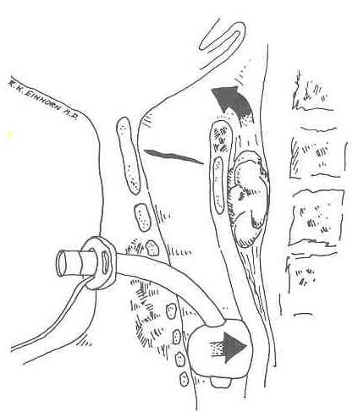
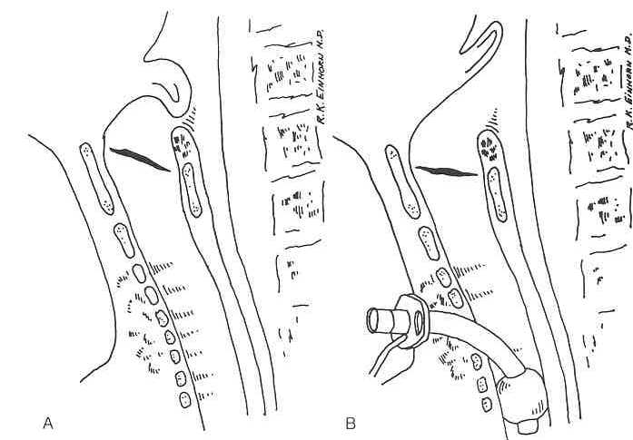
Tracheostomy
Notes:
Tracheostomy affects swallowing in several ways. First, by tethering the trachea to the anterior neck skin (especially with use of the Bjork flap), the tracheostomy prevents proper laryngeal elevation during the pharyngeal phase of swallowing. Direct pressure from the trachea with or without the cuff increases extrinsic esophageal pressure and leads to regurgitation and even aspiration. Tracheostomy may decrease sensitivity of the glottic closure reflex, resulting in increased risk of aspiration. To minimize these complications the smallest sized tracheostomy possible should be used and the airway should be closely monitored and frequently suctioned.

Slide 36
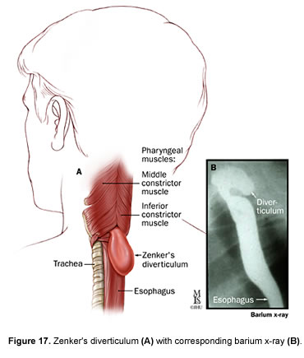
Zenker’s Diverticulum
Notes:
The Zenker's diverticulum is an acquired mucosal herniation through a posterior portion of the cricopharyngeus in an area of congenital weakness in the muscle known as Killian's dehiscence. Symptoms caused by the diverticulum include coughing up undigested food, aspiration, and chronic mucus production. Small diverticula can be treated by cricopharyngeal myotomy alone. Larger diverticula require dissection off of the rest of the esophagus and transection with the defect sutured in layers. Diverticulopexy, or suspension of the diverticulum vertically in pre-vertebral fascia is used to shorten the procedure and reduce risk in high risk elderly patients. Endoscopic techniques use a variation of the Van Overbeek's diverticuloscope and the CO₂ laser to perform the diverticulotomy. The GIA stapler can also be used to divide and secure the pouch endoscopically.

Slide 37
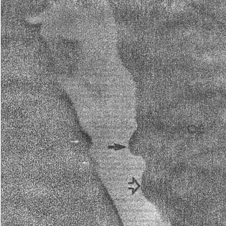
Cervical Spine Disease
Notes:
Large osteoarthritic spurs may develop on the cervical spines of patients with long-standing osteoarthritis. These spurs are a common finding in patients with diffuse idiopathic hyperostosis. The spurs are usually asymptomatic, but they may affect swallowing. Surgical resection of the spurs has been shown to help in some patients.
Anterior surgical approaches to the spine that require dissection and retraction of the larynx and pharynx can cause temporary or prolonged dysphagia secondary to interruption of the motor or sensory innervation.

Slide 38
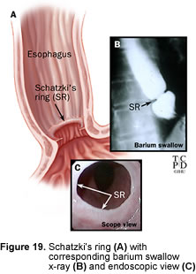
Esophageal Webs and Rings
Notes:
Esophageal webs are squamous mucosal membranes that grow across the lumen of the esophagus and may be congenital or acquired. Most commonly these occur secondary to GERD, but occasionally they occur in association with Plummer-Vinson Syndrome. This syndrome occurs most commonly in individuals of Scandinavian descent and is characterized by esophageal webs, iron deficiency anemia, dysphagia, achlorhydria, atrophic gastritis, hiatal hernia, and increased risk of cancer. Dysphagia improves in the Plummer-Vinson syndrome with iron therapy, though the webs remain.
The esophageal ring is located at the gastro-esophageal junction and contains squamous and columnar epithelium with a core of connective tissue. A common symptom is that of intermittent dysphagia associated with large boluses. Treatment, when necessary, is usually by dilatation.

Slide 39
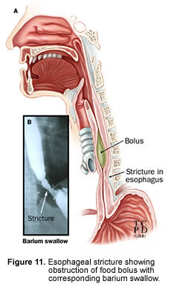
Strictures / Caustic Ingestion
Notes:
Strictures most often result from reflux of gastric acid into the esophagus, but also can result from ingestion of caustic substances. Rarely, strictures are caused by medications such as doxycycline, oral potassium chloride, and quinidine. Alkali ingestion occurs most frequently in children and causes rapid liquefaction necrosis and penetrates deeper than acid. Acid causes coagulation necrosis and creates an eschar that prevents deep burns. The acute reaction in the ingestion of caustic substances includes odynophagia, dysphagia, and inflammatory edema. Supraglottic edema can cause stridor and airway distress. Deep burns, especially with alkali, can cause perforation. Initial endoscopic evaluation is necessary within 24-48 hours of ingestion. If the injury is deep enough, stricture formation is noted 3-6 weeks later. Radiographic studies should be performed after three weeks to assess for the formation of strictures. The treatment for strictures, should they occur is dilatation or even excision.

Slide 40
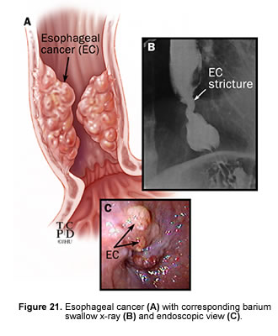
Cancer
Notes:
Cancer of the upper aerodigestive tract is often associated with odynophagia. Patients usually have a history of heavy smoking and/or drinking and unilateral throat pain on swallowing radiating to the ipsilateral ear or to the angle of the mandible. Careful physical exam usually identifies the lesion.
Cancer of the esophagus carries a very vague symptom complex and is usually diagnosed late in its course, accounting for the poor survival rate. A chief symptom is dysphagia to solids more than liquids.

Slide 41
Systemic Disorders that Cause Dysphagia
Stroke – present in up to 47%
Amyotrophic Lateral Sclerosis
Parkinson’s Disease
Multiple Sclerosis
Muscular Dystrophy
Myasthenia Gravis
Notes:
Swallowing difficulty after stroke may occur in up to 47% of cases. Most patients recover within one week. However, there is a high rate of aspiration pneumonia in these patients. Causes for dysphagia after stroke include delayed triggering of the swallow reflex, cricopharyngeal dysfunction, reduced lingual and pharyngeal control, and weak cough. With brain stem strokes, direct cranial nerve deficits can lead to further impairment of glottis closure and coordination of phases of swallowing. Treatment consists of rehabilitative speech therapy and placement of a nasoduodenal feeding tube or gastric feeding tube to avoid aspiration. Also frequent pulmonary toilet is required. If laryngeal impairment is permanent, vocal cord medialization procedures, narrow field laryngectomy, or other procedures may be useful.
AML This is a rapidly progressive degenerative disease of unknown etiology that involves the brain and spinal cord motor neurons. It has a prevalence of 5/100,000 and an average age of onset of 55 years. Speech and swallowing difficulties parallel each other and require intensive speech therapy and eventual feeding tube placement. Aspiration is a problem late in the disease.
Affecting 1% of people over age 50, Parkinson's disease is a progressive disorder of the CNS marked by the classic triad of resting tremor, bradykinesia and rigidity. Dysphagia in Parkinson's disease is addressed by dietary modification and gastric feeding tube placement for end-stage disease.
Multiple sclerosis is a disease in which degenerative plaques are found in the CNS. It has an extremely variable presentation, with the origin of dysphagia being found in the pharyngeal phase of swallowing.
Isolated recurrent laryngeal nerve injuries result in dysphagia and aspiration secondary to decreased glottic closure pressures and neurogenic dysfunction of the inferior constrictor and cricopharyngeus muscles. Treatment is often by true vocal fold gelfoam injection for temporary medialization of the paralyzed vocal fold, followed later by medialization thyroplasty.

Slide 42
Autoimmune Disorders
Systemic Sclerosis
Systemic Lupus Erythematosis
Dermatomyosits
Mixed Connective Tissue Disease
Mucosal Pemphigoid, Epidermolysis Bulosa
Sjogren’s Syndrome (xerostomia)
Rheumatoid Arthritis (cricoarytenoid joint fixation)
Notes:
Autoimmune disorders that carry a high incidence of dysphagia include systemic sclerosis, system lupus erythematosis, dermatomyositis, mixed connective tissue disease, mucosal pemphigoid, epidermolysis bullosa, Sjogren's syndrome (xerostomia) and Rheumatoid arthritis (cricoarytenoid joint fixation).

Slide 43
DYSPHAGIA REHABILITATION
STRATAGIES
Compensatory (not aimed at changing swallowing physiology)
Rehabilitative (aimed at changing swallowing physiology)
Notes:
A common factor in all systemic causes of dysphagia is that swallowing therapy given intensively by a speech therapist can help the patient compensate for weakness in the swallowing apparatus. Patients with deficits of the oral or pharyngeal phases of swallowing may benefit from swallowing therapy. This may include strengthening and coordination exercises or compensatory maneuvers to aid in swallowing. The supraglottic swallow, Mendelsohn maneuver, and neck turning with swallowing are examples of compensatory maneuvers. The supraglottic swallow involves voluntarily holding the breath at the height of inspiration before and during swallowing, thereby closing the vocal fords before and during the swallow. The patient coughs after the swallow to clear any residual food from the larynx. The Mendelsohn maneuver is performed by voluntarily elevating the larynx during the swallow, which tucks the laryngeal inlet anteriorly and opens the PE segments, thereby facilitating the swallow. Patients with unilateral pharyngeal paralysis can turn their head towards the paralyzed side, which diverts the bolus down the functioning side of the pharynx.

Slide 44
COMPENSATORY STRATEGIES
POSTURAL TECNIQUES
Head back
Chin down
Head rotation towards damaged side
Lying down on one side
Head tilt towards stronger side
Head rotated
CHANGES IN VOLUME AND SPEED OF FOOD PRESENTATION
TECHNIQUES TO IMPROVE ORAL SENSORY AWARENESS
TECHNIQUES TO IMPROVE SPEED OF TRIGGERING PHARYNGEAL SWALLOW
DIETRY CHANGES
PROSTHETICS
Notes:
Head back utilizes gravity to clear oral cavity ,chin down widens vallecula to prevent bolus from entering the air way used in pts where swallow reflex is delayed ,head rotation used in unilateral vocal fold palsy or hemilaryngectomy ,lying down eleminates effect of gravity on pharyngeal residue used in pts who have reduced pharyngeal contractions ,head tilt used in unilateral oral pharyngeal palsy ,head rotated used in cricopharyngeal dysfunction

Slide 45
THANK YOU

