Slide 2
Corneal dystrophies

Slide 3
Corneal dystrophies
Group of progressive , usually bilateral , mostly genetically determined , non inflammatory opacifying disorders
Classification
Epithelial
Bowman layer
Stromal
Endothelial
Notes:
Based on biomicroscopical and histopathological features

Slide 4
Epithelial dystrophies
Cogan epithelial basement membrane dystrophy
Meesman epithelial dystrophy
Lisch epithelial dystrophy

Slide 5
Epithelial dystrophies
Cogan epithelial basement membrane dystrophy
Inheritance
Sporadic
Histology
Thick basement membrane
Deposits of fibrillary protein
Absence of hemidesmosomes
Notes:
Most common dystrophy seen in practice
Deposits b/w basement memb and bowman layer
Hemi of basal epithelial cells –responsible for recurrent corneal errosions

Slide 6
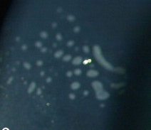
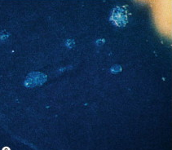
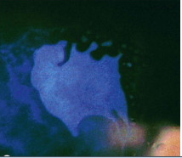
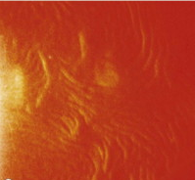
Epithelial dystrophies
Cogan epithelial basement membrane dystrophy
Onset
Signs
Dot like opacities
Epithelial microcyst
Subepithelial map like pattern
Whorled fingerprint – like lines
Notes:
2nd dacade ----10% develop recurrent corneal errosions in 3rd decade
Signs may b seen in isolation or combination
Over time one pattern frequently changes to other ----distribution of the lesion also vary

Slide 7
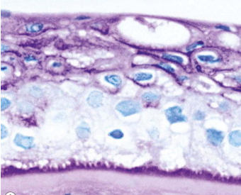
Epithelial dystrophies
2. Meesmann epithelial dystrophy
Inheritance
Histology
Basement membrane thickning
Intraepithelial cyst
Symptoms
Asymptomatic
Ocular irritation
Notes:
AD

Slide 8
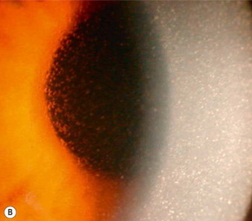
Epithelial dystrophies
2. Meesmann epithelial dystrophy
Signs
Tiny intraepithelial cysts
Reduced sensations
Slightly thinned
Treatment
Notes:
1-Of uniform size,maximal centrally and extends towrds but do not reach limbus
Treatment not normally required other than lubricants

Slide 9
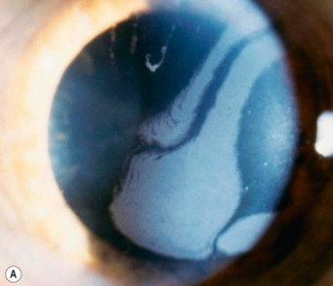
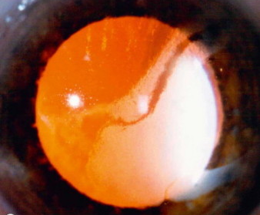
Epithelial dystrophies
3. Lisch epithelial dystrophy
Inheritance
AD or XLD
Gene locus on Xp 22.3 in XLD
Signs
Grey band with whorls
Densely packed microcysts
Notes:
On reteroillumination

Slide 10
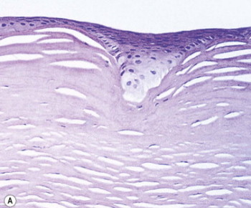
Bowman layer dystrophies
1. Reis – Bucklers dystrophy ( CDB1, GCD type 3)
Inheritance
AD
Gene locus 5q31
Histology
Replacement with fibrous tissue
Onset
1st or 2nd decade
Notes:
Corneal dystrophy of bowman layer type 1/ granular stromal dystrophy type 3
Replacement of bowman layer and epithelial basement membrane
With severe recurrent corneal errosion

Slide 11
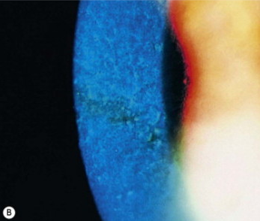
Bowman layer dystrophies
1. Reis – Bucklers dystrophy ( CDB1, GCD type 3)
Signs
Grey white , fine ,round and polygonal
subepithelial opacities
Increase with age
Reduced corneal sensations
Treatment
Directed at recurrent errosions
Excimer laser keratectomy
Notes:
Increase and give rise reticular pattern due to laying down of irregular bands of collagen replacing bowmans layer
Laser achieve satisfactory control in some patients

Slide 12
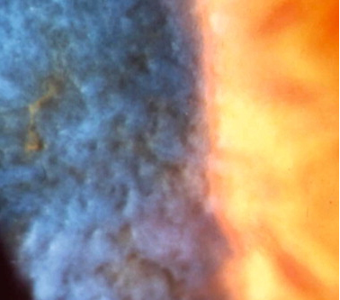
Bowman layer dystrophies
2. Thiel-Behnke dystrophy(CDB2,honeycomb-shaped corneal dystrophy)
Inheritance
Histology
Onset
End of 1st decade
Recurrent erosions
Signs
Honeycomb subepithelial opacity
Treatment
Notes:
AD GENE loci 10q24 and 5q31 gene TGFB1
Histology—curly fibres in bowman layer on electron microscope
Signs----involve central cornea
Treatment----may not be necessary coz visual impairment is less than in ries-buckler

Slide 13
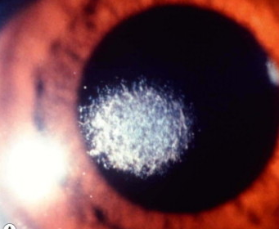
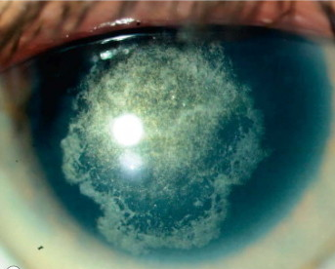
Bowman layer dystrophies
3. Schnyder central crystalline dystrophy
Disorder of corneal lipid metabolism
Inheritance
Histology
Onset
2nd decade , visual imparement
Signs
Central ,oval, subepithelial crystalline opacity
Diffuse corneal haze
Prominent arcus in 3rd decade
Treatment
Notes:
50% pt hav raised serum cholestrol
AD gene loci on 1p36
Histo---deposits of phospholipid and cholestrol
Treatment---by excimer laser

Slide 14
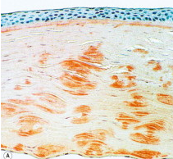
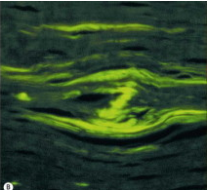
Stromal dystrophies
1. Lattice corneal dystrophy type 1(LCD1,
Biber-Haab-Dimmer)
Inheritance – AD, 5q31
Histology –
Amyloid stain
Green birefringence
Onset
End of 1st decade
Notes:
Stain with congo red
Green bi– with polarizing filter

Slide 15
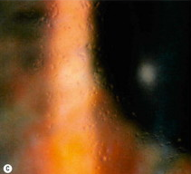
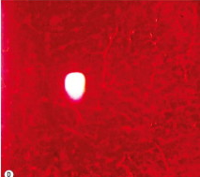
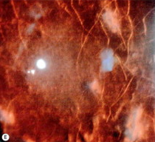
Stromal dystrophies
Lattice corneal dystrophy type 1
Signs
Anterior stromal dots
Fine lattice lines
Spread
Stromal haze
Reduced sensations
Treatment
PKP or DALK
Notes:
In chronologic order
Ant stromal , glassy , refractile dots
Coalese into fine lattice line
Deep ane outward spread sparing periphery
Generalised stromal haze progressively impair vision

Slide 16
Stromal dystrophies
2. Lattice corneal dystrophy type 2 (LCD2,Finnish type amyloidosis, Meretoja syndrome)
Inheritance – AD , gene locus 9q34
Histology – Amyloid deposits in stroma
Onset – 2nd decade
Signs – fine lattice lines
impaired corneal sensations
Treatment –keratoplasty
Notes:
Randomly scattered , short, fine lattice lines, which are sparse, more delicate,more radially oriented , more peripherally located than LCD1
Keratoplasty may rarely required in later life to improve vision

Slide 17
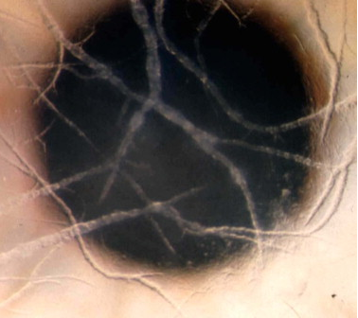
Stromal dystrophies
3. Lattice corneal dystrophy type 3
Inheritance – AD
Onset – 70 – 90 years
Signs – Thick rope like bands of amyloid

Slide 18
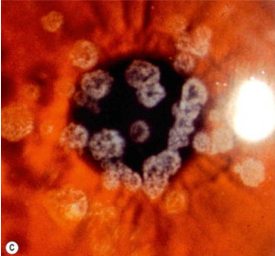
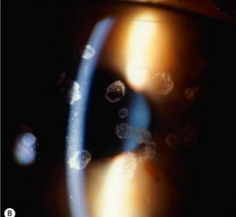
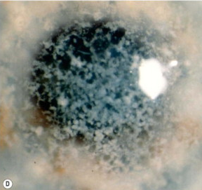
Stromal dystrophies
4. Granular corneal dystrophy type 1 (GCD1 , Groenouw type 1)
Inheritance
Onset – 1st decade
Signs
Anterior stromal deposits
Deeper and outward spread
Impaired corneal sensations
Treatment
Notes:
Small well defined deposits like sugar granules , crumbs, rings or flakes
Histology ---hyaline deposits
PKP or DALK

Slide 19
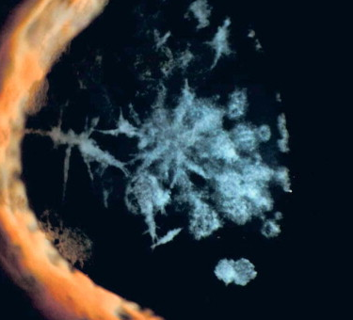
Stromal dystrophies
5. Granular corneal dystrophy type 2(GCD2, combined granular-lattice dystrophy)
Inheritance
Onset – 2nd decade
Signs
Superficial opacities
Deeper linear opacities
Notes:
AD gene locus 5q31
Histo—both hyalin and amyloid deposits
Deeeper linear opacities reminiscent of lattice dystrophy
Treatment– usually not required

Slide 20
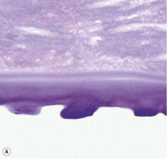
Endothelial dystrophies
1. Fuchs endothelial dystrophy
Bilateral accelerated endothelial cell loss
More common in women
Inheritance – AD
Onset – Old age, slow progressive
Histology – Guttata
Notes:
Assocated with slightly increased prevalence of open angle glaucoma
Guttata==irregular excrescence of descement memb—PAS stain

Slide 21
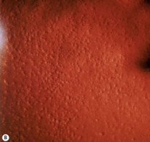
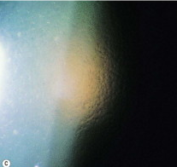
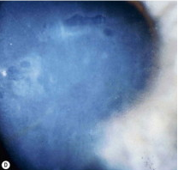
Endothelial dystrophies
1. Fuchs endothelial dystrophy
Signs
Corneal guttata
Beaten metal appearance
Stromal edema
Epithelial edema
Microcyst and bullae
Notes:
Corneal guttata----refers to irregular warts of descement memb,secreted by abnormal endothelial cells
Specular reflection show tiny dark spots due to disruption of regular endothelial mosaic
Progression occurs to beaten metal appearance
Endothelial decompensation gradually lead to stromal edema and dec visionworsen in the morning
Epithelal edema develop when stromal thickness >30%
Persistant epithelial edema---microcyst and bullae which cause pain on rupturedue to nacked nerve endings

Slide 22
Endothelial dystrophies
1. Fuchs endothelial dystrophy
Treatment
Conservative options
0.5% topical sodium chloride
Corneal dehydration
Bandage contact lenses
PKP or DLEK
Other options
Conjunctival flap
Amniotic membrane transplant
Notes:
Use hair dryer to speed corneal dehydration in the morning
BCL- to protect exposed nerve endings and flatten bullae
Keratoplasty-high success rate
Other--- in eye with poor visual outcome

Slide 23
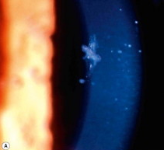
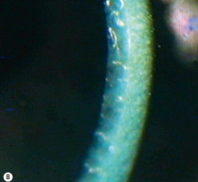
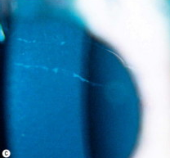
Endothelial dystrophies
2. Posterior polymorphous dystrophy (PPCD)
Innocuos asymptomatic
Inheritance – AD
Onset - at birth
Signs – vesicular endothelial lesion
band like or diffuse
Treatment
Notes:
Rare
Onset-may be incidently diagnosed later in life
Treatment is not usually required

Slide 24
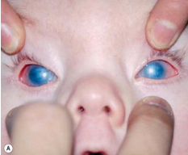
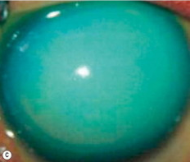
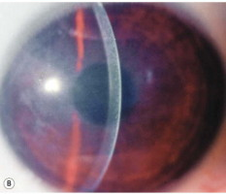
Endothelial dystrophies
3. Congenital hereditary endothelial dystrophy
Focal or generalized absence of corneal endothelium
Two main forms CHED1 and CHED2
Inheritance
Onset – perinatal
Signs
Corneal edema
Opacification
Notes:
Type 1-AD ,,type 2 – AR
Bilateral symmetrical diffuse corneal edema---resulting in blue grey ground glass appearance----to total opacification

Slide 25
Thank you

