Slide 1
Causal Concepts
Notes:
9/3/2012
1

Slide 2
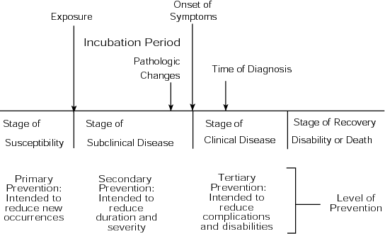
Natural History of Disease
Progression of disease in individual over time
Notes:
9/3/2012
2

Slide 3
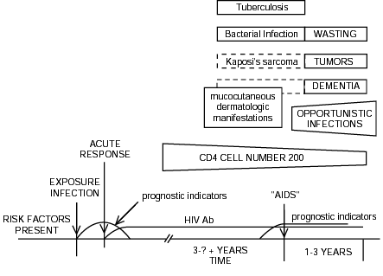
Natural History of HIV/AIDS
Identify stages:
Susceptibility
Incubation
Clinical

Slide 4
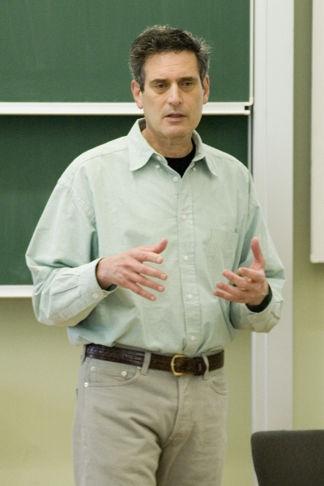
Rothman on Cause
Definition of “cause”
Any event, act, or condition
preceding disease or illness
without which disease would not have occurred
or would have occurred at a later time
Disease results from the cumulative effects of multiple causes acting together (causal interaction)
Ken Rothman
(contemporary epidemiologist)

Slide 5
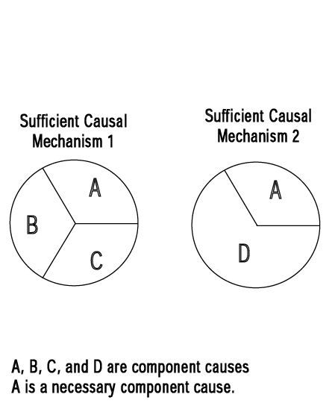
Types of Causes (Causal Pies)
A given disease can have multiple sufficient mechanisms
Necessary cause ≡ found in all cases
Contributing cause ≡ needed in some cases
Sufficient cause ≡ the constellation of necessary & contributing causes that make disease inevitable in an individual

Slide 6
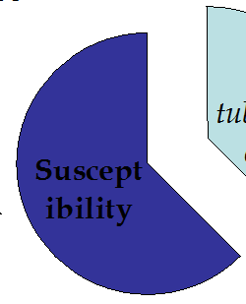
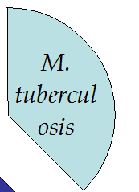
Causal Complement
(Causal Pie)
Causal complement ≡ the set of factors that completes a sufficient causal mechanism
Example: tuberculosis
  Necessary agent Mycobacterium tuberculosis
  Causal complement
  “Susceptibility”
6

Slide 7
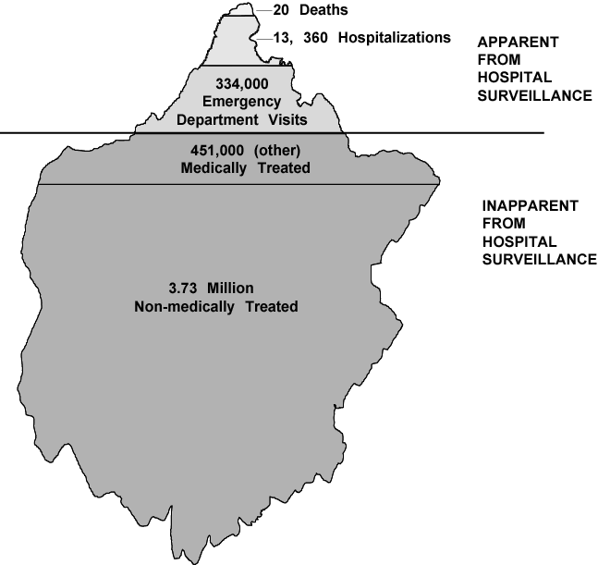
Epidemiological Iceberg & Spectrum of Illness
When looking for population occurrence, only the tip of the iceberg is visible
“Dog bite” iceberg
  3.73 million dog bites annually
  451,000 medically treated
  334,000 emergency room visits
  13,360 hospitalizations
  20 deaths
Notes:
9/3/2012
7

Slide 8

Iceberg & Spectrum
clinical
Spectrum of illness ≡ most diseases demonstrate a range of manifestations and severities
Example: Polio
  95%: subclinical
  4%: flu-like
  1%: paralysis
subclinical
8
Notes:
9/3/2012
Chapter 2: General Concepts
9/3/2012
Epidemiology
8

Slide 9
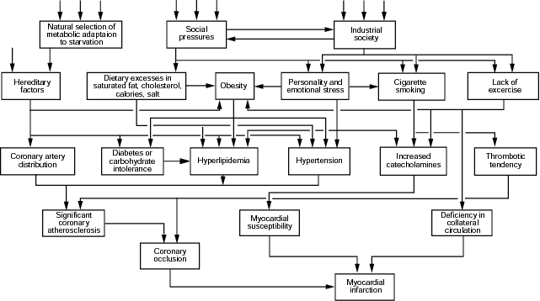
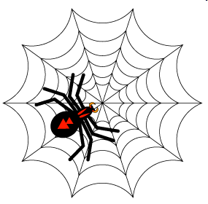
Causal Web
Causal factors act in a hierarchal web

Slide 10
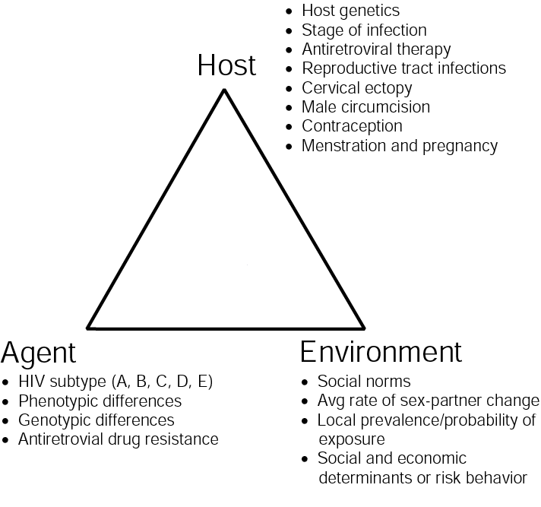
Epidemiologic Triad
Agent, host, and environmental interaction

Slide 11
Types of Agents
Biological | Chemical | Physical
Helminths | Foods | Heat
Protozoans | Poisons | Light / radiation
Fungi | Drugs | Noise
Bacteria | Allergens | Vibration
Rickettsia |  | Objects
Viral
Prion

Slide 12

Types of Host Factors
Physiological
Anatomical
Genetic
Behavioral
Occupational
Constitutional
Cultural
etc!

Slide 13
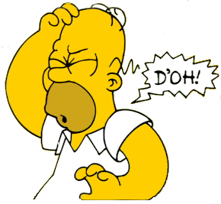
Types of Environmental Factors
Physical, chemical, biological
Social, political, economic
Population density
Cultural
Env factors that affect presence and levels of agents

Slide 14
Homeostatic Balance
H
A
A
H
E
E
Agent becomes more pathogenic
A
H
The proportion of susceptibles in population decreases
E
H
At equilibrium
Steady rate
A
A
E
E
H
Environmental changes that favor the host
Environmental changes that favor the agent

Slide 15
Descriptive Epidemiology
I keep six honest serving men
They taught me all I know;
Their names are what and why and when
And how and where and who.
(Kipling)
Exploration of rates by
person variables
place variables
time variables

Slide 16
“Rate”
Loosely, the “rate” of an event is the number of events divided by population size

Slide 17
Rates Expressed with Population Multiplier
Let m ≡ population multiplier
Simply multiply by m and say “per m”
Example 1: The rate of .00933 expressed “per 1000” is .00933 × 1000
= 9.33 per 1000
Example 2: The rate of .00933 expressed “per 100,000” is .00933 × 100,000
= 933 per 100,000

Slide 18
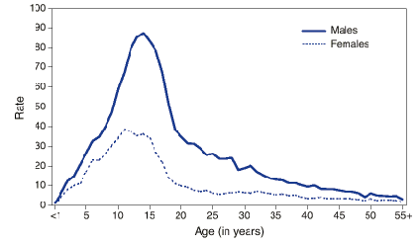
Person Variables
Characteristics, attributes, and behaviors of individuals
Examples of person variable:
Illustration: Recreational injuries per 1000 person-years by age and gender

Slide 19
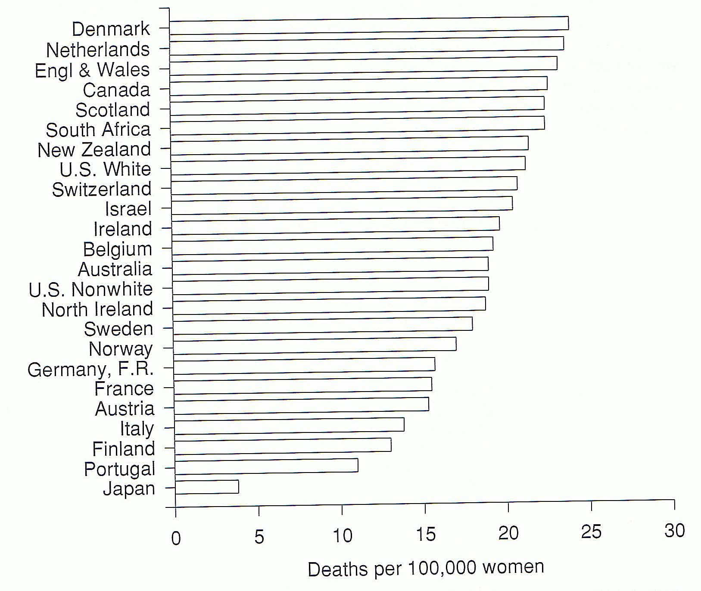
Place Variables
Where people live and work
Examples: see
Illustration: Age-adjusted breast cancer mortality in 23 countries, 1958–59

Slide 20
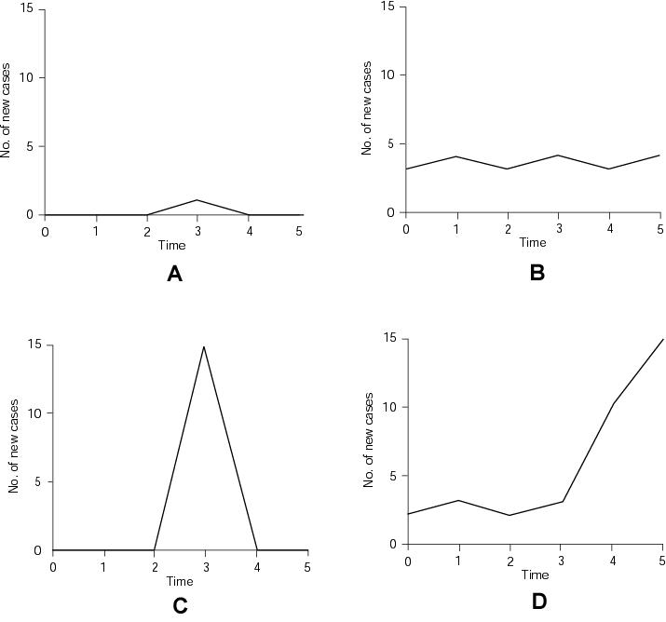
Time Variables
Examples of time variables
Example: Epidemic curves
  Sporadic
  Endemic
  Point epidemic
  Propagating epidemic

Slide 21
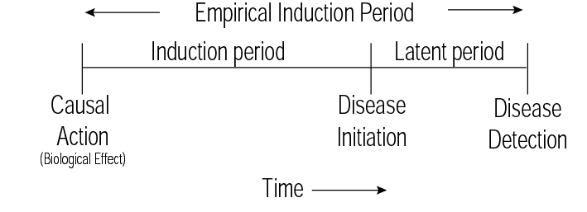
Induction
Sophisticated view of “incubation” needed when considering multicausality
Induction = causal action to initiation
Latency = disease initiation to detection
Empirical induction period = induction + latency

Slide 22
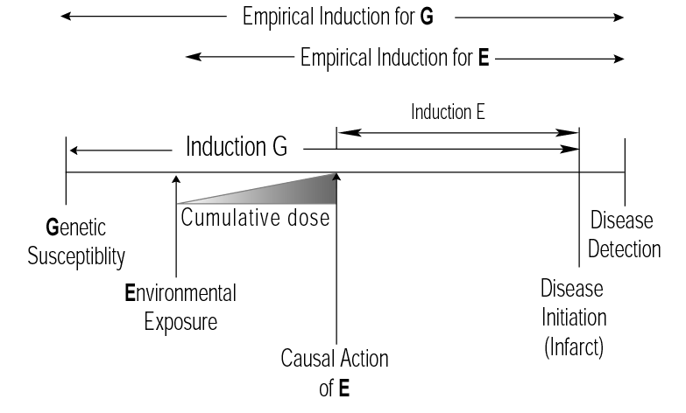
Induction & Initiation
Heart Disease Example
22
Notes:
Chapter 2: General Concepts
9/3/2012
Epidemiology
22

