Slide 1
Case-control study
Start with diseased group (“cases”); compare with non-diseased group (“controls”).
Look back in time for possible differences in exposure factors
Also known as a “retrospective” study

Slide 2
Observational Analytic Studies
Cohort
Exposure
Exposed Outcome?
Not Exposed Outcome?
Case-Control
Outcome
Exposed? Outcome
Exposed? Control

Slide 3
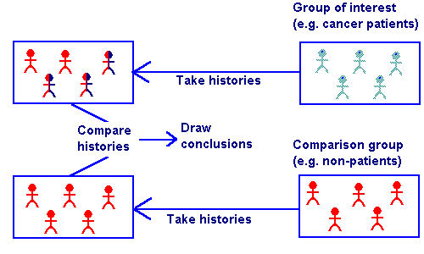
Case Control Studies

Slide 4
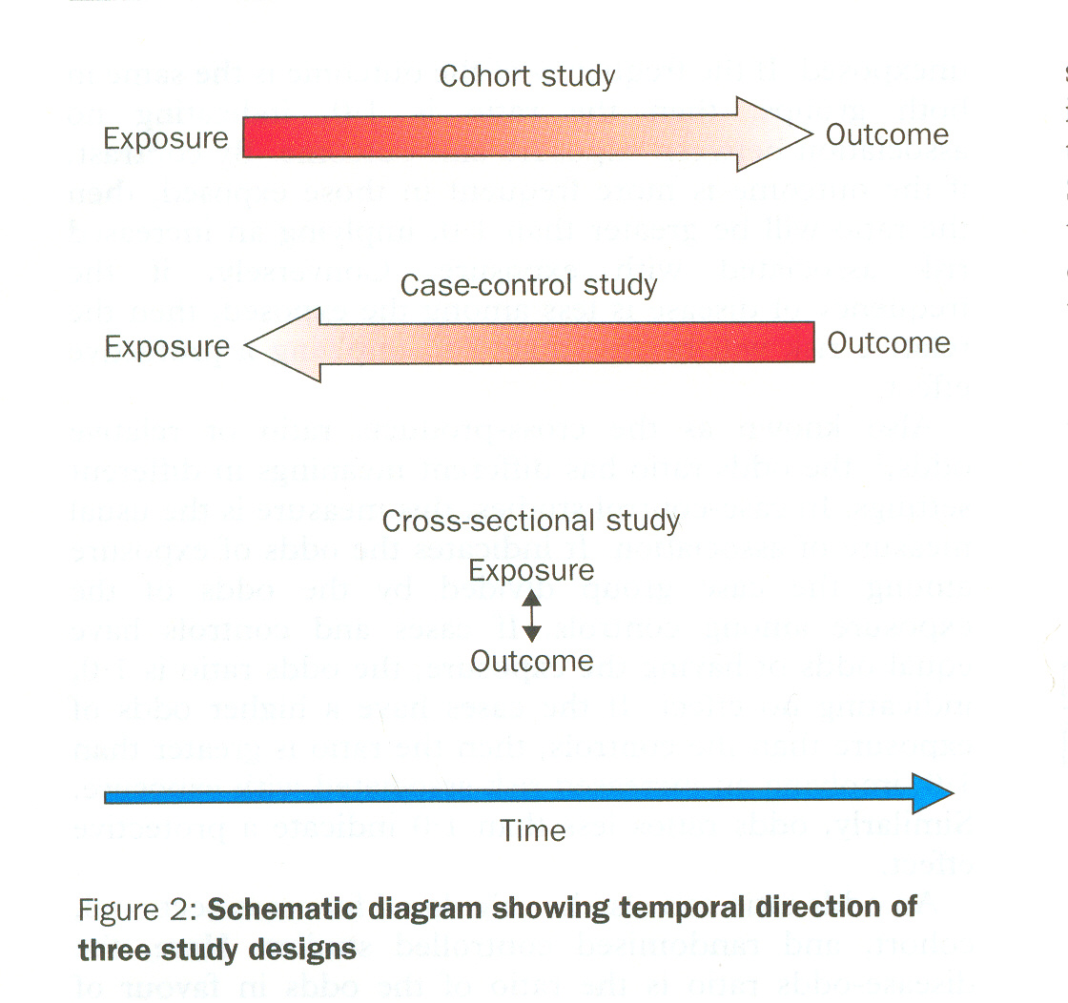
Grimes DA and Schulz KF 2002. An overview of clinical research. Lancet 359:57-61.
Notes:
Grimes’ Figure 2 showing temporal directionality of cohort vs. case-control vs. cross-sectional.

Slide 5
Case Control Study
In its simplest form, comparing a case series to a matched control series.
Possibly the first c-c study was by Whitehead in Broad Street pump episode, 1854 (Snow did not do a c-c study).
First modern c-c study was Janet Lane-Claypon’s study of Breast cancer and reproductive history in 1926.
Four c-c studies implicating smoking and lung cancer appeared in 1950, establishing the method in epidemiology.

Slide 6
Steps in a Case-control Study
Define the study’s objectives
Identify and select “cases”: optimally, persons with new onset of disease
Select “controls”

Slide 7
Steps in a Case-control Study
Collect data: measure level of “exposure” in cases and controls
Analyze data: compare the exposure frequencies in those with and without disease. Measure of association = Odds ratio (exposure odds ratio)
Interpret data

Slide 8
Case Control Study
DATA ANALYSIS
Exposure odds calculation for both case and control groups:
- exposure odds for cases =
- exposure odds for control group =
ODDS RATIO (OR) =

Slide 9
Measure of association, case control studies = Odds Ratio
“Disease”
present absent
present
a
b
“Exposure”
absent
d
c
Initial study group: Cases
a+c
b+d
Initial study group: Controls

Slide 10
Measure of association, case control study = Odds Ratio
Odds of exposure in the diseased (cases)
“Disease”
present absent
a/(a+c)
c/(a+c)
present
a
b
Odds of exposure in the nondiseased (controls)
“Exposure”
b/(b+d)
d/(b+d)
absent
d
c
Initial study group: Cases
a+c
b+d
Initial study group: Controls

Slide 11
Measure of Association, Case Control studies ; Odds Ratio
Exposure Odds ratio = ratio of the odds of exposure in the diseased to the odds of exposure in the non-diseased
a/(a+c)
c/(a+c)
Odds of exposure in the diseased
______________
b/(b+d)
d/(b+d)
Odds of exposure in the nondiseased

Slide 12
Measure of Association, Case Control Studies: Odds Ratio
a/(a+c)
c/(a+c)
Exposure Odds ratio =
a/c
b/d
ad
bc
______________
=
=
b/(b+d)
d/(b+d)

Slide 13
Case-control study: risk factors for AIDS
Initial etiologic investigation for possible AIDS risk factors
Cases = gay men with AIDS (n = 50) from New York, San Francisco, Los Angeles, and Atlanta
Controls = gay men without AIDS from same cities, matched by age, recruited from outpatient clinics (n = 120)
Ann Intern Med 1983;99:145-151.

Slide 14
Case control studies: Strengths
Quick
Relatively inexpensive (no follow-up)
Excellent for studying rare diseases
Useful in etiologic exploration studies (“fishing expeditions”)
No loss to follow-up

Slide 15
Case-control studies: Weaknesses
Cannot directly measure incidence rates (risk) or relative risk (In certain circumstances, can use the odds ratio to estimate the relative risk)
Greater potential for bias compared with cohort studies

Slide 16
Case-Control Study Examples
Study to determine an association between autism and vaccination
Study to determine an association between lung cancer and radon exposure
Study to determine an association between salmonella infection and eating at a fast food restaurant
Notes:
Some examples of a case–control study design are listed here.
A study may assess whether or not members of a population have autism, and then determine whether the cases with autism had a certain vaccination more often than the controls.
A study of lung cancer may seek to determine if lung cancer patients in a population had more exposure to radon in the past than members of the population without lung cancer.
An outbreak of salmonella may be investigated by determining whether salmonella cases ate at a particular fast-food restaurant more than controls who do not have salmonella infection.

Slide 17
Odds Ratio
In a case-control study, the risk of disease cannot be directly calculated because the population at risk is not known
OR is the measure used with case-control studies
a ^{x} d
OR =
b ^{x} c
Notes:
Now let’s change tactics for a minute and talk about the odds ratio. In a case-control study, the risk of disease cannot be directly calculated because the population at risk is not known. Instead, we calculate the odds ratio. The numbers for the odds ratio calculation come from the same type of 2x2 table that we use for the risk ratio. The calculation of the odds ratio, however, comes down to multiplying A times D, and dividing that by B times C. Let’s walk through an example calculation of this.

Slide 18
Odds Ratio Example
 | Autism
MMR Vaccine? | Yes | No | Total
Yes | 130 | 115 | 245
No | 120 | 135 | 255
Total | 250 | 250 | 500
a x d 130 x 135
OR = = = 1.27
b x c 115 x 120
Notes:
To calculate the measure of an association between the outcome of autism and the exposure of the Measles-mumps-rubella vaccine, a case-control study was conducted, with the results shown in the table. To calculate the OR, we multiply cell A, which is 130, times cell D, which is 135. We divide this by the quantity of Cell B, which 120, times cell C, which is 115. The OR comes out to be 1.27.
From this, we can say that the odds of being exposed to the MMR vaccine were 1.27 times higher in those who had autism than in those who did not have autism.

Slide 19
Interpretation
Both the RR and OR are interpreted as follows:
= 1 - indicates no association
> 1 - indicates a positive association
< 1 - indicates a negative association
Notes:
Now we have calculated the RR and the OR, but what do these numbers mean?
If the measure of association = 1, that means that there is no association between the exposure and disease. When the two groups were compared, they were the same.
If the measure of association is greater than 1, that means there is a positive association between the exposure and disease – the group that has the exposure also has more disease.
If the measure of association is less than 1, that means there is a negative association between exposure and disease – the group that has the exposure has LESS disease. This is also known as a “protective effect.”

Slide 20
Interpretation
If the RR = 5
People who were exposed are 5 times more likely to have the outcome when compared with persons who were not exposed
If the RR = 0.5
People who were exposed are half as likely to have the outcome when compared with persons who were not exposed
If the RR = 1
People who were exposed are no more or less likely to have the outcome when compared to persons who were not exposed
Notes:
Here are a few example interpretations:
If the relative risk = 5
People who were exposed are 5 times more likely to have the outcome when compared with persons who were not exposed
If the relative risk = 0.5
People who were exposed are half as likely to have the outcome when compared with persons who were not exposed
If the relative risk = 1
People who were exposed are no more or less likely to have the outcome when compared to persons who were not exposed

Slide 21
Case-Control Design
The Past or Present The Present
Sample
of cases
Exposure
present
Exposure
absent
Outcome
Population with disease (cases)
Sample
of controls
Exposure
present
Exposure
absent
No
Outcome
Much larger population without disease (controls)

Slide 22
Example of Case-Control Design: OC Use and Breast Cancer
The Past or Present The Present
Sample
of cases
OC Use
OC Use absent
Breast Cancer
Population with disease (cases)
Sample
of controls
OC Use
OC Use absent
No
Breast Cancer
Much larger population without disease (controls)

Slide 23
Types of Cohort Studies
You may also NEST a case-control study within a cohort study
Example:
Begin with a cohort of 10,000 individuals without rheumatoid arthritis
Test for the presence of RA antigen
Assume those with RA antigen are the exposed and those without the controls
Follow for 10 years and determine the incidence of disease among both cohorts
This reduces the cost of testing

Slide 24
Case Control Studies
Case control studies aim to identify if there is an association between a potential risk factor and a particular disease or outcome. These studies are used frequently to identify the:-
Source of infection during epidemics
Evaluation of vaccine efficacy
Identification of factors which predispose to severe disease or death.

Slide 25
Three distinct features
Both exposure and outcome (Disease) have occurred before the start of the study.
The study proceeds backward from effect to cause
It uses a control or comparison group to support or refute an inference.

Slide 26
DIFFERENCE BETWEEN CASE CONTROL AND COHORT STUDIES
CASE CONTROL
Proceeds from effect to cause
Starts with disease
Tests whether the suspected cause occurs more frequently in those with disease than those among without disease.
Usually the first approach for testing the hypothesis.
Involves fewer no of subjects
Yields relatively quick results
Suitable for study of rare diseases
Generally yields only estimate of OR
Cannot yield info about diseases other than that selected for study
Relatively inexpensive
COHORT
Proceeds from cause to effect
Starts with healthy people
Tests whether disease occurs more frequently in those exposed or in those not exposed.
Reserved for testing of precisely formulated hypothesis.
Involves larger no of subjects
Yields delayed results
Inappropriate for rare diseases
Yields Incidence, RR & AR
Can yield information about more than one disease.
Expensive

Slide 27
Hierarchy of Epidemiologic Study Design

Slide 28
Q . Identify the Study Designs:
1. Kilbourne and colleagues (1983) investigated an epidemic in Spain involving multiple organ systems. Patients presented with cough, dyspnea, pleuritic chest pain, headache, fever, and bilateral pulmonary infiltrates. Although an infectious agent was first suspected, a strong association with cooking oil sold as olive oil but containing a high proportion of rapeseed oil was detected. Epidemiologic studies found that virtually all patients had ingested such oil but that unaffected person had rarely done so.

Slide 29
2. Kalman and Laskin (1986) presented information on immuno-competent patients who had been referred to a general hospital with a diagnosis of herpes zoster infection. The investigators wanted to determine the percentage of zosteriform rashes clinically diagnosed as herpes zoster but actually caused by herpes simplex virus. They concluded that physicians should distinguish between infections caused by herpes zoster and herpes simplex virus because of the advent of antiviral drugs and the proper use of epidemiologic isolation procedures.

Slide 30
3. Einarsson and colleagues (1985) were interested in learning more about the relationship between bile super saturation with cholesterol and age. It is known that patients with cholesterol gallstones have higher saturation levels of cholesterol than control populations without gallstones, but it is not known whether saturation levels increase as part of the aging process.

