Slide 1
NASAL OBSTRUCTION (Blocked Nose)
Lt Col Mian Amer Majeed
MCPS,FCPS, DO-HNS(London)
Classified ENT Specialist
MH Rawalpindi

Slide 2
History
Complaints:- “I can’t breath through the left side of my nose”
What else do you want to ask the patient?
History of Present Illness:
6-8 mo h/o left nasal obstruction.
Slowly progressive
Occasional epistaxis when bends over
Decreased sense of smell left nasal passage
No visual changes, no headaches

Slide 3
AETIOLOGY

Slide 4
UNILATERAL
VESTIBULE
Furuncle
Vestibulitis
Stenosis
Atresia
Nasoalveolar cyst
papilloma
NASAL CAVITY
F.B
DNS
Hypertrophied turbinates
Synechae
Concha bullosaRhinolith
Sinusitis

Slide 5
BILATERAL
VESTIBULE
Bilateral vestibulitis
Collapsing nasal alae
stenosis
NASAL CAVITY
Ac Rhinitis
Ch rhinitis
Rhinitis medicamentosa
Allergic rhinitis
DNS polyp
Haematoma /abscess

Slide 6
NASOPHARYNX
Adenoids
Choanal polyp
tumours

Slide 7
CAUSES
Infections/inflammatory
Adenoid hyperplasia
Chronic rhino-sinusitis
Allergic rhinitis
Chronic hypertrophic rhinitis
Nasal polyposis

Slide 8
Traumatic
Deviated nasal septum
Foreign Body
SEPTAL HAEMATOMA
ABSCESS
STENOSIS

Slide 9
Congenital
Encephalocele/meningoencephalocele
Craniofacial deformities
Dermoids
Craniopharyngiomas
Teratomas
Chordomas
Posterior choanal stenosis/atresia
Nasoalveolar and Nasopharyngeal (Tornwaldt's) cysts

Slide 10
Differential Diagnosis
V– hemangioma, AVM, juvenile nasoangiofibroma, hamartoma
I – sinusitis, nasal polyposis, mucocele, allergic rhinitis,
T – acquired nasal deformity
A – Wegener’s granulomatosis, relapsing polychondritis
M – none
I – Sarcoid, rhinitis medimentosum
N – mucosal melanoma, lymphoma, nasopharyngeal carcinoma, extramedullary plasmacytoma, adenoid cystic carcinoma, adenocarcinoma, squamous cell ca, papillomas, fibrous dysplasia, osteoma, hemangiopericytoma, esthesioneuroblastoma, sarcomas, SNUC
C – teratomas, dermoid,
D – none

Slide 11
CLASSIFICATION

Slide 12
NONANATOMIC
chronic sinusitis
allergies
overuse of nose sprays
birth control pills
hypertension
thyroid abnormality

Slide 13
ANATOMIC
deviated septum
nasal polyps
large adenoids
nasal foreign body
hypertrophic
turbinate bones

Slide 14
HISTORY
The goals of the evaluation are to determine specific causes of problems, the severity of the obstruction, and the presence of associated medical complications.

Slide 15
Lifelong symptoms suggest congenital malformation or early acquired disease or injury
Pertinent past history include birth trauma, early childhood trauma, previous hospitalizations, medications, and surgical history. Related symptoms must be actively investigated

Slide 16
Voice quality (degree of nasality) and clarity, daytime hypersomnolence, and school/behavioral difficulties should be evaluated. History of rhinorrhea, epistaxis and allergy should be noted.

Slide 17
EXAMINATION
A complete examination of the head and neck is performed.
"Adenoid facies" is characterized by an open mouth, dull facial appearance, and short upper lip
Tonsillar hypertrophy, macroglossia and oropharyngeal masses should be evaluated.

Slide 18
Evaluation of the voice quality includes as assessment of nasality and clarity
The ears should be evaluated as otitis media certainly is associated with nasal obstruction problems. Bony nasal anomalies, external masses, pits, etc. should be evaluated. Anterior rhinoscopy is relatively easy to perform in a small child.

Slide 19
Posterior rhinoscopy and nasopharyngoscopy will require a topical decongestant and local anesthetic and insertion of either a rigid telescope or flexible fiberoptic nasopharyngoscope. This may be difficult to do younger than age 4.

Slide 20
WAKE UP , BE ALERT……………………………. CLINICAL SCENARIOS

Slide 21
CASE 1
Capt Ali blessed with a son yesterday in CMH. Gynaecologist who conducted delivery was informed by nurse that baby has respiratory difficulty in breathing from nose, anaesthetist immediately tried to pass ETT from nose but failed due to blockage in nose……………DIAGNOSIS

Slide 22
Causes
Congenital - choanal atresia
(uni- or bilateral, soft-tissue or bony)
~ presents at birth
~ bilateral is problem as neonate is obligate nose breather
~ airway must be provided as emergency

Slide 23
Case - 2
Famous boxer Muhammad Ali presented to his consultant after having a bout with complaints of epistaxis & nasal blockage rt side…………DIAGNOSIS

Slide 24
Nasal trauma
May be part of more extensive injury to face,
skull, skull-base, neck, chest …….
REMEMBER TO CONSIDER THE AIRWAY AND EXCLUDE
CERVICAL SPINE INJURIES

Slide 25
Remember that low velocity trauma usually results in isolated nasal injury, while high-velocity trauma often has accompanying facial fractures and cervical spine injury must be considered

Slide 26
Document all injuries, symptoms and signs
Supplement notes with drawings, diagrams and photographs
These injuries often require reports for legal purposes and good, clear documentation is vital

Slide 27
CASE - 3
Hassan applied for army but got medically unfit as ENT specialist commented that he is having decreased nasal patency on right side,enlarged inferior tubinate left side. On inquiring Hassan gave h/o nasal obstruction since age 12 when he had nasal trauma……….DIAGNOSIS

Slide 28
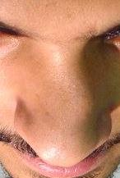
Causes
Acquired - trauma
(without discharge) ~ deviated septum
- unilateral

Slide 29
Deviated septum
Developmental as well as
Traumatic
The convexity of the septum is usually to the obstructed side while the concave side often has enlarged (compensatory) inferior and middle turbinates.

Slide 30
Septal deviations
A truly straight septum is rare - deviations, deflections and spurs occur and, if severe, can cause obstruction.
Perceptions of “abnormality” are subjective as some patients with minimal loss of airflow complain bitterly while complete obstruction is often an incidental finding in others.

Slide 31
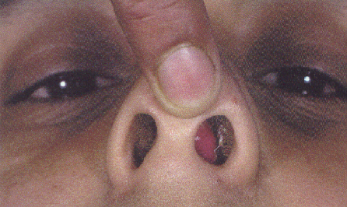
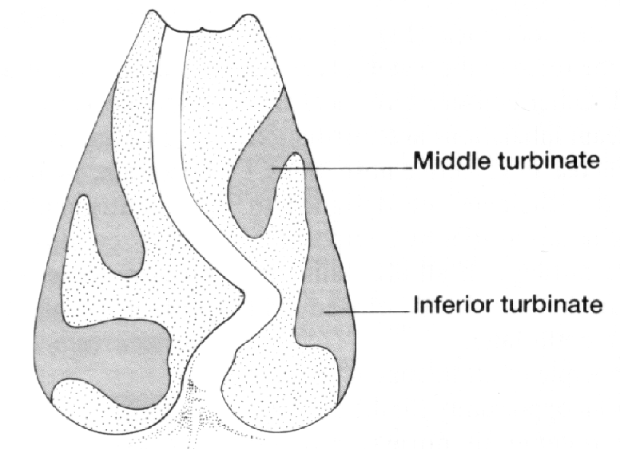
Septal deviation

Slide 32
Symptoms
Usually unilateral
Obstruction - convex side - septum itself
- concave side - turbinate
Facial pain / - enlarged turbinate
sinusitis
Chronic otitis
media - E.Tube dysfunction

Slide 33
Clinical appearance
External appearance of the nose gives idea of symmetry.
Inspection (anterior & posterior rhinoscopy)
- deflection(s)
- caudal dislocation
- spur(s)
- compensatory turbinate enlargement

Slide 34
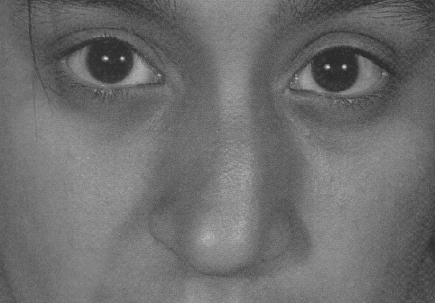
External deformity

Slide 35
Treatment
Depends on degree of symptoms / discomfort
Is surgery indicated, choice is between septoplasty and submucosal resection
Aim is to straighten or remove the deviated section and reposition it in the midline, while retaining adequate support of the nasal dorsum
Turbinates may be trimmed or realigned

Slide 36
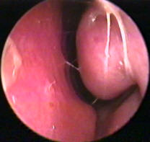
CASE - 4
HAJIRA 3rd yr medical student in AM College presented in ENT opd with h/o running nose, early morning sneezing since childhood…….DIAGNOSIS

Slide 37
Allergic Rhinitis
Acquired - mucosal inflammation
(with discharge) - allergy
~ atopy history
~ seasonal or perennial
~ obstruction, rhinorrhoea, itch
Allergen avoidance ± antihistamines ± topical nasal steroids

Slide 38
CASE - 5
Ahmar 4th yr cadet took his younger brother (14 months old) in ENT dept on Saturday with c/o nasal stuffiness and obstruction for last 7 days ass with foul smelly discharge from nose………..diagnosis

Slide 39
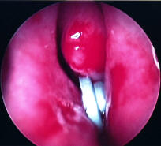
FOREIGN BODY
Acquired - mucosal inflammation
(with discharge)
- foreign body
~ unilateral, foul-smelling rhinorrhoea in a child is a foreign body until disproven.
Visualise and remove ± local anaesthetic

Slide 40
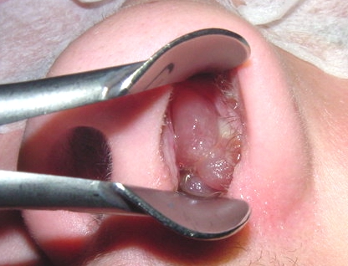
CASE - 6
Final yr cadet Mariam presented in ENT opd with nasal obstruction. Examination revealed decreased nasal patency on rt side and pale mass with glistering surface filling rt nasal cavity……..DIAGNOSIS

Slide 41
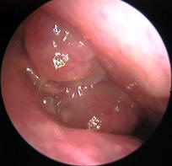
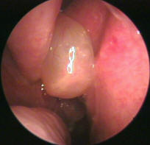
POLYPS

Slide 42
CASE - 7
Adil a Biochemistry teacher presented with h/o recurrent epistaxis. Examination revealed small pointed projection on nasal septum rt side…………DIAGNOSIS

Slide 43
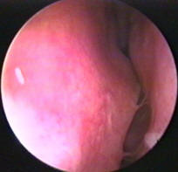
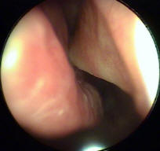
SEPTAL SPUR

Slide 44
CASE - 8
Maj Atif presented with 5 days h/o fever,nasal obstruction and pain nose. Examination revealed soft swelling on nasal septum rt obscuring nasal cavity…….DIAGNOSIS

Slide 45
Septal abscess

Slide 46
CASE - 9
Filmstar Meera presented with 5 yr h/o nasal obstruction. She had septal surgery 1 yr back for DNS but her nasal obstruction increased after operation… ….DIAGNOSIS

Slide 47
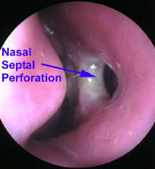

Slide 48
CASE - 10
Sep Allah Ditta presented with 6 months h/o nasal obstruction. Examination showed stony mass on nasal cavity floor (rt). History revealed some FB impaction 8 months back but GP didn’t find anything in nose………….DIAGNOSIS

Slide 49
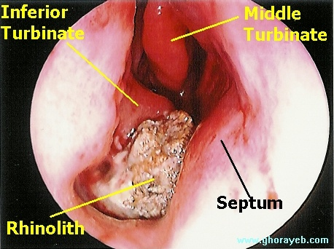
Rhinolith

Slide 50
Conclusion – common sense
Identify cause
Remove cause
Treat any underlying / residual problems
Reassurance

Slide 51
QUESTIONS ?

