Slide 1
KERATOPLASTY
Major M Kashif Hanif
DOMS FCPS
AFIO RWP

Slide 2
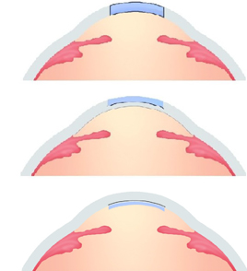
Keratoplasty (corneal transplantation, grafting) is an operation in which abnormal corneal host tissue is replaced by healthy donor cornea
A corneal graft may be
(a) full-thickness
(penetrating)
(b) partial-thickness
(lamellar or deep lamellar)

Slide 3
Penetrating keratoplasty
Indications
Optical
keratoplasty is performed to improve vision
Bullous keratopathy
Keratoconus
Dystrophies & degenerations
Scarring
Tectonic grafting may be carried out to restore or preserve corneal integrity in eyes with severe structural changes such as
Stromal thinning
Descemetocele

Slide 4
Therapeutic corneal transplantation may afford removal of infected corneal tissue in eyes unresponsive to antimicrobial therapy
Cosmetic grafting may rarely be performed to improve the appearance of the eye

Slide 5
Donor tissue
Donor tissue should be removed within 24 hours of death. Corneas from infants are usually not used, being floppy and likely to result in high astigmatism
Corneas from donors over the age of 70 years may also be inappropriate due to low endothelial cell counts
Preoperative evaluation of donor tissue includes slit-lamp examination and specular microscopy

Slide 6
Donor corneas should not be utilized under the following circumstances
Death of unknown cause
Infectious diseases of the CNS (e.g. Creutzfeld-Jakob disease, systemic sclerosing panencephalitis, progressive multifocal leucoencephalopathy)
Certain systemic infections (e.g. AIDS, viral hepatitis, syphilis, septicaemia)
Leukaemia and lymphoma.
Intrinsic eye disease (e.g. malignancy, active inflammation) or previous intraocular surgery

Slide 7
Prognostic Factors
The following factors may adversely affect the prognosis of a corneal graft and should therefore be addressed prior to surgery
Abnormalities of the eyelids such as blepharitis, ectropion, entropion and trichiasis should be corrected before surgery
Tear film dysfunction
Recurrent or progressive forms of conjunctival inflammation, such as atopic conjunctivitis and ocular cicatricial pemphigoid

Slide 8
Severe stromal vascularization, absence of corneal sensation, extreme thinning at the proposed host-graft junction and active corneal inflammation
Anterior synechiae
Uncontrolled glaucoma
Uveitis

Slide 9
Technique
Determination of graft size
It is done preoperatively with a variable slit beam and operatively, by trial placement of trephines with different diameters or measurement with a caliper
Grafts of diameter 8.5mm or more are prone to postoperative anterior synechiae formation, vascularization and increased intraocular pressure
An ideal size is 7.5mm; grafts smaller than this may give rise to high astigmatism

Slide 10
Preparation of donor cornea

Slide 13
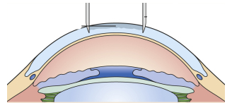
Partial thickness trephination

Slide 14
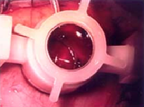

Slide 15
Excision of donor cornea
It should always precede that of the host. Donor tissue is prepared by trephining a previously excised corneoscleral button, endothelial side up in a concave Teflon block
Alternatively, the donor may be trephined from the intact donor globe having first injected air or viscoelastic substance into the anterior chamber
The donor button is usually about 0.25mm larger in diameter than the planned diameter of the host opening, to facilitate watertight closure, minimize postoperative flattening and reduce the possibility of postoperative glaucoma

Slide 16
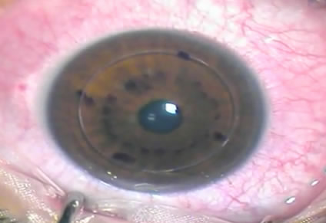

Slide 17
Excision of diseased host tissue is then carried out taking care not to damage the iris and lens
Sutures are placed through the insertions of the superior and inferior rectus muscles.
Partial-thickness trephination is performed
The anterior chamber is entered with a knife
Excision is completed with scissors
Viscoelastic is injected

Slide 18
Fixation of donor button is usually with 10-0 monofilament nylon
The donor button is placed onto the cornea
Four interrupted radial 'cardinal' sutures are placed; the first at 12 o'clock , the second at 6 o'clock, the third at 3 o'clock and the last at 9 o'clock ( The corneal 'bite' should be almost full-thickness to prevent wound gape
Further interrupted sutures are inserted
Closure is completed with a continuous running suture
Replacement of viscoelastic substance with balanced salt solution

Slide 19
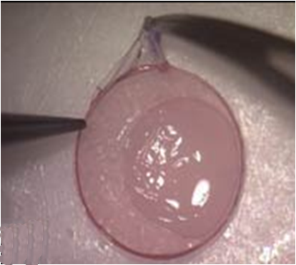

Slide 20
Postoperative management
Topical steroids
They are used to reduce immunological graft rejection
After initial administration 2-hourly and then q.i.d. for a few weeks, the dose may be further tapered, depending on the condition of the eye
Steroids are usually continued at low doses such as once daily for a year or more
Mydriatics b.d. for 2 weeks, or longer if uveitis persists.

Slide 21
Oral aciclovir may be used in the context of pre-existing herpes simplex keratitis to minimize the risk of recurrence
Removal of sutures when the graft-host junction has healed is usually after 12-18 months, although in elderly patients it may take much longer
Rigid contact lenses may be required to optimize visual acuity in eyes with astigmatism

Slide 22
Postoperative Complications
Early complications include persistent epithelial defects, irritation by protruding sutures which may give rise to papillary hypertrophy, wound leak, flat anterior chamber, iris prolapse, uveitis, elevation of intraocular pressure and infection. A rare complication is a fixed dilated pupil (Urrets-Zavalia syndrome)
Late complications include astigmatism, recurrence of initial disease process on the graft, late wound separation, retrocorneal membrane formation, glaucoma and cystoid macular oedema

Slide 23
Corneal Allograft Rejection
Allograft rejection of any layer of the cornea can occur following penetrating keratoplasty and, less commonly, lamellar grafts. Endothelial rejection is the most common and most severe as it can lead to severe endothelial cell loss and decompensation. Late graft failure through decompensation can also occur in the absence of further rejection episodes
Stromal rejection and epithelial rejection are less frequent and respond readily to topical steroid treatment with few long-term consequences. Elements of the different types of rejection can coexist

Slide 24
Pathogenesis
The cornea is immunologically privileged and a normal cornea will usually not reject. However, if there is inflammation this privilege is lost and rejection may occur
Other important predisposition for rejection includes corneal vascularization, grafts over 8mm in diameter, eccentric grafts, infection, glaucoma and previous keratoplasty

Slide 25
If the host becomes sensitized to the major or minor histocompatibility antigens present in the donor, cornea type IV hypersensitivity can develop against the graft and rejection and graft failure may result
Antigen presenting cells in the donor cornea may initiate this process. HLA Class I matching has a small beneficial effect on graft survival

Slide 26
Symptoms of graft rejection
These include
blurred vision
Photophobia
dull periocular ache
However, many cases are asymptomatic until advanced rejection is established

Slide 27
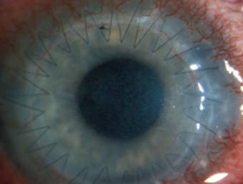
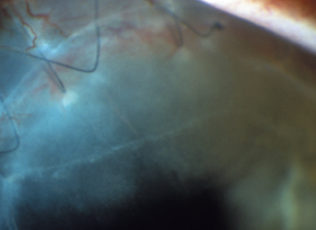
Ciliary injection and anterior uveitis is a pre-rejection manifestation
Epithelial rejection may be accompanied by an elevated line of abnormal epithelium

Slide 28
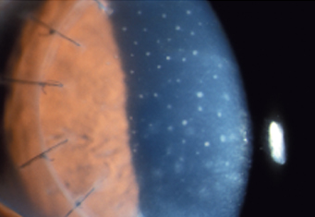
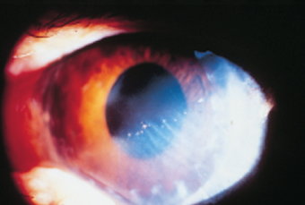
Stromal rejection is characterized by subepithelial infiltrates, reminiscent of adenoviral infection (Krachmer spots) on
the donor cornea
Endothelial rejection is characterized by linear pattern of keratic precipitates (Khodadoust endothelial rejection line) associated with an area of inflammation at the graft margin
Stromal oedema is indicative of
endothelial failure

Slide 29
Management
Early treatment is essential as this greatly improves the chances of reversing the rejection episode
Topical steroids (dexamethasone phosphate 0.1% or prednisolone acetate 1%) hourly for 24 hours are the mainstay of therapy. The frequency is reduced gradually over several weeks but high risk patients should be maintained on the highest tolerated topical dose (e.g. prednisolone acetate 1% q.i.d)

Slide 30
Systemic steroids (oral prednisolone 1mg/kg/day in divided doses, or a single intravenous dose of methylprednisolone 500mg) may help to reverse rejection and prevent further rejection episodes but only if given within 8 days of onset of rejection. Repeated intravenous methylprednisolone may be associated with loss of bone density and osteoporosis
Subconjunctival steroids (betamethasone 2mg) may be useful

Slide 31
Differential Diagnosis
Graft failure
Reactivation of HSV
Uveitis
Epithelial down-growth

Slide 32
Lamellar keratoplasty
Lamellar keratoplasty involves partial thickness excision of the corneal epithelium and stroma so that the endothelium and part of deep stroma are left behind

Slide 33
Indications
Opacification of the superficial one-third of the corneal stroma not caused by potentially recurrent disease
Marginal corneal thinning or infiltration as in recurrent pterygium, Terrien marginal degeneration and limbal dermoids or other tumours
Localized thinning or descemetocele formation

Slide 34
Technique
This is similar to penetrating keratoplasty except that only a partial thickness of cornea is grafted

Slide 35
Deep lamellar keratoplasty
Deep lamellar keratoplasty is a relatively new technique in which all opaque corneal tissue is removed almost to the level of Descemet membrane
The theoretical advantage is the decreased risk of rejection because the endothelium, a major target for rejection, is not transplanted

Slide 36
Indications
Disease involving the anterior 95% of corneal thickness with a normal endothelium and absence of breaks or scars in Descemet membrane
Chronic inflammatory disease such as atopic keratoconjunctivitis which carries an increased risk of graft rejection

Slide 37
Advantages
No risk of endothelial rejection although epithelial rejection may occur
Less astigmatism and a structurally stronger globe as compared with penetrating keratoplasty
Increased availability of graft material since endothelial quality is irrelevant

Slide 38
Disadvantages
Difficult and time-consuming with a high risk of perforation in older patients
Interface haze may limit best final visual acuity

Slide 39
Postoperative management
This is similar to penetrating keratoplasty except that topical steroids are used less frequently and sutures can usually be removed after 6 months

