Slide 1
Epidemiological Study designs

Slide 2
Learning Objectives
Classification of Epidemiological Studies
Recognize different study designs
Define a Cross-Sectional study
Ecological Studies
Ecological Fallacy
Notes:
This slide lists the learning objectives.

Slide 3
Types of Epidemiological Studies
Non Experimental
Observational Studies
Experimental/
Interventional Studies
Randomized
Control trial
or
(Clinical trial)
Non-randomized
Quasi-Experimental
Field trial
Community Trial
Population
Based
Individual
Based
Descriptive
(Health
Survey)
Analytic
(Ecological
Study)
Descriptive
Case reports
Case series
Analytic
Cross-sectional study
Or Prevalence study
Case-control study
Or Case-reference
Cohort study or
Follow-up study

Slide 4
Descriptive vs Analytic Epidemiology
Descriptive epidemiology deals with the questions: Who, What, When, and Where
Analytic epidemiology deals with the remaining questions: Why and How
Notes:
Remember that Descriptive epidemiology deals with the questions: Who, What, When, and Where. Descriptive epidemiology describes the occurrence of disease in a population.
Analytic epidemiology deals with the remaining questions: Why and How. Analytic epidemiology compares one group of people to another group of people to help determine the cause of a disease.

Slide 5
Analytic Epidemiology
Used to help identify the cause of disease
Typically involves designing a study to test hypotheses developed using descriptive epidemiology
Notes:
Epidemiologists use analytic methods to help identify the cause of disease. The results of descriptive epidemiology may present some questions as how or why disease is occurring in certain population groups. Identifying the cause of disease in groups typically involves designing a study to test the hypotheses that were developed using descriptive epidemiology.

Slide 6
Types of Studies
Two main categories:
  Experimental
  Observational
Experimental studies – exposure status is assigned
Observational studies – exposure status is not assigned
Notes:
When we set out to test a hypothesis, there are several types of studies that we can choose from. These studies fall into two main categories:
experimental studies and observational studies.
In experimental studies, the investigators conducting the study assign the exposure to the study participants.
In observational studies, the exposure status is not assigned – the exposures that are already occurring are measured and observed by the investigators.
In the next several slides, we’ll talk in more detail about each of these types of studies.

Slide 7
Observational Studies
Three main study designs:
  Cross-sectional study
  Cohort study
  Case-control study
Notes:
Observational studies are the other type of epidemiologic study. There are three main study designs that are used. These are the cross-sectional study, the cohort study, and the case-control study.
In all of these study designs, investigators gather data on an exposure and an outcome that is already occurring (or will occur) in a population of people.

Slide 8
Observational studies
  Analytical
    Cross Sectional
    Cohort
    Case Control Studies
  Descriptive
    Case report
    Case series

Slide 9
Case Reports and Case Series
A detailed report by a physician of an unusual disease in a single person.
Population: unknown
Select patient: (case report)
or patients (case series) with disease of interest
Assessment: Describe clinical findings
Analysis: Radiographs, lab reports, etc
Interpretation: Special features of this disease
Example: “Normal plasma cholesterol in an 88-year-old man who eats 25 eggs a day” [Kern J, NEJM 1991; 324:896–899]12

Slide 10
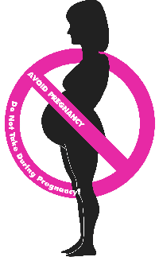
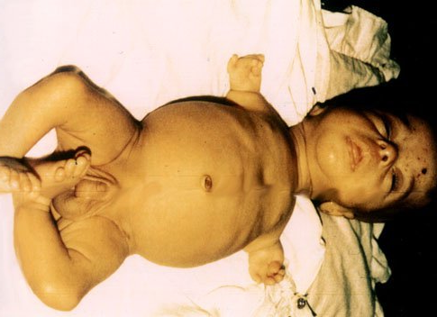
Case Series and Case Reports
No comparison group!
Unusual/dramatic outcome (Phocomelia in offsprings of mothers receiving Thalidomide)
Sufficient for hypothesis generation (Need more studies)

Slide 11
Cross-sectional studies
Also called a prevalence study
Prevalence measured by conducting a survey of the population of interest e.g.,
  Interview of clinic patients
  Random-digit-dialing telephone survey
Mainstay of descriptive epidemiology
  patterns of occurrence by time, place and person
  estimate disease frequency (prevalence) and time trends
Useful for:
  program planning
  resource allocation
  generate hypotheses

Slide 12
Cross-sectional Studies
Select sample of individual subjects and report disease prevalence (%)
Can also simultaneously classify subjects according to exposure and disease status to draw inferences
  Describe association between exposure and disease prevalence.

Slide 13
Examples
  Prevalence of Asthma in School-aged Children in Lahore
  Trends and changing epidemiology of hepatitis in Pakistan
  Characteristics of teenage smokers in Multan
  Prevalence of stroke in Gujranwala

Slide 14
Concept of the Prevalence “Pool”
New cases
Recovery
Death

Slide 15
Cross-sectional Studies
Advantages:
  quick, inexpensive, useful
Disadvantages:
  uncertain temporal relationships
  survivor effect
  low prevalence due to
    rare disease
    short duration

Slide 16
Cross-sectional Study
Data collected at a single point in time
Describes associations
Prevalence
Burden of Disease
A “Snapshot”

Slide 17
Cross-Sectional Study: Definition
Conducted at a single point in time or over a short period of time. No Follow-up.
Exposure status and disease status are measured at one point in time or over a period.
Prevalence studies. Comparison of prevalence among exposed and non-exposed.

Slide 18
Cross-Sectional Studies
Exposure and outcome status are determined at the same time
Examples include:
  Behavioral Risk Factor Surveillance System (BRFSS) - http://www.cdc.gov/brfss/
  National Health and Nutrition Surveys (NHANES) - http://www.cdc.gov/nchs/nhanes.htm
Also include most opinion and political polls
Notes:
A cross-sectional study is like a snapshot of the exposures and outcomes present in a population at a given point in time. Both exposure status and outcome status of people in the population are determined at the same time.
One example of a cross-sectional study is the Behavioral Risk Factor Surveillance System, known as the BRFSS. The BRFSS is a nationwide survey that asks individuals about health and lifestyle factors, such as exercise, smoking behavior, alcohol consumption, nutritional habits, and so on. At the same time, the survey asks for information on the person’s health outcomes, such as cancer, cardiovascular disease, and diabetes.
The National Health and Nutrition Surveys, or NHANES, is another nationwide cross-sectional study. It captures similar health information about study participants, but also gathers detailed information about nutritional habits, and types and amounts of foods eaten. The growth chart for children located in most pediatrician offices was developed using data from NHANES.
Most opinion or political polls are also cross-sectional in nature. They assess opinions at one point in time.

Slide 19
Cross-sectional: Advantages
Usually use population-based samples, instead of convenient samples. Generalizability.
Conducted over short period of time
Relatively inexpensive

Slide 20
Cross-sectional: Disadvantages
Difficult to separate cause from effect, because measurement of exposure and disease is conducted at the same time.
A persons exposure status at the time of the study may have little to do with their exposure status at the time the disease began.

Slide 21
Ecologic Studies
Aggregates of individuals.
Aggregates often defined by units: geographic region, school, health care facility.
Does the overall occurrence disease in a population correlate with occurrence of the exposure.
No individual data

Slide 23
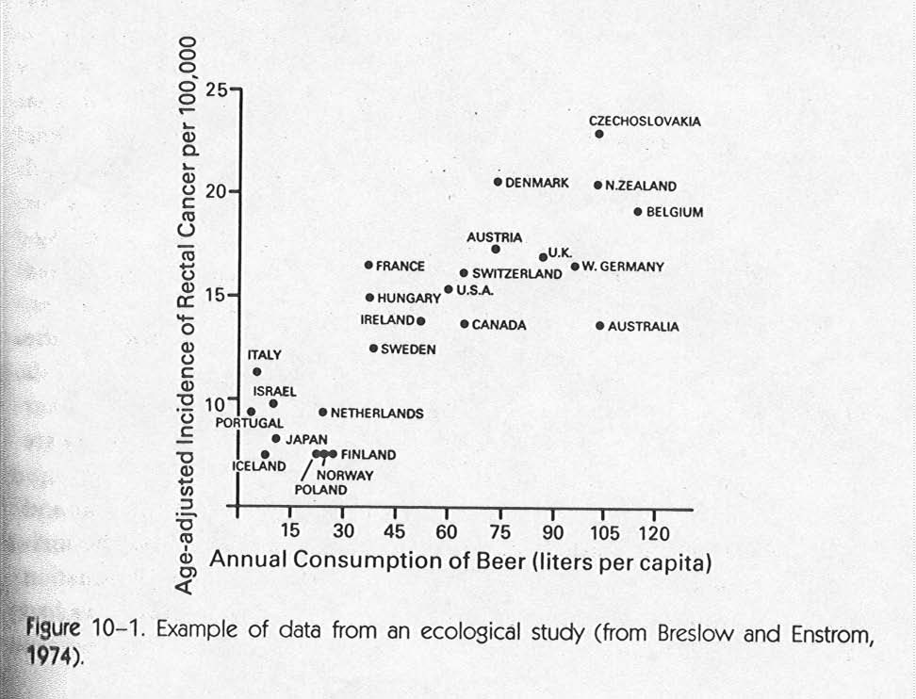

Slide 24
Ecologic Studies
Use aggregate data, used primarily for hypothesis
generation as opposed to hypothesis testing
Examples of aggregate data:
Disease rates (incidence, mortality, etc)
Birth rates
“Exposure” data: smoking rates, geographic residence,
air pollution data, mean income, per capita
consumption of saturated fats, proximity to nuclear
power plants

Slide 25
Ecologic Fallacy
Grouped data do not necessarily represent individual level data
Example: Fat intake and breast cancer rates with countries as the unit of measurement have consistently been found to be highly correlated.
But studies of individuals (cohort, case control studies) have not found any association with fat intake.

Slide 26
Why?
Possible reasons–countries with high fat intake are more likely to have other risk factors associated with breast cancer (i.e. late age at first pregnancy)
Or-- within population variability is low, but inter-population variability is high.
i.e. Extreme example– if everyone in a country had high fat intake, we would not be able to detect any excess because there would not be any population to compare them to with low fat intake

Slide 27
Examples
Ecological studies are useful for generation of hypotheses, supporting hypotheses, or for intervening at the population level.
Rates of stomach cancer declined dramatically after the advent of refrigeration in the 1930s–
Supports studies showing risk of stomach cancer increases with consumption of nitrates in preserved foods (sausage, lunch meat etc)
Smoking and lung cancer
Oral cancer and snuff use in the KPK

Slide 28
Summary
Descriptive Epidemiology
  Answers: Who, what, where, when
  Key Terms: Prevalence, person, place, time
  Hypothesis-generating
Analytic Epidemiology
  Answers: Why, how
  Key Terms: Measure of association
  Hypothesis-testing
Notes:
Descriptive epidemiology is used in an early phase of an investigation, to describe who, what, where, and when a health event is occurring. Prevalence, person, place, and time, are commonly used in descriptive epidemiology.
Analytic epidemiology answers why and how a health event is occurring. The process of analytic epidemiology involves developing a hypothesis based on descriptive data, and designing and conducting a study to test the hypothesis. The data is analyzed to calculate a measure of association, a relative risk or odds ratio, to determine whether the association between an exposure and an outcome is statistically significant.

